Slide 1
Process Operability Class Materials
Process Flexibility
Basic flowsheet
Design with Operability
LC
1
FC
1
Copyright © Thomas Marlin 2019
The copyright holder provides a royalty-free license for use of this material at non-profit educational institutions

Slide 2
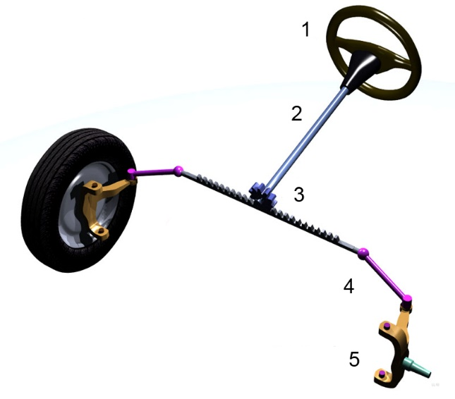
Key Operability issues
1. Operating window
2. Flexibility/
controllability
3. Reliability
4. Safety & equipment protection
5. Efficiency & profitability
6. Operation during transitions
7. Dynamic Performance
8. Monitoring & diagnosis
Chapter 3 Flexibility
When you design an automobile, your customers would appreciate a way to steer the vehicle! Seems pretty obvious, but have you thought about the way to control all of the equipment that you have learned about: flow, heat transfer mass transfer, chemical reactor, etc.
One important aspect of the design is the addition of flexibility – ways to adjust the operation
This diagram shows rack and pinion steering. The engineers had to include this in the design.
What about your process design?
Citation 6

Slide 3
Key Operability issues
1. Operating window
2. Flexibility/
controllability
3. Reliability
4. Safety & equipment protection
5. Efficiency & profitability
6. Operation during transitions
7. Dynamic Performance
8. Monitoring & diagnosis
Chapter 3 Flexibility
Where do we stand after completing the previous chapter on the Operating Window?
We have selected candidate controlled variables and candidate adjusted variables based on steady-state behavior – it provides the range of effects required.
In the heat exchanger network, the operating window requires the heat transfer to be adjusted.
What adjustable equipment can be installed to affect the heat duty (remember, the heat exchanger has been installed)?
this chapter
How can the adjustments be automated?
subsequent chapters

Slide 4
Key Operability issues
1. Operating window
2. Flexibility/
controllability
3. Reliability
4. Safety & equipment protection
5. Efficiency & profitability
6. Operation during transitions
7. Dynamic Performance
8. Monitoring & diagnosis
Chapter 3 Flexibility
Lesson Outline
Flexibility for Fluid Flow
Flexibility for Heat Transfer
Production Control
Unit Operation
- Boiler and Steam System

Slide 5
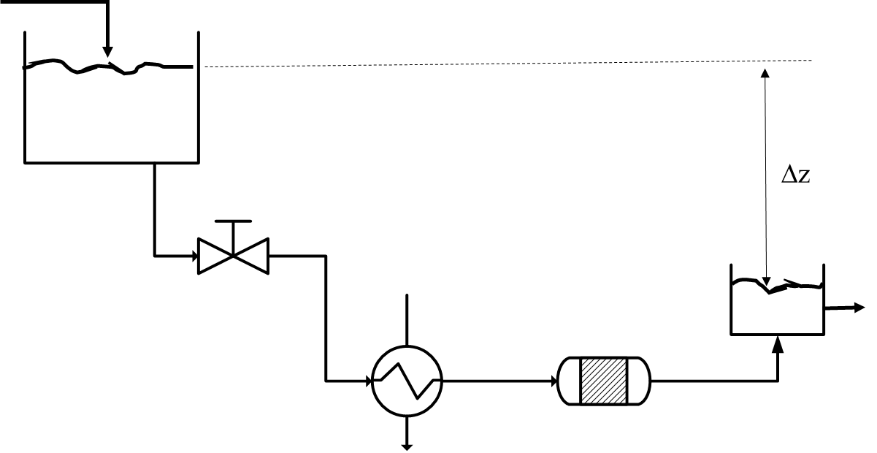
Key Operability issues
1. Operating window
2. Flexibility/
controllability
3. Reliability
4. Safety & equipment protection
5. Efficiency & profitability
6. Operation during transitions
7. Dynamic Performance
8. Monitoring & diagnosis
Chapter 3 Flexibility
To state the obvious, we have to move material around in the process. Since Chemical Engineering deals mostly with fluids, we will concentrate on
Flexibility For Fluid Flow
What affects the flowrate?
What can be adjusted?

Slide 6
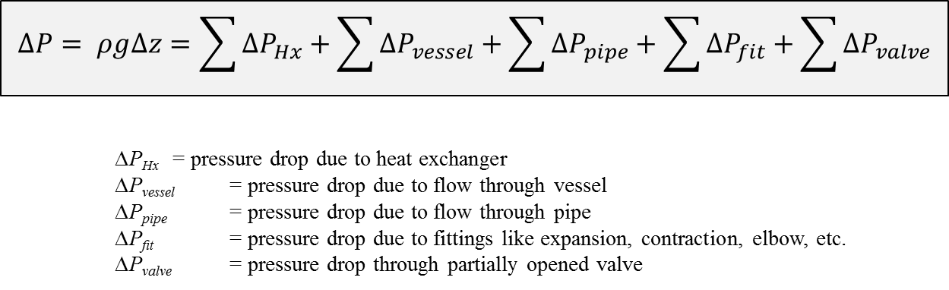
Key Operability issues
1. Operating window
2. Flexibility/
controllability
3. Reliability
4. Safety & equipment protection
5. Efficiency & profitability
6. Operation during transitions
7. Dynamic Performance
8. Monitoring & diagnosis
Chapter 3 Flexibility
Liquids
Flexibility For Fluid Flow
Each term depends on the flow rate

Slide 7
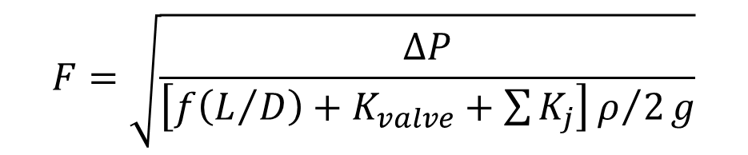
Key Operability issues
1. Operating window
2. Flexibility/
controllability
3. Reliability
4. Safety & equipment protection
5. Efficiency & profitability
6. Operation during transitions
7. Dynamic Performance
8. Monitoring & diagnosis
Chapter 3 Flexibility
Liquids
Flexibility For Fluid Flow
∆P_{pipe} = pressure drop due to flow through pipe = f (L/D) ρF²/2g
∆P_{i} = pressure drop for all other elements = K_{i} ρF²/2g
$$F=\sqrt{\frac{∆P}{\left[f\left(L/D\right)+K_{valve}+\sum{K_{j}}\right]ρ/2g}}$$
The flow is influenced by the adjustable valve opening
j = summation over all elements except the valve

Slide 8
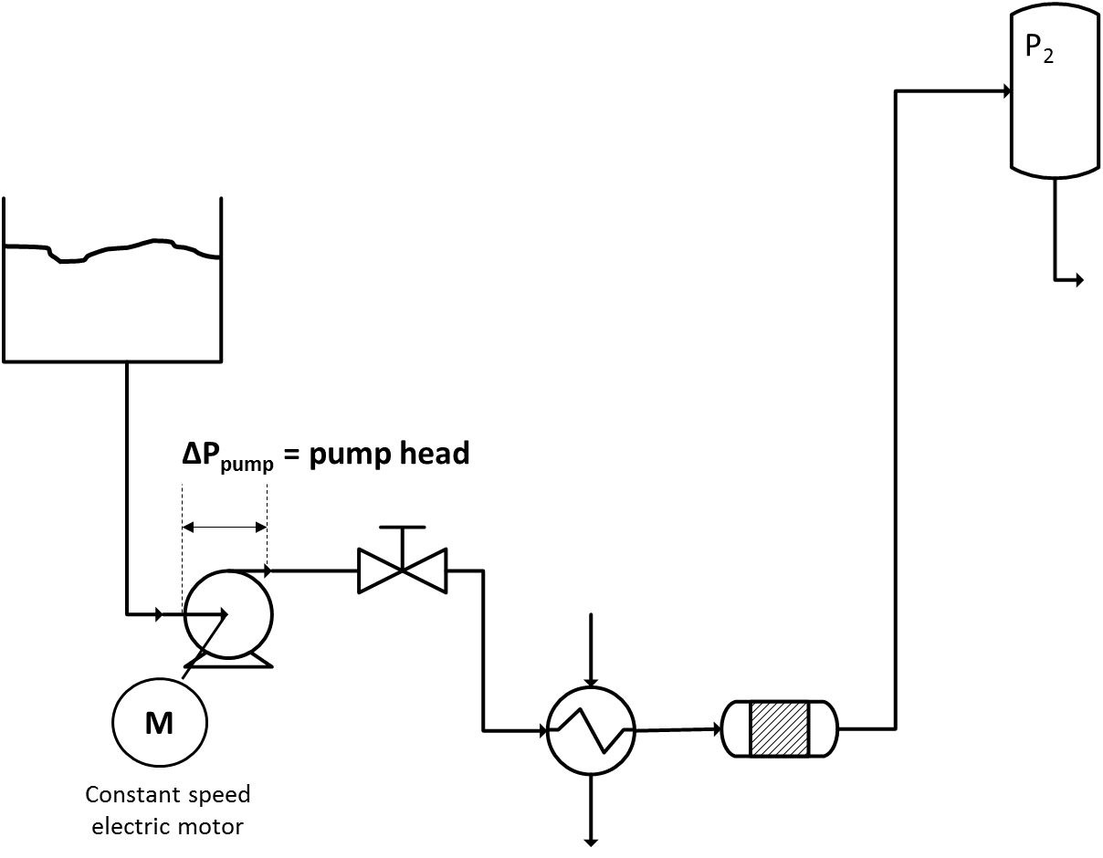
Key Operability issues
1. Operating window
2. Flexibility/
controllability
3. Reliability
4. Safety & equipment protection
5. Efficiency & profitability
6. Operation during transitions
7. Dynamic Performance
8. Monitoring & diagnosis
Chapter 3 Flexibility
Liquids
Flexibility For Fluid Flow
We cannot build our plants on a hillside, so we need pumps.
Centrifugal pump

Slide 9
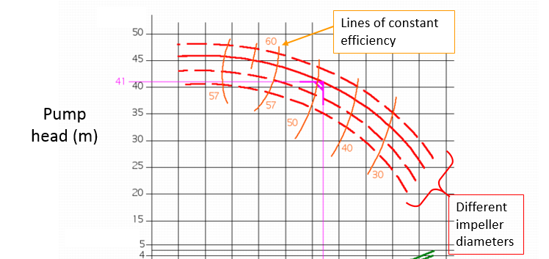

Key Operability issues
1. Operating window
2. Flexibility/
controllability
3. Reliability
4. Safety & equipment protection
5. Efficiency & profitability
6. Operation during transitions
7. Dynamic Performance
8. Monitoring & diagnosis
Chapter 3 Flexibility
Liquids
Flexibility For Fluid Flow
Typical pump performance curve
Citation 1

Slide 10
Key Operability issues
1. Operating window
2. Flexibility/
controllability
3. Reliability
4. Safety & equipment protection
5. Efficiency & profitability
6. Operation during transitions
7. Dynamic Performance
8. Monitoring & diagnosis
Chapter 3 Flexibility
Liquids
Flow flexibility through valve adjustments
P₂
Centrifugal pump
Constant speed electric motor
M
Percent valve opening
60%
80%
100%
Pump head
To achieve the desired flow, we vary the system resistance by changing the valve opening that affects the valve pressure drop.
Head at outlet of pump
System losses
Flow rate with the valve 100% open.
Flow rate

Slide 11
Key Operability issues
1. Operating window
2. Flexibility/
controllability
3. Reliability
4. Safety & equipment protection
5. Efficiency & profitability
6. Operation during transitions
7. Dynamic Performance
8. Monitoring & diagnosis
Chapter 3 Flexibility
Liquids
P₂
Flow flexibility through speed adjustments
Centrifugal pump
M
To achieve the desired flow, we vary the the pump speed (rpm) with all valves fully opened.
Head at outlet of pump
Pump head curves for different speeds with the same impeller diameter
Flow rate

Slide 12
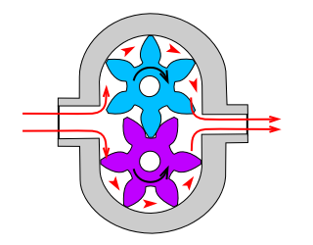
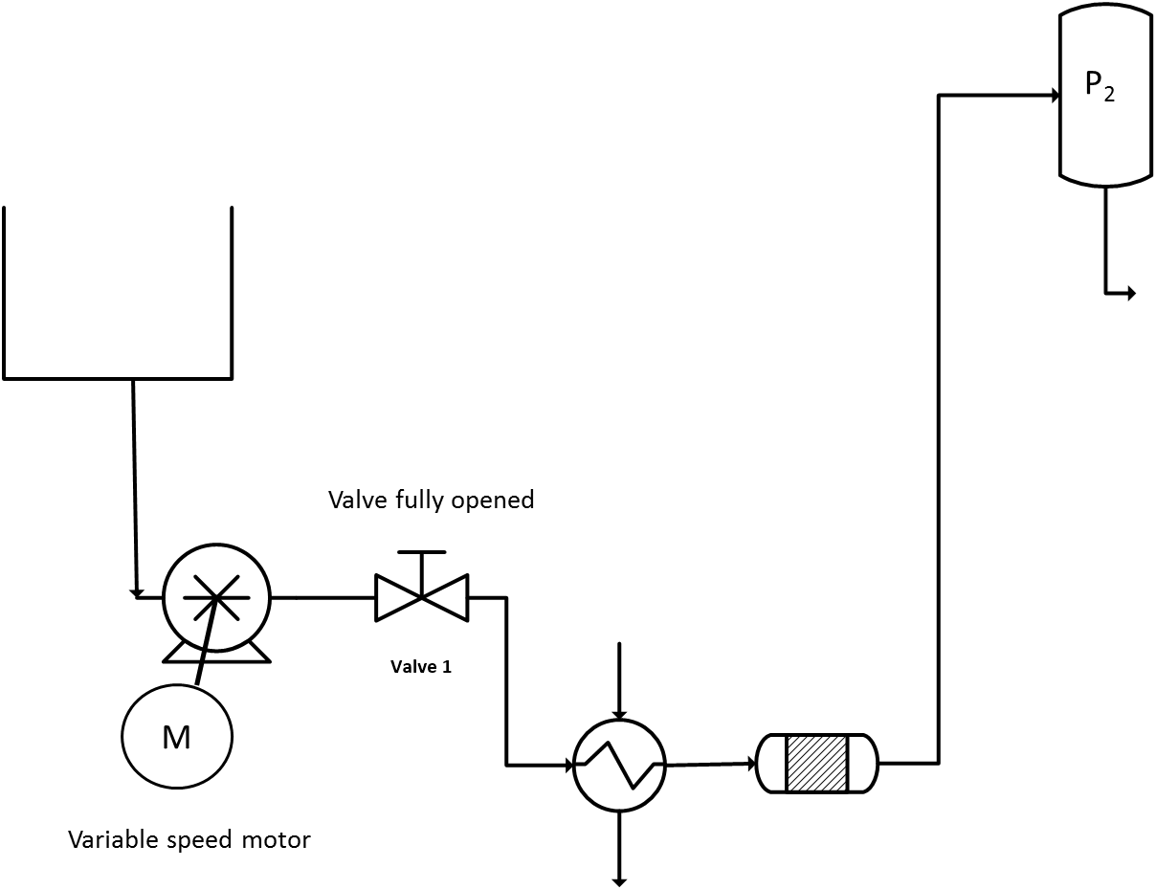
Key Operability issues
1. Operating window
2. Flexibility/
controllability
3. Reliability
4. Safety & equipment protection
5. Efficiency & profitability
6. Operation during transitions
7. Dynamic Performance
8. Monitoring & diagnosis
Chapter 3 Flexibility
Liquids
Flexibility For Fluid Flow
Positive displacement pumps
Positive displacement Gear pump
Citation 2
Flexibility through speed adjustments, NOT valve adjustments

Slide 13
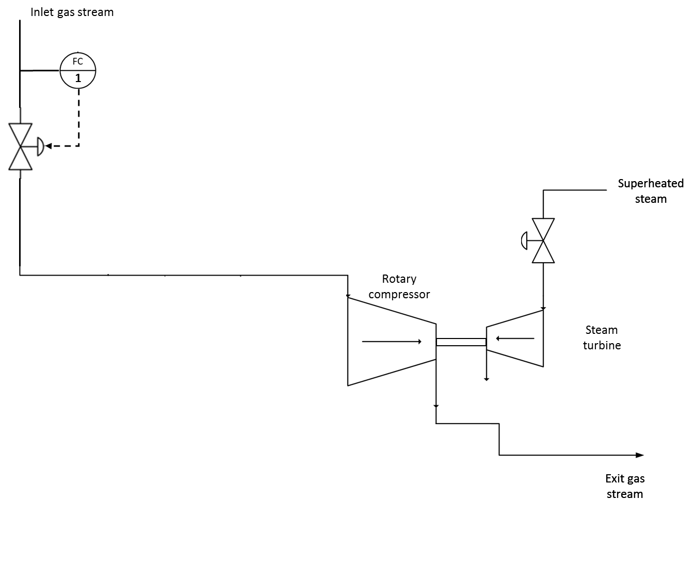
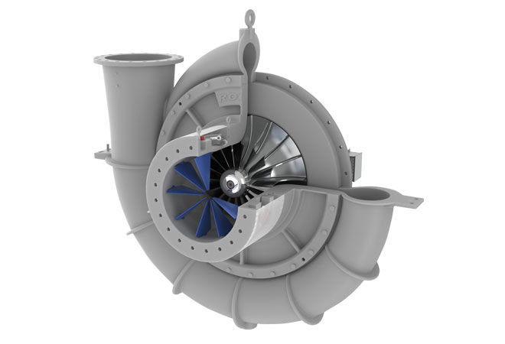
Key Operability issues
1. Operating window
2. Flexibility/
controllability
3. Reliability
4. Safety & equipment protection
5. Efficiency & profitability
6. Operation during transitions
7. Dynamic Performance
8. Monitoring & diagnosis
Chapter 3 Flexibility
Gases
Flexibility For Fluid Flow
Compressor to increase gas pressure
Centrifugal compressor
Citation 3
How is flexibility introduced?

Slide 14
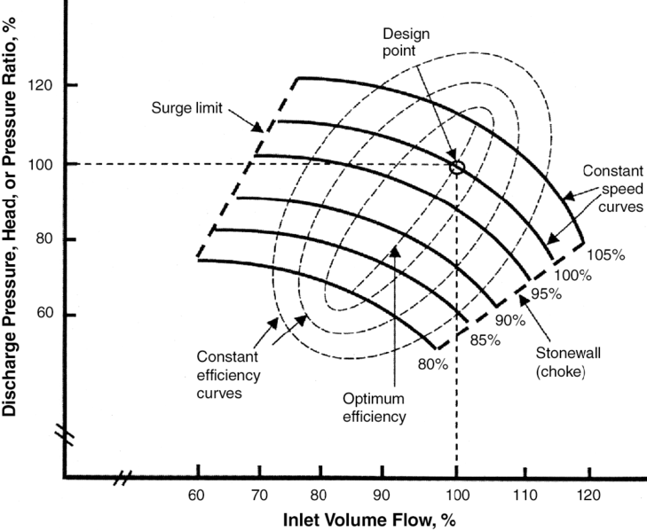
Key Operability issues
1. Operating window
2. Flexibility/
controllability
3. Reliability
4. Safety & equipment protection
5. Efficiency & profitability
6. Operation during transitions
7. Dynamic Performance
8. Monitoring & diagnosis
Chapter 3 Flexibility
Gases
Flexibility For Fluid Flow
Compressor to increase gas pressure
Citation 5

Slide 15
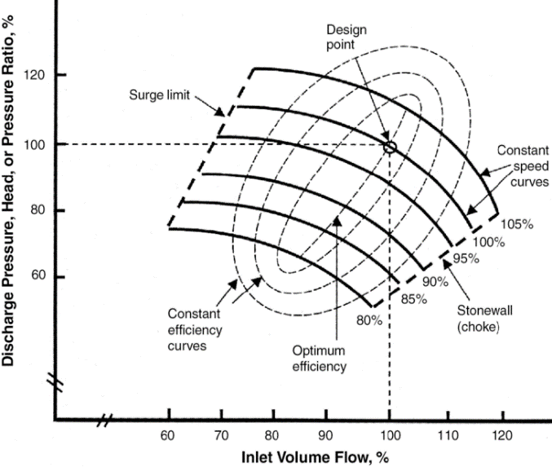
Key Operability issues
1. Operating window
2. Flexibility/
controllability
3. Reliability
4. Safety & equipment protection
5. Efficiency & profitability
6. Operation during transitions
7. Dynamic Performance
8. Monitoring & diagnosis
Chapter 3 Flexibility
Gases
Flexibility For Fluid Flow
Compressor to increase gas pressure
The compressor map shows that
The variables are the volumetric flow rate and pressure ratio
The speed affects the head
The maximum efficiency can be predicted
A minimum flow is needed to prevent surge
A maximum flow occurs at the stonewall

Slide 16
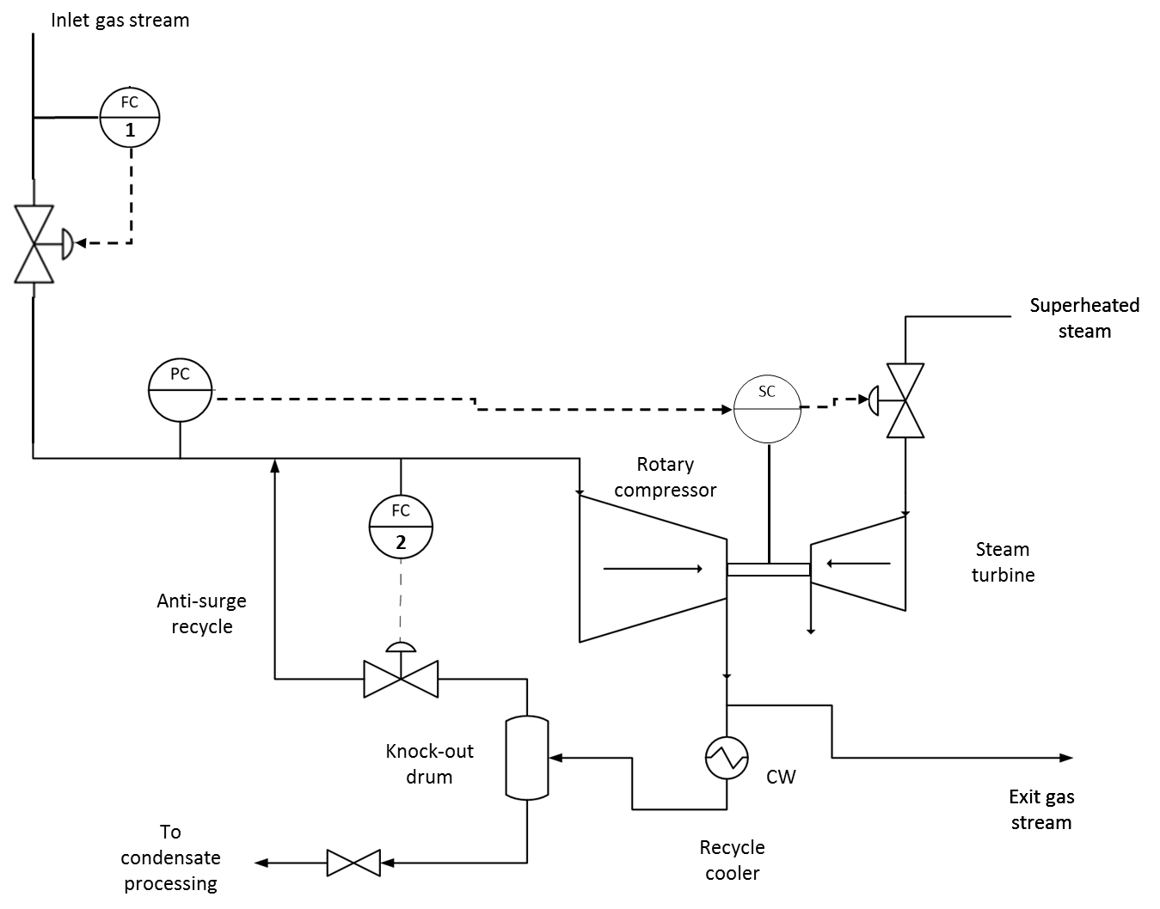
Key Operability issues
1. Operating window
2. Flexibility/
controllability
3. Reliability
4. Safety & equipment protection
5. Efficiency & profitability
6. Operation during transitions
7. Dynamic Performance
8. Monitoring & diagnosis
Chapter 3 Flexibility
Gases
Flexibility For Fluid Flow
Compressor to increase gas pressure
Add flexibility

Slide 17

Key Operability issues
1. Operating window
2. Flexibility/
controllability
3. Reliability
4. Safety & equipment protection
5. Efficiency & profitability
6. Operation during transitions
7. Dynamic Performance
8. Monitoring & diagnosis
Chapter 3 Flexibility
Lesson Outline
Flexibility for Fluid Flow
Flexibility for Heat Transfer
Production Control
Unit Operation
- Boiler and Steam System

Slide 18
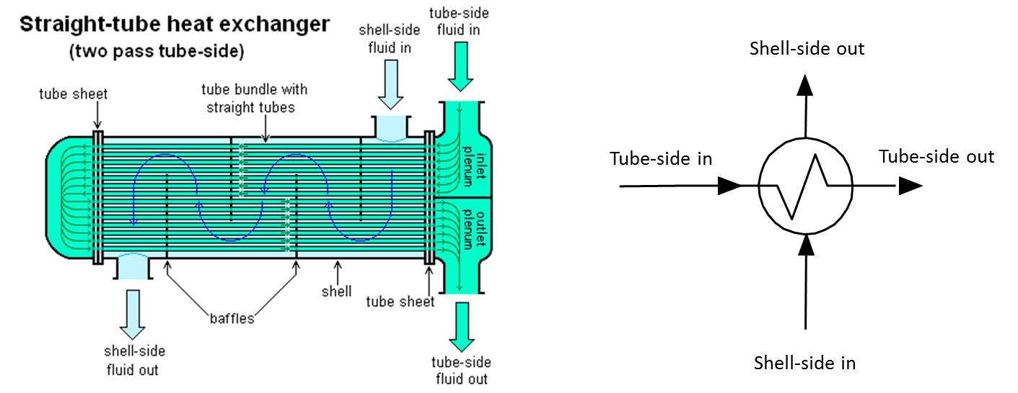
Key Operability issues
1. Operating window
2. Flexibility/
controllability
3. Reliability
4. Safety & equipment protection
5. Efficiency & profitability
6. Operation during transitions
7. Dynamic Performance
8. Monitoring & diagnosis
Chapter 3 Flexibility
Flexibility For Heat Transfer
Citation 4
Q = U A ∆T*
Flexibility can be introduced by influencing any of the terms; U , A , or ∆T*.
∆T* modified for equipment design, e.g., log-mean

Slide 19
Key Operability issues
1. Operating window
2. Flexibility/
controllability
3. Reliability
4. Safety & equipment protection
5. Efficiency & profitability
6. Operation during transitions
7. Dynamic Performance
8. Monitoring & diagnosis
Chapter 3 Flexibility
Flexibility For Heat Transfer
Q = U A ∆T*
Flexibility through changing one total flow rate
T
Process stream
Influences heat transfer coefficient
Utility adjustment does not influence production
Utility stream
Utility stream (cooling water, steam, etc.) must be provided in the plant design
∆T* modified for equipment design, e.g., log-mean

Slide 20
Key Operability issues
1. Operating window
2. Flexibility/
controllability
3. Reliability
4. Safety & equipment protection
5. Efficiency & profitability
6. Operation during transitions
7. Dynamic Performance
8. Monitoring & diagnosis
Chapter 3 Flexibility
Class Workshop: Add flexibility to the heat exchanger to achieve the goal for three different scenarios. You may add piping and valve(s).
Goal: Maintain cold effluent T_{cold} at a desired value
Freedom to adjust total flows
Stream A Stream B
1. Constant Adjustable
2. Adjustable Constant
3. Constant Constant
T
Stream A
(cold)
Stream B
(hot)
No phase change occurs to either stream.

Slide 21
Key Operability issues
1. Operating window
2. Flexibility/
controllability
3. Reliability
4. Safety & equipment protection
5. Efficiency & profitability
6. Operation during transitions
7. Dynamic Performance
8. Monitoring & diagnosis
Chapter 3 Flexibility
Workshop solution
Freedom to adjust total flow rates
Stream A Stream B
a. Constant Adjustable
b. Adjustable Constant
c. Constant Constant
a
TC
Stream A
(cold)
Stream B
(hot)
b
c
TC
TC
Stream A
(cold)
Stream A
(cold)
Stream B
(hot)
Stream B
It is not typical to adjust a stream flow to control its temperature; if the temperature is important, likely the flow rate is also important.
(hot)

Slide 22
Key Operability issues
1. Operating window
2. Flexibility/
controllability
3. Reliability
4. Safety & equipment protection
5. Efficiency & profitability
6. Operation during transitions
7. Dynamic Performance
8. Monitoring & diagnosis
Chapter 3 Flexibility
Class Workshop: The previous solution for Case c is repeated below. The flexibility has a limited range of adjustment; complete by-pass is not possible. Improve the design to allow greater range from 0% to 100% by-pass flow.
TC
Stream A
(cold)
Stream B
(hot)

Slide 23
Key Operability issues
1. Operating window
2. Flexibility/
controllability
3. Reliability
4. Safety & equipment protection
5. Efficiency & profitability
6. Operation during transitions
7. Dynamic Performance
8. Monitoring & diagnosis
Chapter 3 Flexibility
Workshop solution
TC
fc
Stream A
(cold)
v100
fo
v200
Stream B
(hot)
v200 percent open
100
100
v100 percent open
0
0
0 Controller output (%) 100

Slide 24
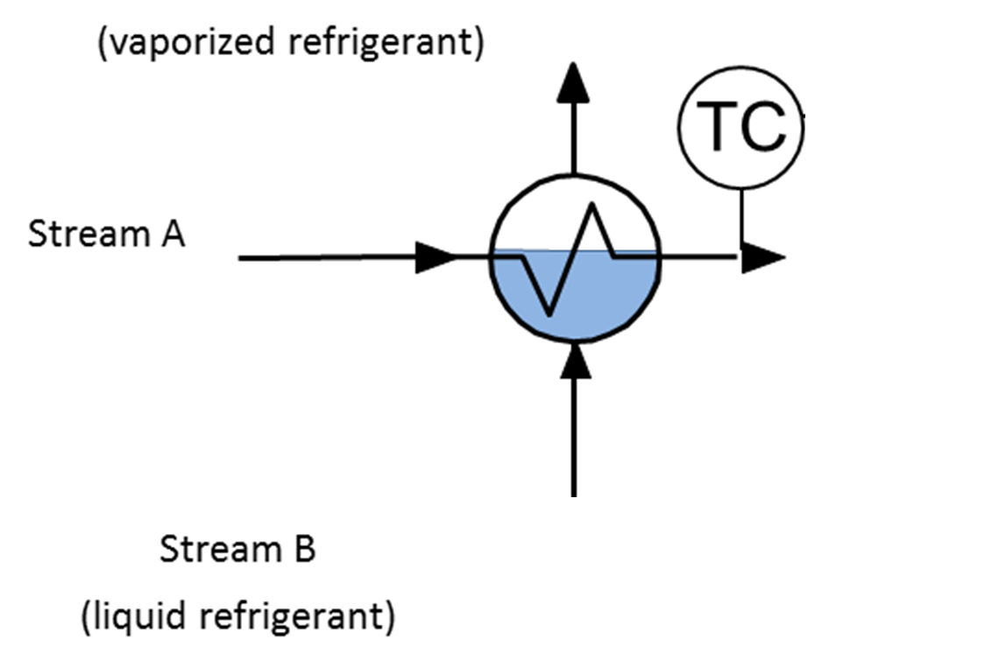
Key Operability issues
1. Operating window
2. Flexibility/
controllability
3. Reliability
4. Safety & equipment protection
5. Efficiency & profitability
6. Operation during transitions
7. Dynamic Performance
8. Monitoring & diagnosis
Chapter 3 Flexibility
Class Workshop: Liquid refrigerant is vaporizer while providing cooling in the heat exchanger shown below. Add flexibility so that the Stream A exit temperature can be controlled.
Helpful hint: The liquid level in the heat exchanger is stable.

Slide 25
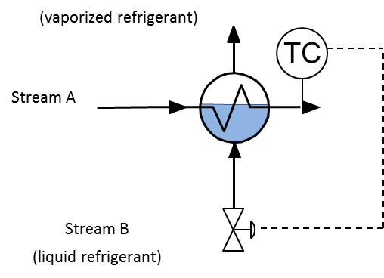
Key Operability issues
1. Operating window
2. Flexibility/
controllability
3. Reliability
4. Safety & equipment protection
5. Efficiency & profitability
6. Operation during transitions
7. Dynamic Performance
8. Monitoring & diagnosis
Chapter 3 Flexibility
Workshop solution: The rate of heat transfer depends on the area of the tubes that are in contact with the liquid refrigerant. Flexibility changes the liquid level.

Slide 26
Key Operability issues
1. Operating window
2. Flexibility/
controllability
3. Reliability
4. Safety & equipment protection
5. Efficiency & profitability
6. Operation during transitions
7. Dynamic Performance
8. Monitoring & diagnosis
Chapter 3 Flexibility
Class Workshop: The stirred tank in the figure requires heating and cooling at different times. Add flexibility to provide the heat transfer.
Feed
Heat transfer medium
Effluent

Slide 27
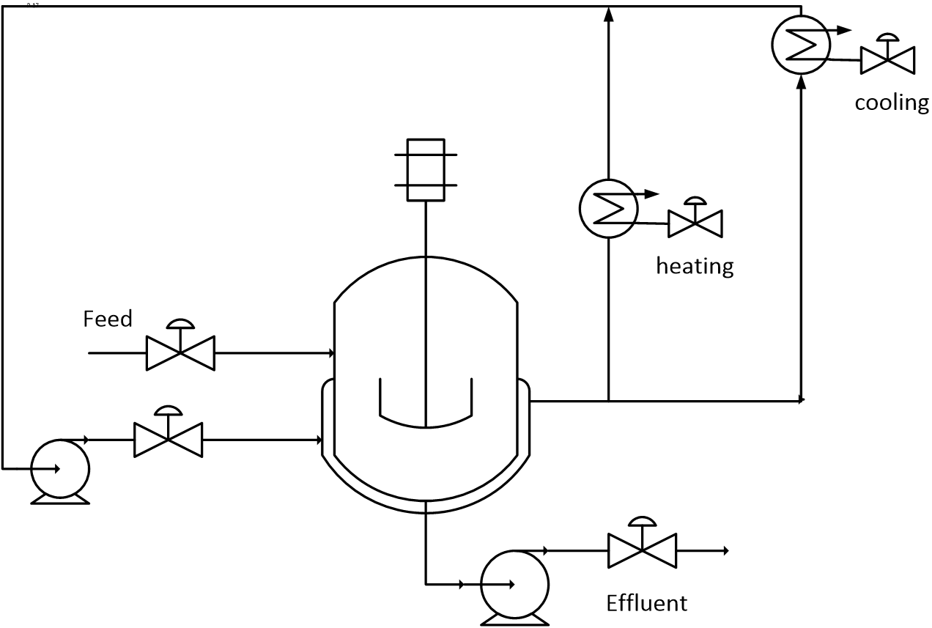
Key Operability issues
1. Operating window
2. Flexibility/
controllability
3. Reliability
4. Safety & equipment protection
5. Efficiency & profitability
6. Operation during transitions
7. Dynamic Performance
8. Monitoring & diagnosis
Chapter 3 Flexibility
Workshop solution: This design also includes a barrier between the heat and cooling fluids and the stirred tank.

Slide 28
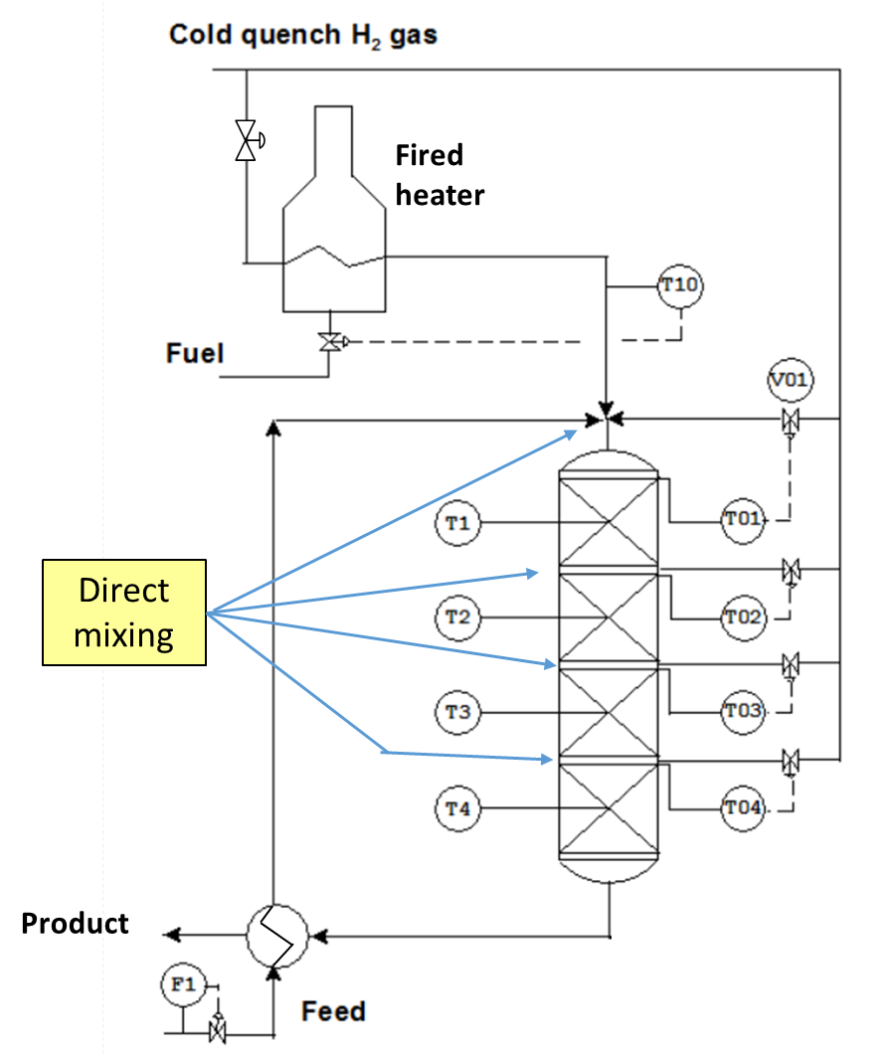
Key Operability issues
1. Operating window
2. Flexibility/
controllability
3. Reliability
4. Safety & equipment protection
5. Efficiency & profitability
6. Operation during transitions
7. Dynamic Performance
8. Monitoring & diagnosis
Chapter 3 Flexibility
Flexibility For Heat Transfer – Direct Mixing
Flexibility can be introduced using direct mixing.
The hydrocracker involves highly exothermic reactions.

Slide 29
Key Operability issues
1. Operating window
2. Flexibility/
controllability
3. Reliability
4. Safety & equipment protection
5. Efficiency & profitability
6. Operation during transitions
7. Dynamic Performance
8. Monitoring & diagnosis
Chapter 3 Flexibility
Class Workshop: The design involves utilities for heating and cooling. Modify the design to retain flexibility and reduce utility costs.

Slide 30
Key Operability issues
1. Operating window
2. Flexibility/
controllability
3. Reliability
4. Safety & equipment protection
5. Efficiency & profitability
6. Operation during transitions
7. Dynamic Performance
8. Monitoring & diagnosis
Chapter 3 Flexibility
Class Workshop: The design involves utilities for heating and cooling. Modify the design to retain flexibility and reduce utility costs.
Proposed solution 1: Discuss the strengths and weaknesses.

Slide 31
Key Operability issues
1. Operating window
2. Flexibility/
controllability
3. Reliability
4. Safety & equipment protection
5. Efficiency & profitability
6. Operation during transitions
7. Dynamic Performance
8. Monitoring & diagnosis
Chapter 3 Flexibility
Class Workshop: The design involves utilities for heating and cooling. Modify the design to retain flexibility and reduce utility costs.
Proposed solution 2: Discuss the strengths and weaknesses.

Slide 32
Key Operability issues
1. Operating window
2. Flexibility/
controllability
3. Reliability
4. Safety & equipment protection
5. Efficiency & profitability
6. Operation during transitions
7. Dynamic Performance
8. Monitoring & diagnosis
Chapter 3 Flexibility
Lesson Outline
Flexibility for Fluid Flow
Flexibility for Heat Transfer
Production Control
Unit Operation
- Boiler and Steam System

Slide 33
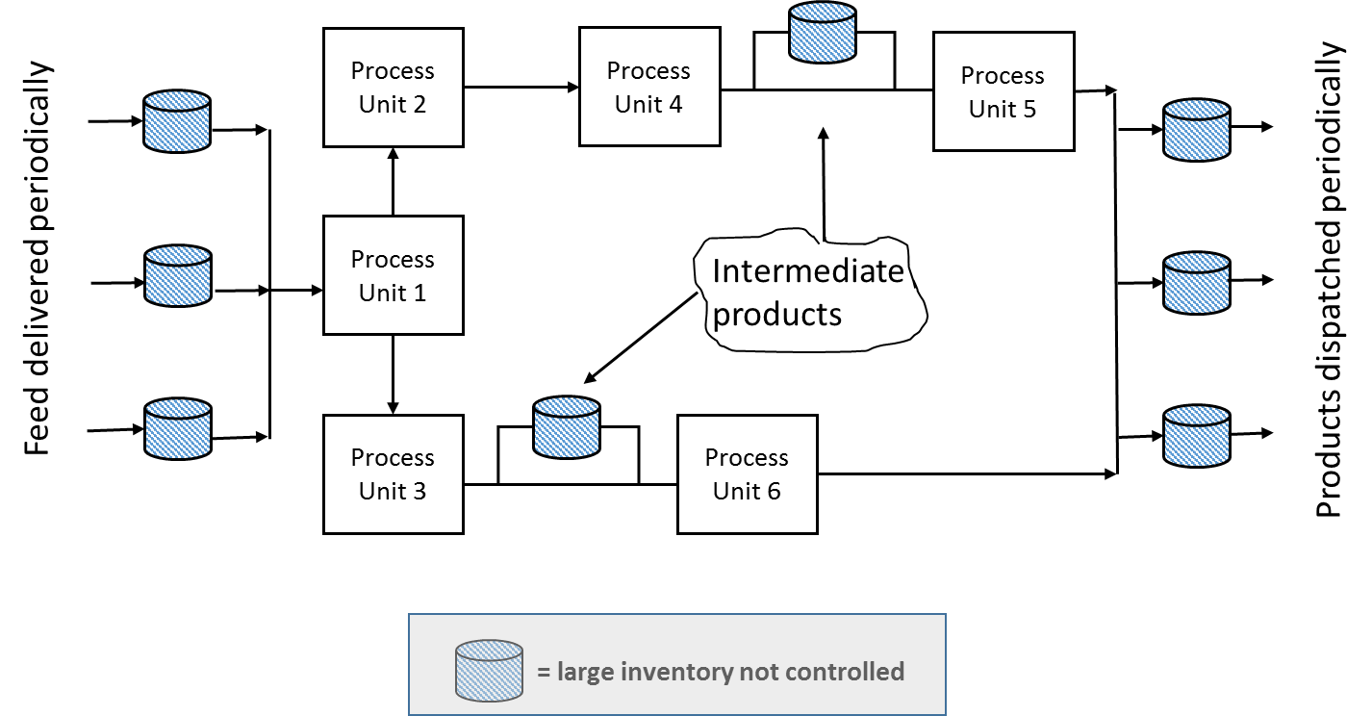
Key Operability issues
1. Operating window
2. Flexibility/
controllability
3. Reliability
4. Safety & equipment protection
5. Efficiency & profitability
6. Operation during transitions
7. Dynamic Performance
8. Monitoring & diagnosis
Chapter 3 Flexibility
Flexibility For Production Control
One flexible variable sets production rate
Flows through the remainder of the process respond automatically, without human action
Cannot match measured flows – measurement errors

Slide 34
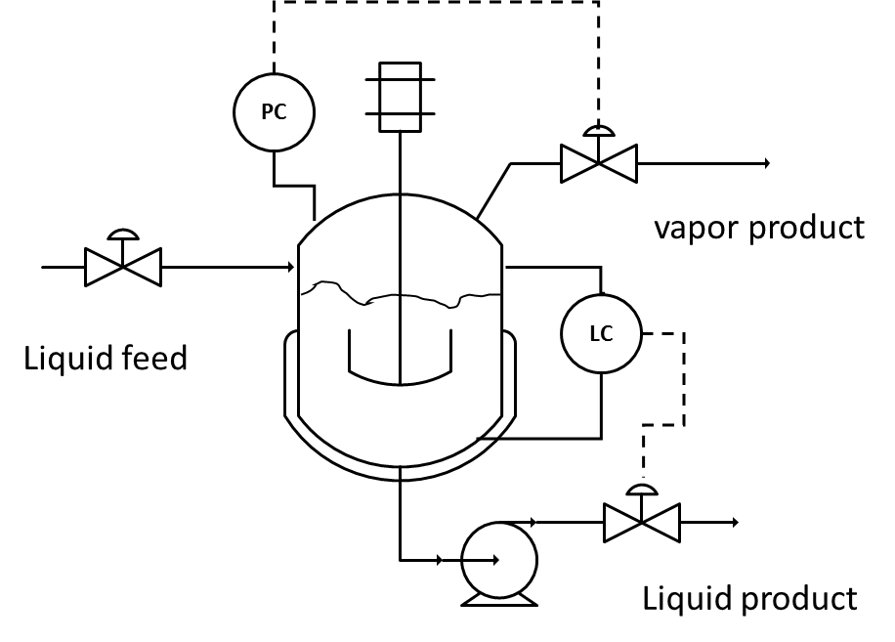
Key Operability issues
1. Operating window
2. Flexibility/
controllability
3. Reliability
4. Safety & equipment protection
5. Efficiency & profitability
6. Operation during transitions
7. Dynamic Performance
8. Monitoring & diagnosis
Chapter 3 Flexibility
Flexibility For Production Control
Workshop: Ensure that (average) flows match throughout the process by controlling inventories, so that no material accumulation occurs.

Slide 35
Key Operability issues
1. Operating window
2. Flexibility/
controllability
3. Reliability
4. Safety & equipment protection
5. Efficiency & profitability
6. Operation during transitions
7. Dynamic Performance
8. Monitoring & diagnosis
Chapter 3 Flexibility
Flexibility For Production Control
Solution: Level indicates liquid (solid) inventory, and pressure indicates vapor (or liquid-filled) inventory.

Slide 36
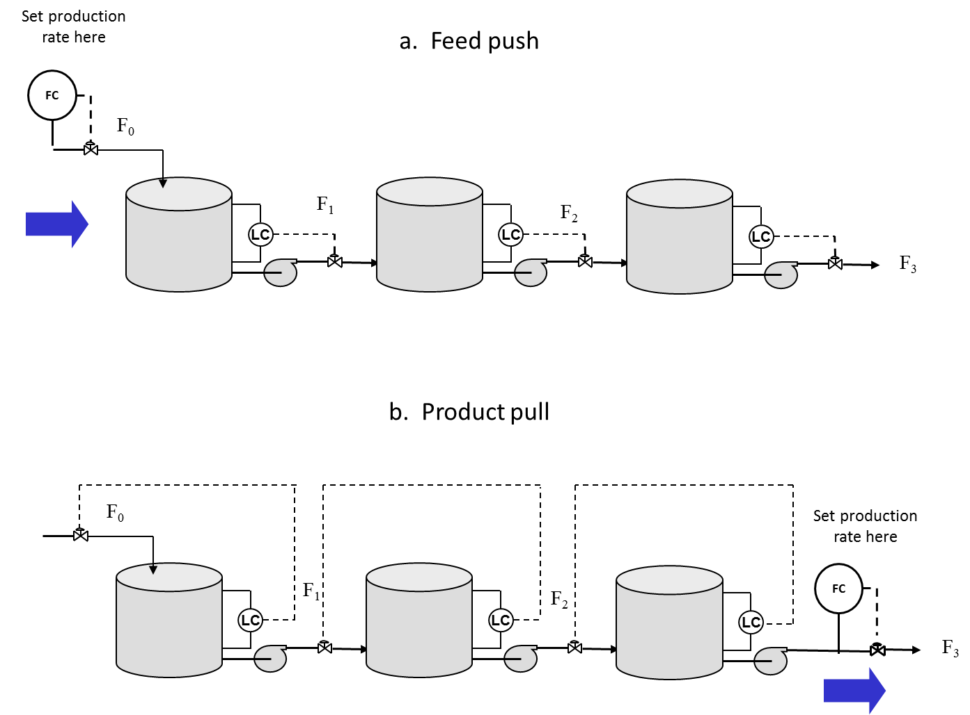
Key Operability issues
1. Operating window
2. Flexibility/
controllability
3. Reliability
4. Safety & equipment protection
5. Efficiency & profitability
6. Operation during transitions
7. Dynamic Performance
8. Monitoring & diagnosis
Chapter 3 Flexibility
Flexibility For Production Control
Most production systems
Most utility systems

Slide 37
Key Operability issues
1. Operating window
2. Flexibility/
controllability
3. Reliability
4. Safety & equipment protection
5. Efficiency & profitability
6. Operation during transitions
7. Dynamic Performance
8. Monitoring & diagnosis
Chapter 3 Flexibility
Flexibility For Production Control
IC
IC
IC
IC
IC
IC
IC
Production rate controller
IC
= inventory controller

Slide 38
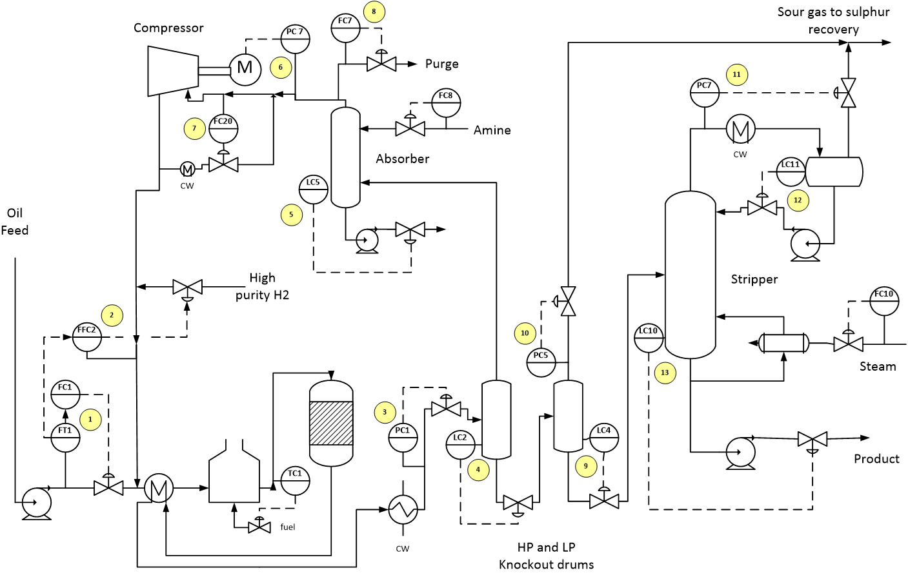
Chapter 3 Flexibility
Flexibility For Production Control

Slide 39
Key Operability issues
1. Operating window
2. Flexibility/
controllability
3. Reliability
4. Safety & equipment protection
5. Efficiency & profitability
6. Operation during transitions
7. Dynamic Performance
8. Monitoring & diagnosis
Chapter 3 Flexibility
Lesson Outline
Flexibility for Fluid Flow
Flexibility for Heat Transfer
Production Control
Unit Operation
- Boiler and Steam System

Slide 40
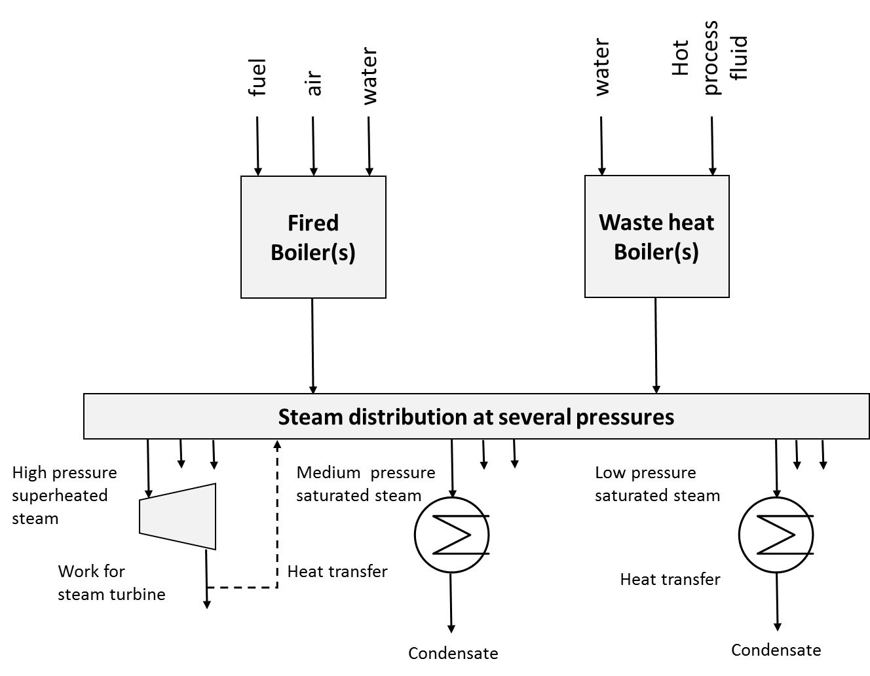
Key Operability issues
1. Operating window
2. Flexibility/
controllability
3. Reliability
4. Safety & equipment protection
5. Efficiency & profitability
6. Operation during transitions
7. Dynamic Performance
8. Monitoring & diagnosis
Chapter 3 Flexibility
Flexibility in Boiler and Steam System
Product system sets demands that must be satisfied by the steam system
Pull system!
Entire supply system balanced automatically
Superheated steam for work; saturated steam for heat transfer
Heat transfer at several temperatures (pressures)
All steam condensed and returned to boilers

Slide 41
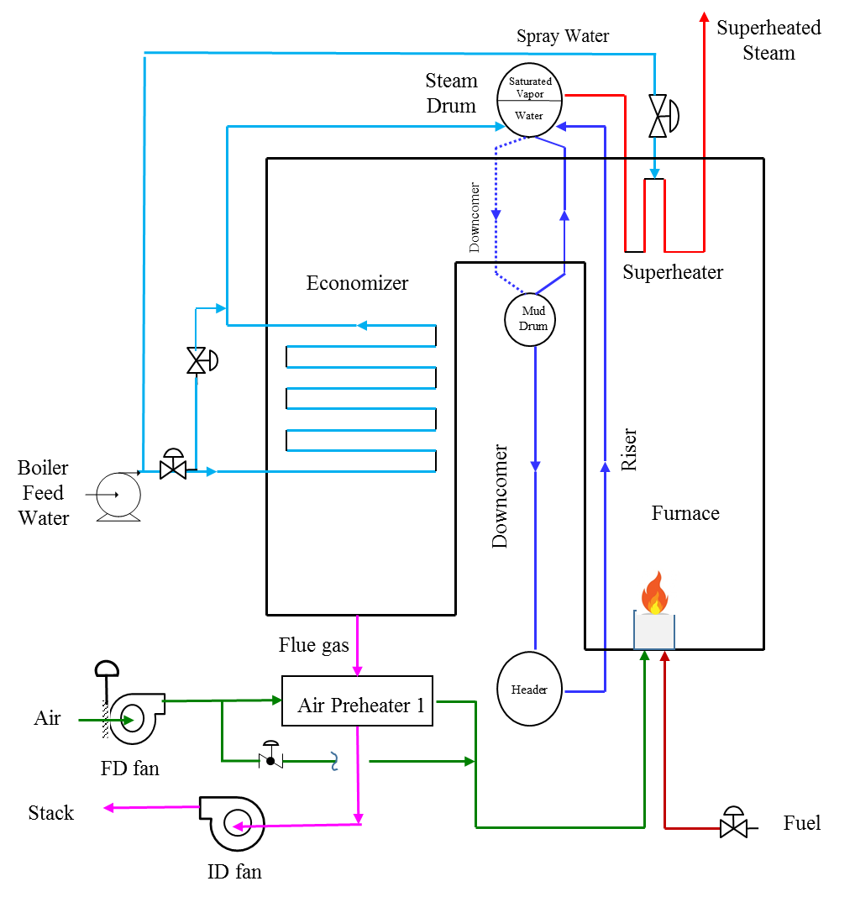
Key Operability issues
1. Operating window
2. Flexibility/
controllability
3. Reliability
4. Safety & equipment protection
5. Efficiency & profitability
6. Operation during transitions
7. Dynamic Performance
8. Monitoring & diagnosis
Chapter 3 Flexibility
Flexibility in Boiler and Steam System

Slide 42
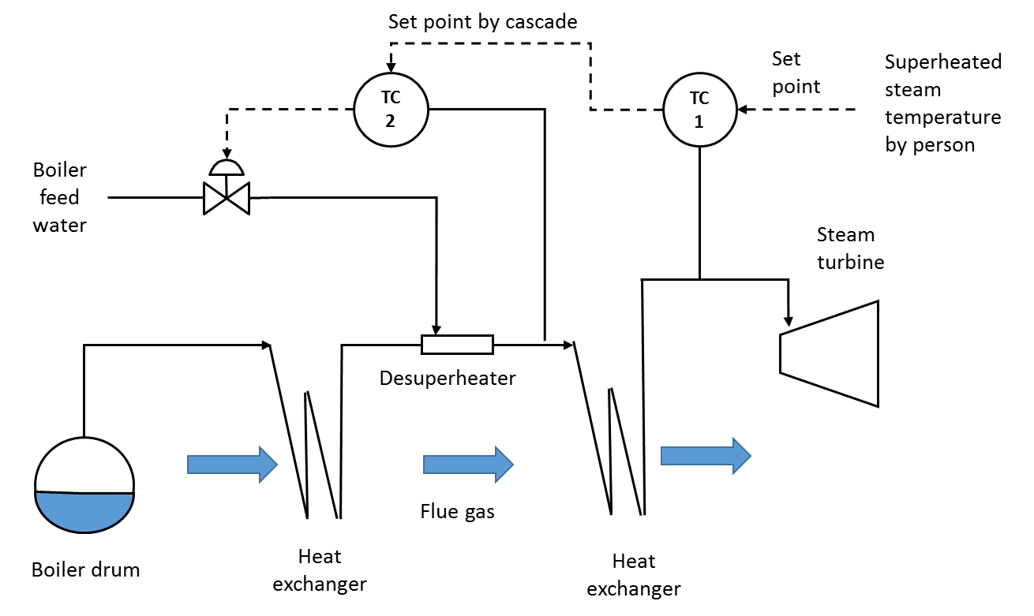
Key Operability issues
1. Operating window
2. Flexibility/
controllability
3. Reliability
4. Safety & equipment protection
5. Efficiency & profitability
6. Operation during transitions
7. Dynamic Performance
8. Monitoring & diagnosis
Chapter 3 Flexibility
Flexibility in Boiler and Steam System
High-pressure steam superheat flexibility
Faster dynamics
Direct mixing

Slide 43
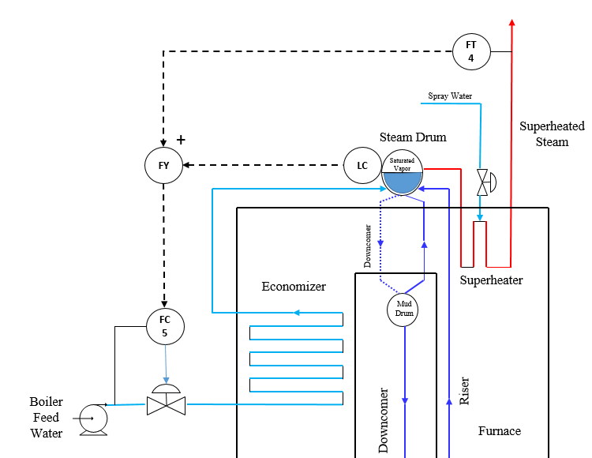
Key Operability issues
1. Operating window
2. Flexibility/
controllability
3. Reliability
4. Safety & equipment protection
5. Efficiency & profitability
6. Operation during transitions
7. Dynamic Performance
8. Monitoring & diagnosis
Chapter 3 Flexibility
Flexibility in Boiler and Steam System
Three-element Boiler Drum Level Control
Feedforward
Feedback
“Swell” occurs in riser and drum

Slide 44
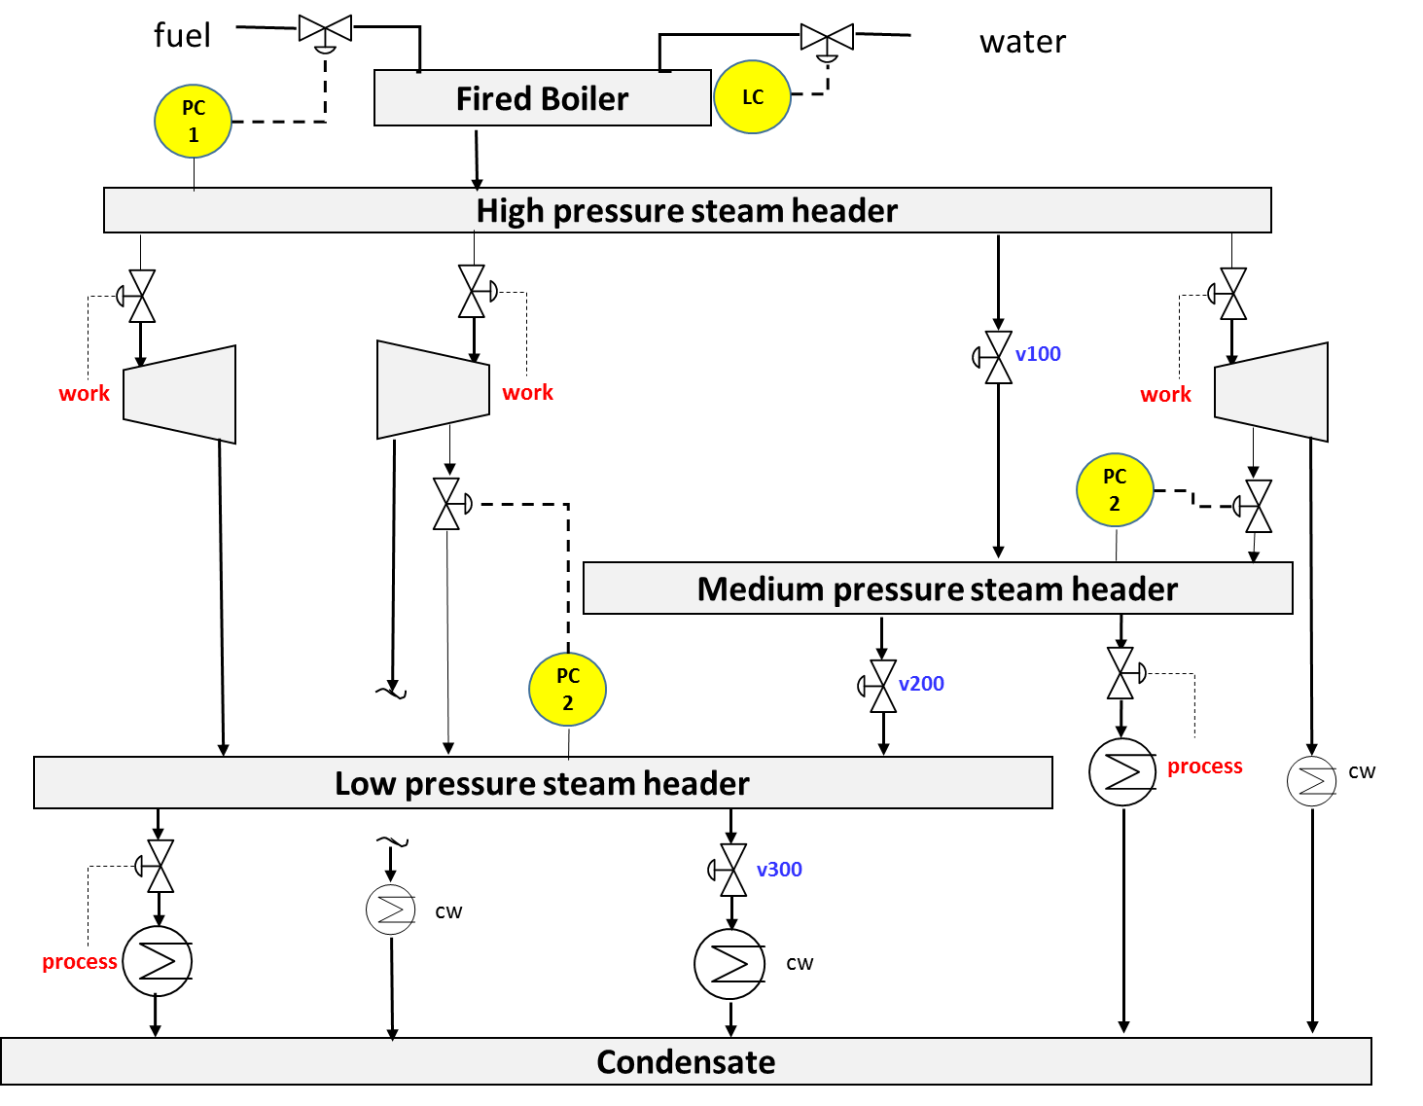
Key Operability issues
1. Operating window
2. Flexibility/
controllability
3. Reliability
4. Safety & equipment protection
5. Efficiency & profitability
6. Operation during transitions
7. Dynamic Performance
8. Monitoring & diagnosis
Chapter 3 Flexibility
Flexibility in Boiler and Steam System

Slide 45
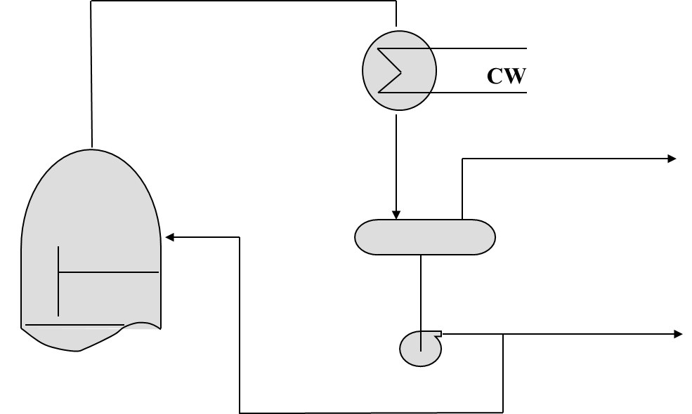
Key Operability issues
1. Operating window
2. Flexibility/
controllability
3. Reliability
4. Safety & equipment protection
5. Efficiency & profitability
6. Operation during transitions
7. Dynamic Performance
8. Monitoring & diagnosis
Chapter 3 Flexibility
Flexibility in Distillation
Flexibility for pressure control

Slide 46
Key Operability issues
1. Operating window
2. Flexibility/
controllability
3. Reliability
4. Safety & equipment protection
5. Efficiency & profitability
6. Operation during transitions
7. Dynamic Performance
8. Monitoring & diagnosis
Chapter 3 Flexibility
Flexibility in Distillation
Flexibility for pressure control – Constant vapor product
PC
CW
LC

Slide 47
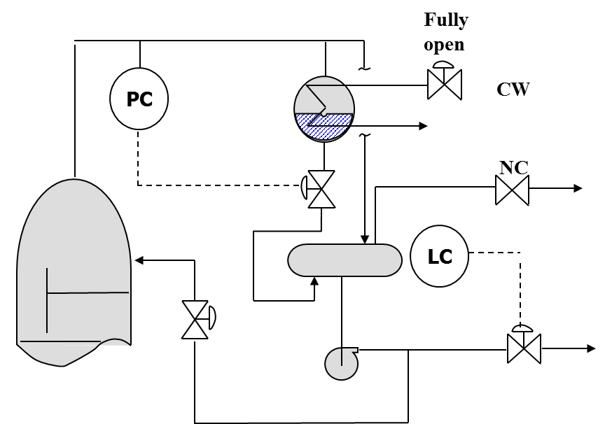
Key Operability issues
1. Operating window
2. Flexibility/
controllability
3. Reliability
4. Safety & equipment protection
5. Efficiency & profitability
6. Operation during transitions
7. Dynamic Performance
8. Monitoring & diagnosis
Chapter 3 Flexibility
Flexibility in Distillation
Flexibility for pressure control – No vapor product

Slide 48
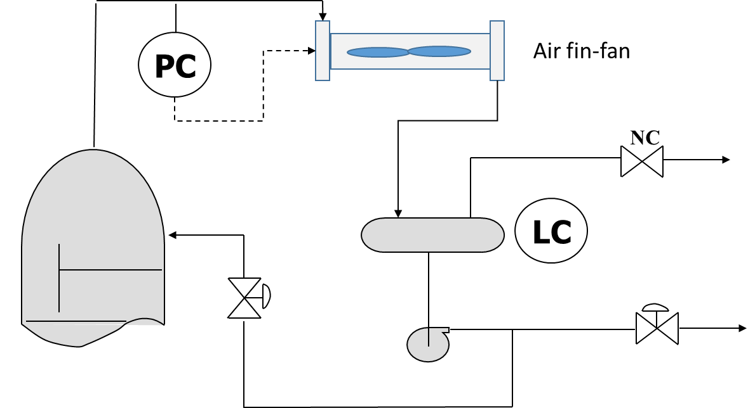
Key Operability issues
1. Operating window
2. Flexibility/
controllability
3. Reliability
4. Safety & equipment protection
5. Efficiency & profitability
6. Operation during transitions
7. Dynamic Performance
8. Monitoring & diagnosis
Chapter 3 Flexibility
Flexibility in Distillation
Flexibility for pressure control – No vapor product
What can be adjusted?
Blade speed
Blade pitch
Louver position

Slide 49
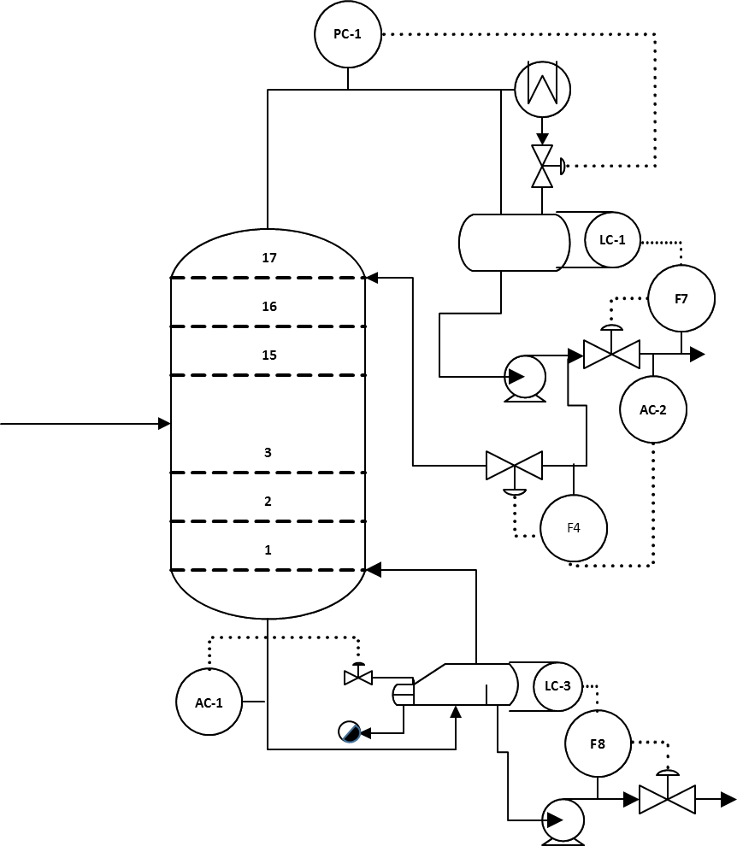
Key Operability issues
1. Operating window
2. Flexibility/
controllability
3. Reliability
4. Safety & equipment protection
5. Efficiency & profitability
6. Operation during transitions
7. Dynamic Performance
8. Monitoring & diagnosis
Chapter 3 Flexibility
Flexibility in Distillation
Flexibility for typical two-product tower

Slide 50
Key Operability issues
1. Operating window
2. Flexibility/
controllability
3. Reliability
4. Safety & equipment protection
5. Efficiency & profitability
6. Operation during transitions
7. Dynamic Performance
8. Monitoring & diagnosis
Chapter 3 Flexibility
Wrap-up and Look ahead
In the operating window, we
Selected controlled and manipulated variables
Determined the capacity of equipment
In the flexibility analysis, we
Added equipment to enable the system to respond to disturbances and changes to set points
In the upcoming reliability and safety, we
Add capacity and flexibility for atypical situations that can damage equipment and/or introduce hazards
In the upcoming process control, we
Finalize the strategies for using measurements to adjust final elements automatically achieve the all goals

Slide 51
Key Operability issues
1. Operating window
2. Flexibility/
controllability
3. Reliability
4. Safety & equipment protection
5. Efficiency & profitability
6. Operation during transitions
7. Dynamic Performance
8. Monitoring & diagnosis
Chapter 3 Flexibility
Citations
1. Castelnuovo, R. (2005) https://commons.wikimedia.org/wiki/File:Centrifugal_3.png#/media/File:Centrifugal_3.png
2. Duk (2005) https://commons.wikimedia.org/wiki/File:Gear_pump.png
3. Howitworks (2019) http://howitsworkss.blogspot.ca/2015/06/centrifugal-compressor.html
4. Padleckas, H. (2006) https://commons.wikimedia.org/wiki/File:Straight-tube_heat_exchanger_2-pass.PNG
5. Smith, Glenda (2013) Compressor performance diagram: http://petrowiki.org/Centrifugal_compressor
6. van Lieshout, Laurens (2019) https://commons.wikimedia.org/wiki/File:Steer_system.jpg

