Slide 1
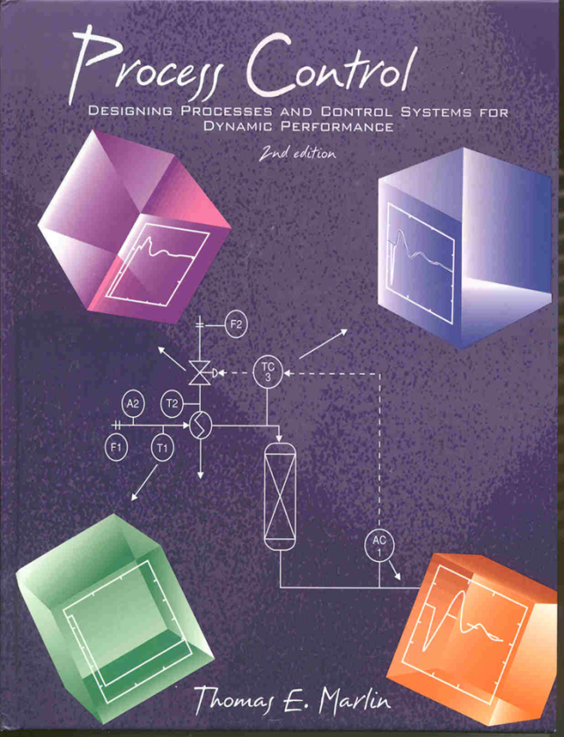
Process Control: Designing Process and Control Systems for Dynamic Performance
Chapter 23. Centralized Model Predictive Control
Copyright © Thomas Marlin 2013
The copyright holder provides a royalty-free license for use of this material at non-profit educational institutions

Slide 2
CHAPTER 23: Centralized MPC Control
When I complete this chapter, I want to be
able to do the following.
Explain centralized control
Build a discrete process model
Explain the trajectory optimization for MPC
Explain the advantages of MPC
Describe criteria for selecting MPC over multiloop control

Slide 3
CHAPTER 23: Centralized MPC Control
Outline of the lesson.
Review IMC structure and principles
Develop MPC for SISO
Generalize MPC for MIMO
Discuss important enhancements
Explain key insights
Develop application guidelines

Slide 4
CHAPTER 23: Centralized MPC Control
Centralized Control uses all CV measurements to calculate all manipulated variables simultaneously.
Describe decentralized
control and
compare with
centralized.
Centralized
Controller
F
T
L
A

Slide 5
CHAPTER 23: Centralized MPC Control
F
Centralized
Controller
Centralized Control is applied to control systems with interaction.
T
L
A
All process information is used by the controller
Better control performance is possible
Substantial increases in controller complexity and
real-time computations

Slide 6
CHAPTER 23: Centralized MPC Control
Centralized Control developed in the 1960’s with major enhancements around 1980.
Centralized
Controller
F
T
L
A
Original use was limited to few industries and highly skilled practitioners
Now widely applied in many industries
Good software facilitates applications
We will discuss the Dynamic Matrix Control approach, using the IMC control structure

Slide 7
CHAPTER 23: Centralized MPC Control
D(s)
G_{d}(s)
SP(s)
T_{p}(s)
MV(s)
CV(s)
+
G_{MPC}(s)
G_{v}(s)
G_{P}(s)
+
-
+
-
+
Centralized controller
G_{m}(s)
E_{m}(s)
Let’s recall the IMC structure
Transfer functions
G_{MPC}(s) = controller
G_{v}(s) = valve
G_{P}(s) = feedback process
G_{m}(s) = model
G_{d}(s) = disturbance process
Variables
CV(s) = controlled variable
CV_{m}(s) = measured value of CV(s)
D(s) = disturbance
E_{m}(s) = model error
MV(s) = manipulated variable
SP(s) = set point
T_{p}(s) = set point corrected for model error

Slide 8
CHAPTER 23: Centralized MPC Control
D(s)
G_{d}(s)
SP(s)
T_{p}(s)
MV(s)
CV(s)
+
G_{MPC}(s)
G_{v}(s)
G_{P}(s)
+
-
+
-
+
Centralized controller
G_{m}(s)
E_{m}(s)
The variables are vectors
The transfer functions are matrices

Slide 9
CHAPTER 23: Centralized MPC Control
From Chapter 19, we know that the IMC structure must obey the following criteria.
1. The controller steady-state gain must be the inverse of the model gain.
2. Perfect control requires an exact inverse.
3. Realistic control cannot “look into the future” or invert models that lead to unstable controllers.

Slide 10
CHAPTER 23: Centralized MPC Control
What does the MPC Controller calculate?
It determines the best (optimal) trajectory from the current conditions to the set point.
To perform this calculation using the DMC approach, we need a model that gives predictions of discrete values, rather than a continuous transfer function.
Therefore, we start with a modified modelling approach.

Slide 11
CHAPTER 23: Centralized MPC Control
Modelling approach: Although we could use use fundamental models, the basis for nearly all applications are empirical models.
Empirical identification
Continuous
Model using process reaction curve or statistics
Sampled output model for unit step with Δt = 2.5 minutes
Sample number
Step
here
0 0
1 0
2 0
3 0.394
4 0.632
5 0.777
6 0.864
7 0.918
8 0.950
9 0.970
10 0.982
11 0.989
output variable
input variable
0
time
Could we use the data from the experiment as the model?

Slide 12
CHAPTER 23: Centralized MPC Control
Modelling approach:
1. Inputs can be represented as a series of steps.
2. The effect of a step of magnitude ΔMV is the magnitude times the unit step model.
3. The output effect of a sequence of inputs is the sum of each input effect.
1.5
S-LOOP plots deviation variables (IAE = 20.0383)
1
Controlled Variable
0.5
0
0
50
100
150
200
250
Time
50
40
Manipulated Variable
30
20
10
0
0
50
100
150
200
250
Time

Slide 13
CHAPTER 23: Centralized MPC Control
Modelling approach: Directly performed using matrices.
Step model, a_{k}
0 0
1 0
2 0
3 0.394
4 0.632
5 0.777
6 0.864
7 0.918
8 0.950
9 0.970
10 0.982
11 0.989
Dynamic Matrix
A ΔMV = CV
Notes: 1. The MV& CV subscripts represent samples (different times)
2. The CV values are deviation from initial steady state
3. Some time after the input step, the process achieves steady
state and the model values (a_{k}) are constant at K_{p}

Slide 14
CHAPTER 23: Centralized MPC Control
Basic controller calculation: Open-loop trajectory
SP(s)
T_{p}(s)
MV(s)
CV(s)
+
G_{MPC}(s)
G_{v}(s)
G_{P}(s)
-
The controller calculates the manipulations in the future that will achieve the control objective - which for now is closely tracking the set point.

Slide 15
CHAPTER 23: Centralized MPC Control
Error at each time step that is reduced by the future values of the manipulated variable adjustments determined by the controller
Set point
. . . .
Controlled variable calculated using model and past values of manipulated variable
Controlled variable calculated using model and past values of manipulated variable
Past values of the manipulated variable
Calculated by MPC Controller
Future values of the manipulated variable determined by the controller
← past
future →
Only the current result is implemented
Time

Slide 16
CHAPTER 23: Centralized MPC Control
Controller calculation: Controller minimizes sum of squares of error.
First, calculate the response if no future moves occurred, CV^{f}. This includes the affects of past moves.
Second, calculate the error if no future moves occurred, E^{f}.
Third, calculate the manipulation to minimize the goal given below.
with CV^{c} the effect of the controller manipulation at the current and future times

Slide 17
CHAPTER 23: Centralized MPC Control
Controller calculation: Controller minimizes sum of squares of error.
Means minimize by adjusting values of ΔMV^{c}
Quadratic objective with linear equations; can be solved
Model relates ΔMV^{c} to CV^{c}
Solution is least squares equations, involving solution to linear equations offline and simple matrix-vector product online.

Slide 18
CHAPTER 23: Centralized MPC Control
Controller calculation: Example for single I/O controller with perfect model.
Why didn’t the CV
track the set
point exactly?
3
2.5
2
concentration
1.5
1
0.5
0
20
40
60
80
100
We calculated
four steps, but
only two changed;
why?
55
valve opening
50
45
0
50
100
150
Time

Slide 19
CHAPTER 23: Centralized MPC Control
Controller calculation: We have to added feedback!
SP(s)
T_{p}(s)
MV(s)
CV(s)
+
G_{MPC}(s)
G_{v}(s)
G_{P}(s)
-
+
Why
feedback?
-
+
G_{m}(s)
E_{m}(s)
Feedback

Slide 20
CHAPTER 23: Centralized MPC Control
Error (corrected by feedback) at each time step that is reduced by the future values of the manipulated variable adjustments determined by the controller
Current measured value of the controlled variable
Set point
. . . .
What do we
assume about
the model error?
Model mismatch, E_{mm}
Controlled variable calculated using model and past values of manipulated variable, without feedback
Controlled variable calculated using model and past values of manipulated variable
Past values of the manipulated variable
Future values of the manipulated variable determined by the controller
← past
future →
Time

Slide 21
CHAPTER 23: Centralized MPC Control
Controller calculation: Example for single I/O controller with feedback; model error of 35% in gain only.
Returned to set
point; why?
3
2.5
2
concentration
1.5
1
0.5
0
20
40
60
80
100
Diagnose this
performance?
55
valve opening
50
45
0
50
100
150
Time

Slide 22
CHAPTER 23: Centralized MPC Control
Controller calculation: We have be able to tune the controller! We want robustness and moderate MV adjustments.
Not acceptable
SP(s)
T_{p}(s)
MV(s)
CV(s)
+
G_{MPC}(s)
G_{v}(s)
G_{P}(s)
-
+
-
+
G_{m}(s)
E_{m}(s)

Slide 23
CHAPTER 23: Centralized MPC Control
Controller calculation: Controller minimizes sum of squares of error with penalty on MV moves (ΔMV²).
Quadratic objective with linear equations; can be solved
Solution is least squares equations, involving solution to linear equations offline and simple matrix-vector product online.

Slide 24
CHAPTER 23: Centralized MPC Control
Tuning: Increasing the move penalty (qq/ww) reduces the manipulation magnitude rapidly with small increase in CV variation.
10.00
25.00
9.00
20.00
Example results for SISO system in example.
(ww = 1)
8.00
15.00
controlled variable ISE
manipulated variable ISE
7.00
10.00
6.00
5.00
5.00
0.00
0.00
0.10
0.20
0.30
0.40
0.50
0.60
0.70
0.80
0.90
1.00
move suppression, qq

Slide 25
CHAPTER 23: Centralized MPC Control
Controller calculation: Example for single I/O controller with feedback; model error of 35% in gain only and with ww = 1.0 and qq = 0.20.
3
Diagnose and
recommend fine
tuning.
2.5
2
concentration
1.5
1
0.5
0
20
40
60
80
100
Diagnose and
recommend fine
tuning.
55
valve opening
50
45
0
50
100
150
Time

Slide 26
CHAPTER 23: Centralized MPC Control
A great advantage of MPC is the direct application to centralized multivariable control using the same principles.
How does this differ
from PID composition
control?

Slide 27
CHAPTER 23: Centralized MPC Control
Modelling approach: Must include effects from every MV to every CV.
Dynamic Matrix
A ΔMV = CV
Notes: 1. A_{ij} is the dynamic matrix between output i and input j
2. [ΔMV_{j}] and [CV_{i}] are vectors of the values for each variable over the horizon

Slide 28
CHAPTER 23: Centralized MPC Control
Controller calculation: Controller minimizes sum of squares of all errors with penalty on all MV moves.
Quadratic objective with linear equations; can be solved
Solution is least squares equations, involving solution to linear equations offline and simple matrix-vector product online.

Slide 29
CHAPTER 23: Centralized MPC Control
Controller calculation: Sample distillation without model error and with move suppression.
Why did
this change?
0.024
0.99
Why slow
for fast
process?
0.023
0.022
Distillate, XD
Bottoms, XB
0.985
0.021
0.02
0.98
0.019
0
100
200
300
0.018
0
100
200
300
How much delay
before this
changed?
9.4
14.4
9.2
14.2
9
14
Reflux, FR
Reboiled vapor, FV
8.8
13.8
8.6
13.6
8.4
0
100
200
300
400
13.4
0
100
200
300
400
Time
Time

Slide 30
CHAPTER 23: Centralized MPC Control
Controller calculation: The following parameters are adjusted by the engineer.
Δt The controller execution period
NN The controlled variable horizon, which should be the time to reach steady state
MM The manipulated variable horizon (≈NN/4)
ww The weight on each controlled variable; can be used to represent different relative importances
qq The individual manipulated variable move suppressions; these have units!

Slide 31
CHAPTER 23: Centralized MPC Control
Controller calculation: An important enhancement includes possible limits on CVs and MVs.
Penalty for any violation of controlled variables bounds, D≥0
Hard bounds on the manipulated variables

Slide 32
CHAPTER 23: Centralized MPC Control
Controller calculation: Sample distillation without model error, move suppression, and bound on manipulated variable.
0.99
0.024
Discuss the
control
performance.
0.985
0.022
Distillate, XD
Bottoms, XB
0.98
0.02
0.975
0
50
100
150
200
250
0.018
0
50
100
150
200
250
Time
Time
9.5
14.5
Upper bound on reboiler vapor
9
14
Reflux
Reboiled vapor
8.5
0
50
100
150
200
250
13.5
0
50
100
150
200
250
Time
Time

Slide 33
CHAPTER 23: Centralized MPC Control
Controller calculation: Sample distillation without model error, move suppression, and bound on controlled variable.
0.99
0.024
Discuss the
control
performance.
0.985
0.022
Upper bound on XB
Distillate, XD
Bottoms, XB
0.98
0.02
0.975
0
50
100
150
200
250
0.018
0
50
100
150
200
250
Time
Time
9.5
14.5
9
14
Reflux
Reboiled vapor
8.5
0
50
100
150
200
250
13.5
0
50
100
150
200
250
Time
Time

Slide 34
CHAPTER 23: Centralized MPC Control
KEY INSIGHTS
The MPC design methods yields easily solved optimization problems, least squares (unconstrained, offline) or quadratic programming, QP (constrained, online)
The constrained controller does not have a fixed control calculation; it changes in response to the active constraints
The calculation of the QP is much more complex than typical controllers, but it gives extraordinary features.
- The QP is convex, so that the global optimum is
guaranteed at the solution.
- Essentially every MPC includes the QP

Slide 35
CHAPTER 23: Centralized MPC Control
KEY INSIGHTS
The MPC controller can easily be formulated for “non-square” systems, i.e. a different number of manipulated and controlled variable.
The MPC controller can calculate the feedforward compensation for measured disturbances using the same, unmodified optimization. Only E^{f} is changed.
The MPC can be used to display the predicted future transient to the operators.
MPC controllers can handle large systems, certainty 10+ CVs and MVs, with much larger industrial applications reported

Slide 36
CHAPTER 23: Centralized MPC Control
MPC APPLICATION GUIDELINES
Use MPC for MIMO systems; SISO can use PID or IMC
Non-square systems of high complexity, where signal select and split range become too complex
Process systems with complex dynamics
Process systems that often encounter constraints and the constraint activity changes
MPC usually is arranged in a cascade structure resetting the set points of regulatory PID (or IMC) controllers
See next slide for a small example of MPC

Slide 37
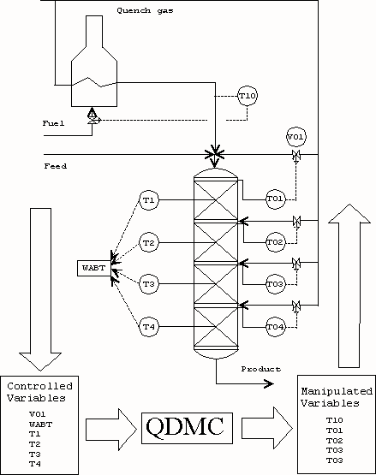
CHAPTER 23: Centralized MPC Control
OPERATING OBJECTIVES
Total “conversion” is key quality, measured by weighted average bed temperature
Exothermic reactor beds must not “run away”
Reaction in each bed depends on strategy, max selectivity or max catalyst life
T10 should be low, but the bypass valve v01 (adjusted by T01) should be opened for fast control

Slide 38
CHAPTER 23: Centralized MPC Control
COMMERCIAL MPC PRODUCTS
Involve complex software, transparent to user
Integrated empirical modelling and controller design
Simulation test bed for controller tuning and evaluation
Design and tuning on PC/Workstation with download of controller parameters to DCS
Many other features not discussed here, e.g.,
- Steady-state optimization
- Check for controllability and conditioning
- Features for unstable processes (levels and other)
- Enhanced feedback with disturbance model

Slide 39
CHAPTER 23: MPC CONTROL WORKSHOP 1
The MPC control objective involved the square of error (and move sizes). Discuss the advantages and disadvantages of using the power 2 (and not 1, 3, 4, 1/2, absolute value, etc.)
Hint: The choice is not arbitrary; it provides important advantages.

Slide 40
CHAPTER 23: MPC CONTROL WORKSHOP 2
Describe the sequence of calculations performed in the offline design of MPC. Restrict your presentation to the unconstrained, multivariable MPC.
Begin with the empirical identification
Include parameters that are manually inputted
Organize the calculations in the order performed
Solution is least squares equations, involving solution to linear equations offline and simple matrix-vector product online.

Slide 41
CHAPTER 23: MPC CONTROL WORKSHOP 3
Describe the sequence of calculations performed by the MPC online controller at every execution.
Identify information from controller design, manual entry, and sensors
Organize the calculations in the order performed
SP(s)
T_{p}(s)
MV(s)
CV(s)
+
G_{MPC}(s)
G_{v}(s)
G_{P}(s)
-
+
-
+
G_{m}(s)
E_{m}(s)

Slide 42
CHAPTER 23: MPC CONTROL WORKSHOP 4
Would you recommend applying multivariable MPC for control of the flash process?
Vapor
product
T6
P1
T1
T2
T5
P ≈ 1000 kPa
T ≈ 298 K
Feed
Methane
Ethane (LK)
Propane
Butane
Pentane
F1
T4
T3
L1
F2
F3
A1
Liquid
product
Process
fluid
Steam
L. Key

Slide 43
CHAPTER 23: Centralized MPC Control
When I complete this chapter, I want to be
able to do the following.
Explain centralized control
Build a discrete process model
Explain the trajectory optimization for MPC
Explain the advantages of MPC
Describe criteria for selecting MPC over multiloop control
Lot’s of improvement, but we need some more study!
Read the textbook
Review the notes, especially learning goals and workshop
Try out the self-study suggestions
Naturally, we’ll have an assignment!

Slide 44
CHAPTER 23: LEARNING RESOURCES
SITE PC-EDUCATION WEB
- Tutorials (Chapter 23)
The Textbook, naturally, for more examples.
Addition information on MPC control is given in the following references.
Brosilow, C. and B. Joseph, Techniques of Model-Based Control, Prentice Hall, Upper Saddle River, 2002 - Some additional introductory material on MPC
Maciejowski, J.M., Predictive Control with Constraints, Prentice Hall, Harlow, England, 2002 - A clearly presented, comprehensive presentation at the advanced level
Qin, S. J. and T. Badgwell - A Survey of industrial model predictive control technology, Control Engineering Practice, 11, 733-764, 2003

Slide 45
CHAPTER 23: SUGGESTIONS FOR SELF-STUDY
1. Discuss the similarities and differences between IMC and MPC algorithms.
2. Find a recent journal article with an industrial application of MPC. Describe why you think that MPC was a good (or poor) choice for control.
3. Prove that the solution to the MPC controller gain (K_{MPC}) is the least squares equation.
4. Discuss the effect of one or more manipulated variable encountering and remaining at a bound (either upper or lower).
5. Compare PID with decoupling with multivariable MPC; discuss advantages of each.

