Slide 1
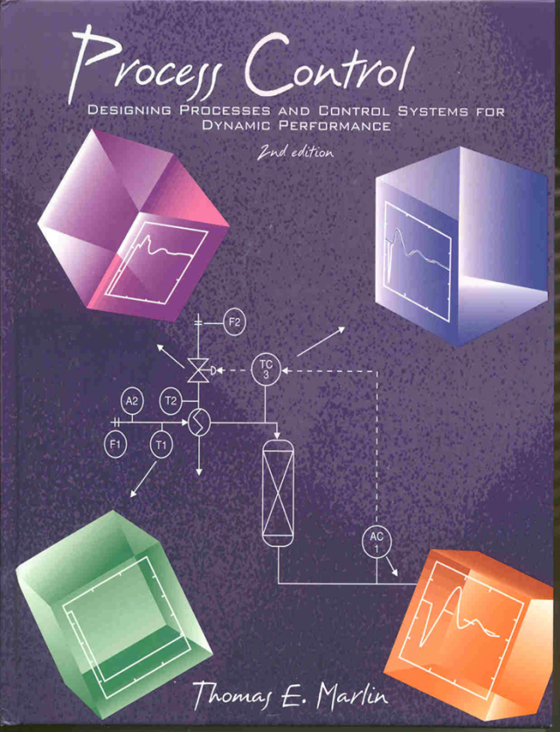
Process Control: Designing Process and Control Systems for Dynamic Performance
Chapter 22. Variable Structure and Constraint Control
Copyright © Thomas Marlin 2013
The copyright holder provides a royalty-free license for use of this material at non-profit educational institutions

Slide 2
CHAPTER 22: VARIABLE STRUCTURE CONTROL
When I complete this chapter, I want to be
able to do the following.
Understand why many applications of process control require variable structure
Implement a design using more than one valve in a “control loop”
Implement a design using more than one controlled variable in a “control loop”

Slide 3
CHAPTER 22: VARIABLE STRUCTURE CONTROL
Outline of the lesson.
Reasons for variable structure
Split range control
Signal select control
Applications for constraint control
Workshop

Slide 4
CHAPTER 22: VARIABLE STRUCTURE CONTROL
Sometimes, the control objectives cannot be achieved with a strict pairing of one sensor/controller/valve. We need the flexibility to change the pairing automatically, as part of the control system.
We might need to control a different measured variable
We might need to adjust a different valve

Slide 5
CHAPTER 22: VARIABLE STRUCTURE CONTROL
Sometimes, the control objectives cannot be achieved with a strict pairing of one sensor/controller/valve. We need the flexibility to change the pairing automatically, as part of the control system.
In this chapter, we will learn methods that are easily applied
Retain the PID (or IMC) single-loop controller
Use the same tuning approaches
This advantage is gained by accepting the following limitations
One controller - many valves
Many controllers - one valve
• • •
• • •

Slide 6
CHAPTER 22: VARIABLE STRUCTURE CONTROL
We often manipulate several variables to achieve our objectives.
For example, to achieve a comfortable temperature in a room.
Split range
• • •
cooling
heating

Slide 7
CHAPTER 22: VARIABLE STRUCTURE CONTROL
Split range
Split range enables one controller to adjust more that one final element. We will introduce this through a process example, purchase and distribution of fuel gases.
• • •
What do we measure and
control to ensure that the
purchase and consumption
balance?
fc
Fuel A
To consumers. They chose
how much to take!
Fuel B
fc

Slide 8
CHAPTER 22: VARIABLE STRUCTURE CONTROL
Split range
We chose to control pressure.
• • •
Measured variable
Pressure which is constant when flows in and out are the same.
Manipulated variable
Either valve has causal relationship and fast dynamics
Disturbances
Changes in consumption rate
fc
Fuel A
Which valve??
PC
To consumers.
Fuel B
fc

Slide 9
CHAPTER 22: VARIABLE STRUCTURE CONTROL
Split range
We chose to adjust both valves!
• • •
fc
Manipulating two valves gives more flexibility, but how does it work?
First, if we adjust two valves, on what basis can we decide which valve to open first?
Fuel A
x
x
PC
To consumers.
x
Fuel B
fc
Hint:
x = controller output

Slide 10
CHAPTER 22: VARIABLE STRUCTURE CONTROL
Split range
We will have a ranking for use of valves. This priority ranking will not change.
• • •
Less expensive
fc
We have determined that fuel A is less expensive than fuel B.
Fuel A
x
Our strategy is to use only fuel A unless we must use B (when fuel valve A is completely open).
How?
x
PC
To consumers.
More expensive
x
Fuel B
fc
x = controller output

Slide 11
CHAPTER 22: VARIABLE STRUCTURE CONTROL
Split range
Split range: The valves are calibrated to respond as shown in the figure
• • •
opened
Less expensive
Fuel A
fc
Fuel A
x
Valve opening
Fuel B
x
PC
To consumers.
More expensive
x
Fuel B
fc
x = controller output
closed
0 100
x, controller output %

Slide 12
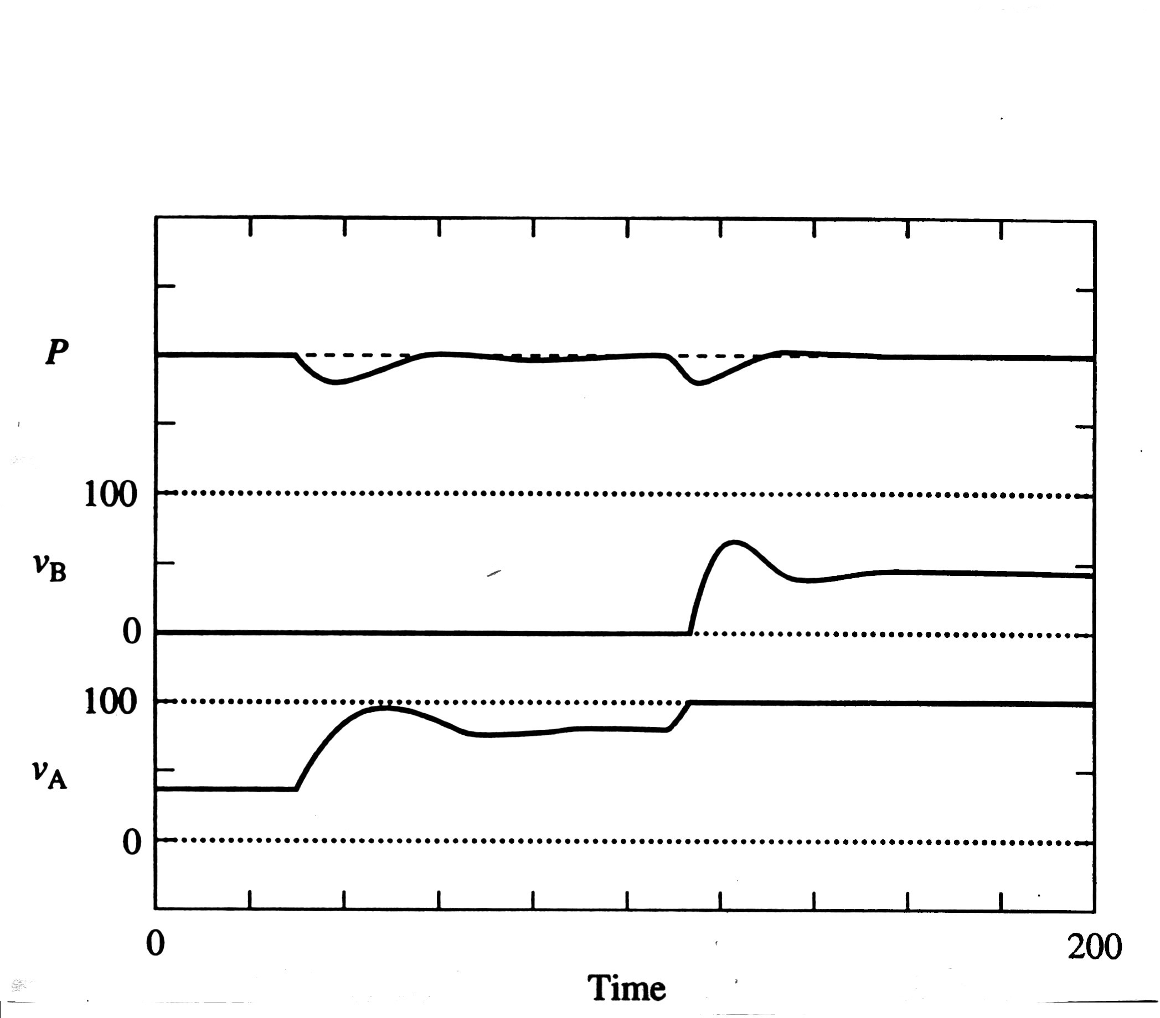
CHAPTER 22: VARIABLE STRUCTURE CONTROL
Split range
Dynamic response of the split range control system to two step increases in fuel consumption.
First increase in consumption, PC increases its output, which affects only v_{A}
• • •
Less expensive
fc
Fuel A
x
x
PC
To consumers.
More expensive
x
Fuel B
fc
Second increase in consumption, PC increases its output, which increases v_{A} to its maximum, then begins to open v_{B}.

Slide 13
CHAPTER 22: VARIABLE STRUCTURE CONTROL
Split range
Split range: The closed-loop system (characteristic equation) changes when the valve being adjusted changes. This affects stability and performance.
• • •
v_{A}(s)
G_{vA}(s)
G_{PA}(s)
SP(s)
+
G_{c}(s)
MV(s)
CV(s)
+
-
v_{A}(s)
+
G_{vB}(s)
G_{PB}(s)
G_{s}(s)
May have to adjust
tuning when the
adjusted valve
changes.
Value of MV
Characteristic equation
0 - 50%
50 - 100%

Slide 14
CHAPTER 22: VARIABLE STRUCTURE CONTROL
Split range
Split range is used widely in practice to provide flexibility, retain simple technology and employ simple calculations.
• • •
SPLIT RANGE DESIGN CRITERIA
1. There is one controller and more than one final element.
2. There is a causal relationship between each final element and the controlled variable.
3. The proper order for adjusting the final element adheres to a fixed priority ranking.

Slide 15
CHAPTER 22: VARIABLE STRUCTURE CONTROL
We often try to achieve many objectives when manipulating one final element.
For example, when we are driving and adjusting our speed.
Signal Select
• • •
Don’t get a ticket
for speeding.
Get through the
intersection before
the light turns red.
Don’t be late for
process control class.
Don’t skid on
the icy road.

Slide 16
CHAPTER 22: VARIABLE STRUCTURE CONTROL
Signal Select
• • •
Now, we will address the other method, split range. Again, we consider a process example.
The process involves a CSTR with an exothermic reaction and a cooling coil. Generally, we wish to control the composition of the reactant in the effluent. However, we must keep the temperature below a maximum limit to prevent damaging the glass lining of the reactor.
FC
I am not sure what to do, so let’s start
with a controller for the composition.
T
LC
A
Reaction: A → B

Slide 17
CHAPTER 22: VARIABLE STRUCTURE CONTROL
Signal Select
The process involves a CSTR with an exothermic reaction and a cooling coil. Generally, we wish to control the composition of the reactant in the effluent. However, we must keep the temperature below a maximum limit to prevent damaging the glass lining of the reactor.
• • •
FC
Looks good to me. What could go wrong?
T
LC
AC
Reaction: A → B

Slide 18
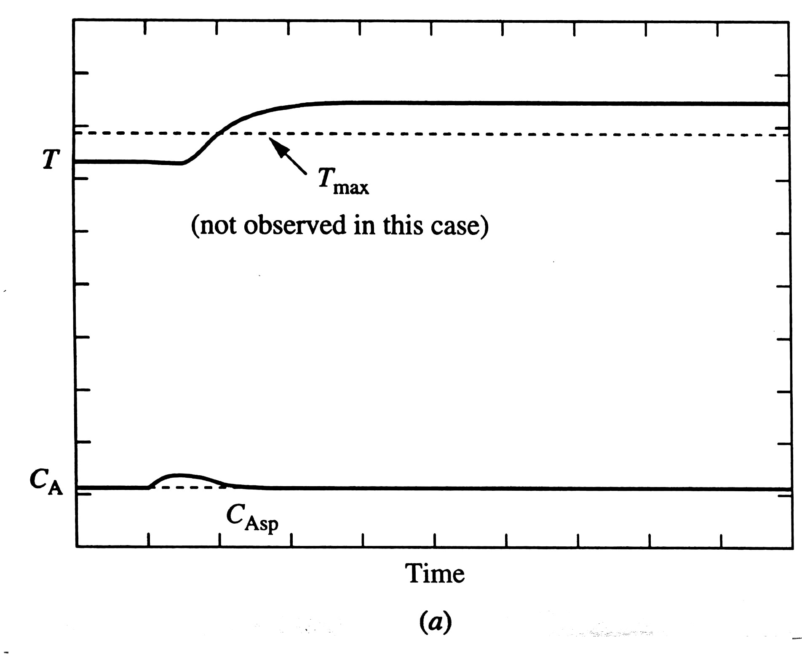
CHAPTER 22: VARIABLE STRUCTURE CONTROL
FC
Signal Select
Disturbance is feed inhibitor increase.
• • •
T
LC
Reaction: A → B
AC
Unfortunately, the design does not consider T, which exceeded its maximum. The equipment was damaged!
Not acceptable
The controller did a good job of keeping C_{A} near its set point.

Slide 19
CHAPTER 22: VARIABLE STRUCTURE CONTROL
Signal Select
The process involves a CSTR with an exothermic reaction and a cooling coil. Generally, we wish to control the composition of the reactant in the effluent. However, we must keep the temperature below a maximum limit to prevent damaging the glass lining of the reactor.
• • •
Well, back to the drawing board!
What can we do to improve the design?
FC
TC
LC
AC
We could add a switch and have a
person decide (every second) which
controller output goes to the valve.

Slide 20
CHAPTER 22: VARIABLE STRUCTURE CONTROL
Signal Select
The process involves a CSTR with an exothermic reaction and a cooling coil. Generally, we wish to control the composition of the reactant in the effluent. However, we must keep the temperature below a maximum limit to prevent damaging the glass lining of the reactor.
• • •
Now, the correct controller is selected
automatically.
Why was a low signal select used?
Hint: What is the safest % valve opening?
FC
TC
LC
AC
fo
< = low signal select
AY = calculation element
<
AY

Slide 21
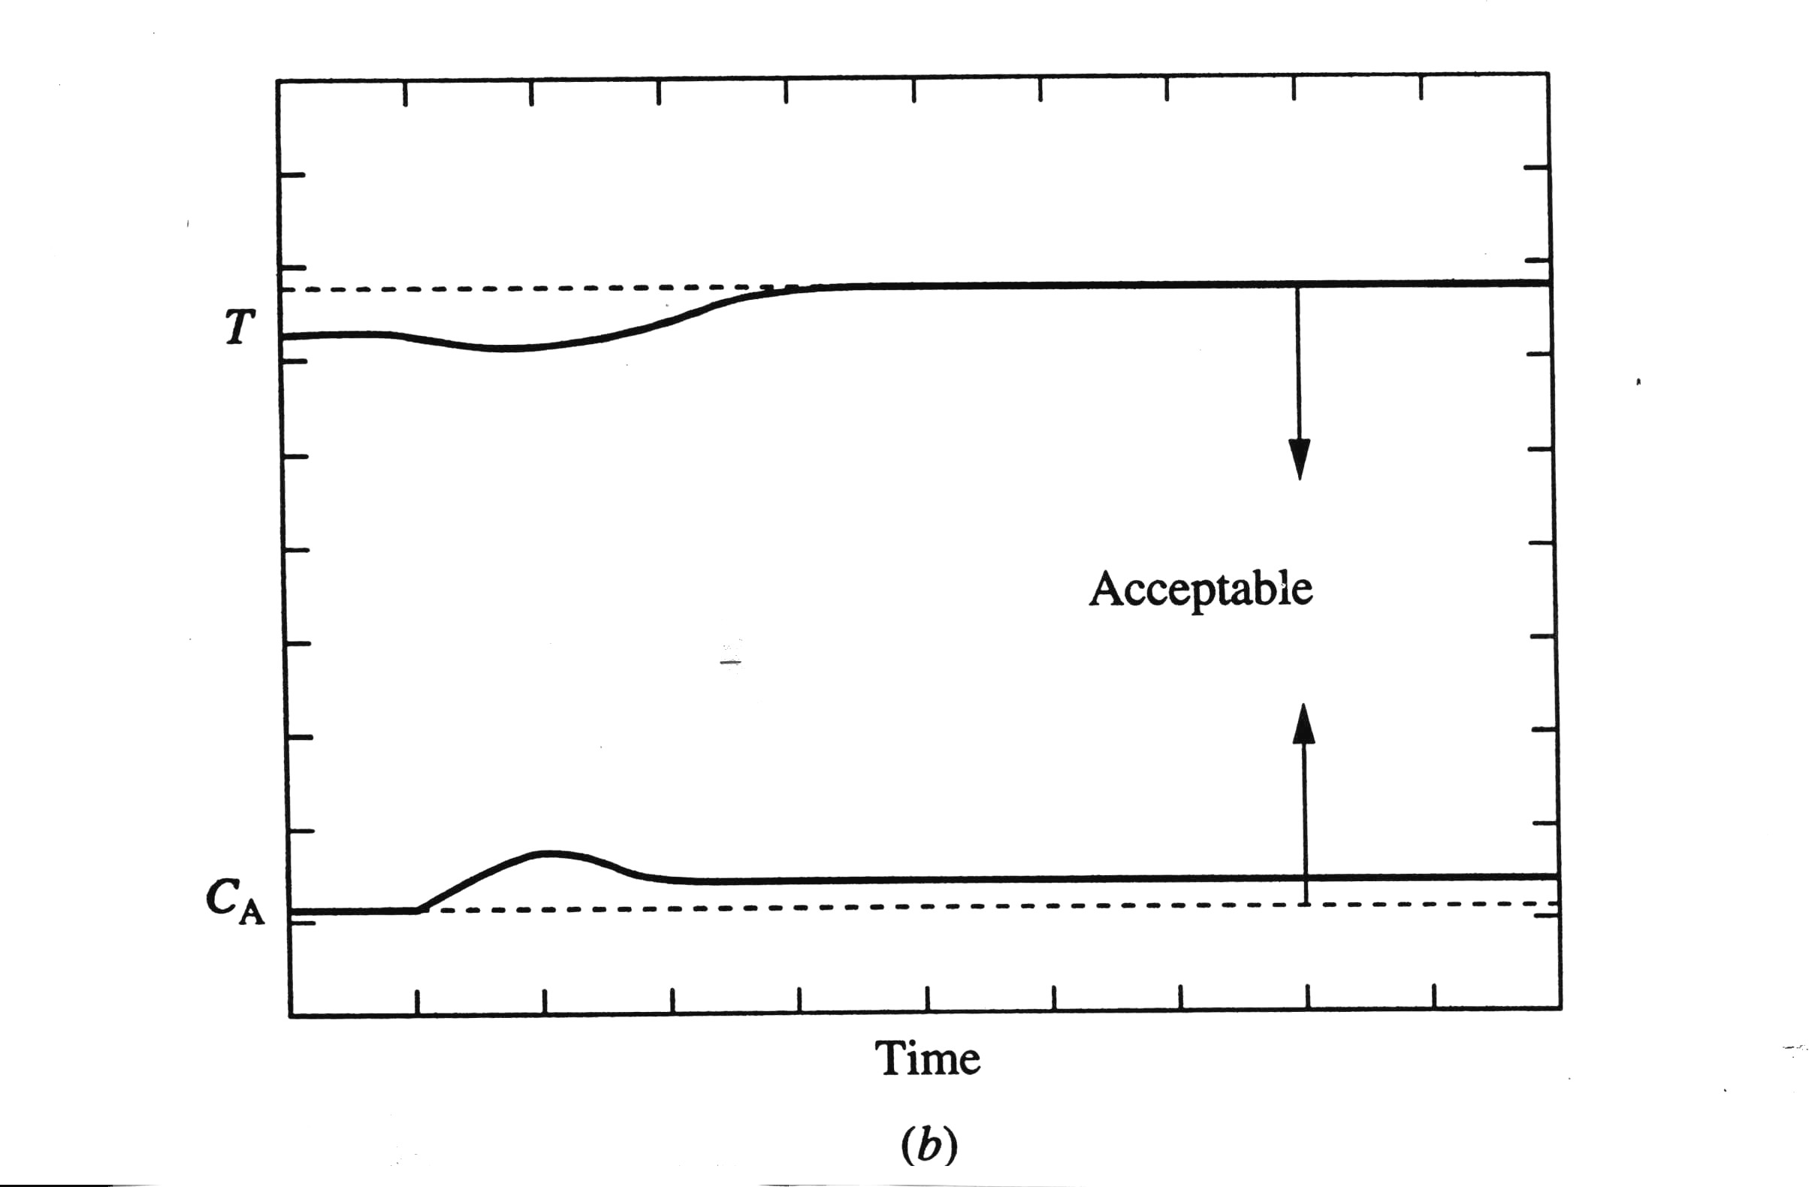
CHAPTER 22: VARIABLE STRUCTURE CONTROL
FC
Signal Select
Disturbance is feed inhibitor increase.
• • •
TC
LC
AC
Reaction: A → B
fo
AY
<
The design controls T, as it approaches its maximum. The equipment was not damaged!
acceptable
The controller cannot keep C_{A} at its set point!

Slide 22
CHAPTER 22: VARIABLE STRUCTURE CONTROL
Signal Select
Signal select is used widely in practice to provide flexibility, retain simple technology and employ simple calculations.
• • •
SIGNAL SELECT DESIGN CRITERIA
1. There is one manipulated variable and more than one final element.
2. There is a causal relationship between the manipulated variable and each controlled variable.
3. There is a feasible operating point that satisfies the control objectives.

Slide 23
CHAPTER 22: VARIABLE STRUCTURE CONTROL
CONSTRAINT CONTROL
Signal select and split range are often used for achieving constraint control. Often, good plant operation occurs when some of the manipulated and/or controlled variables are near their limiting values (constraints).
For example, let’s consider the ethylene plant. We would like to maximize the feed rate (production), but many possible constraints exist.
How do we do this?

Slide 24
CHAPTER 22: VARIABLE STRUCTURE CONTROL
CONSTRAINT CONTROL
<
FY
SC
AC
FC
FC

Slide 25
CHAPTER 22: VARIABLE STRUCTURE CONTROL
CONSTRAINT CONTROL
Other methods are sometimes used for achieving constraint control. Often, good plant operation occurs when some of the manipulated and/or controlled variables are near their limiting values (constraints).
FC
For example, let’s consider the CSTR. We would like to maximize the feed rate (production), but we must always control the temperature.
How do we do this?
LC
TC

Slide 26
CHAPTER 22: VARIABLE STRUCTURE CONTROL
CONSTRAINT CONTROL
We would like to maximize the feed rate (production), but we must always control the temperature.
To the SP of the feed flow
VC = “valve position” controller using feedback principle and PI algorithm
FC
MV from the VC controller
LC
This design achieves the maximum feed flow rate consistent with being able to control the temperature.
TC
SP = 95% open
VC
MV from the TC controller
CV to the VC controller

Slide 27
CHAPTER 22: VARIABLE STRUCTURE CONTROL
Potential issues with variable structure control designs
1. The integral mode for controller not “selected” will windup.
Every algorithm must have anti-reset-windup protection. This must also provide smooth transitions between selected variables.
2. The control system for a valve position controller can become unstable if a different controller is placed in manual (off) status.
The control design should have an “interlock” that places other controllers (that would become unstable) in manual when the operator places a controller in manual.
For example, in the previous example if TC is placed in manual, VC must be placed in manual at the same time.

Slide 28
CHAPTER 22: VARIABLE STRUCTURE CONTROL
Potential issues with variable structure control designs
3. Noise can reduce the effectiveness of signal selects.
The effects of noise can be reduced by (1) removing a derivative mode, (2) filtering the signal, and (3) reducing the controller gain as the controller deviates from its set point on the “safe side”.
4. For signal select, the operator does not immediately know how to adjust the valve manually.
TC
AC
An “auto-manual station” should be placed after the signal select.
fo
<
AY
A/M

Slide 29
CHAPTER 22: VARIABLE STRUCTURE WORKSHOP 1
Design controls to maintain the level within limits and to minimize the flow to waste.
Downstream processing
Waste

Slide 30
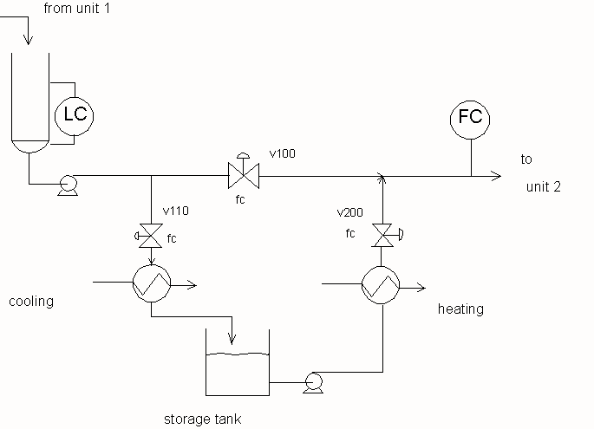
CHAPTER 22: VARIABLE STRUCTURE WORKSHOP 2
Design controls to control the level and the feed to unit 2 while minimizing the heating and cooling associated with the storage tank.

Slide 31
CHAPTER 22: VARIABLE STRUCTURE WORKSHOP 3
Describe examples in everyday life when you
Employ signal selects
Employ split range
Split range
Signal Select
• • •
• • •

Slide 32
CHAPTER 22: VARIABLE STRUCTURE WORKSHOP 4
Design controls for the situation in which the least expensive manipulated variable has a substantially slower response, as in the figure where fuel A is evaporated.
Less expensive
Fuel A
steam
Fuel B
More expensive

Slide 33
CHAPTER 22: VARIABLE STRUCTURE WORKSHOP 5
Design two control approaches for the packed bed reactor. The feed is preheated. The goal is to maximize the conversion in the reactor, but no temperature should exceed its maximum limit.
feed
feed
Heating
medium
Heating
medium

Slide 34
CHAPTER 22: VARIABLE STRUCTURE CONTROL
When I complete this chapter, I want to be
able to do the following.
Understand why many applications of process control require variable structure
Implement a design using more than one valve in a “control loop”
Implement a design using more than one controlled variable in a “control loop”
Lot’s of improvement, but we need some more study!
Read the textbook
Review the notes, especially learning goals and workshop
Try out the self-study suggestions
Naturally, we’ll have an assignment!

Slide 35
CHAPTER 22: Learning Resources
SITE PC-EDUCATION WEB
- Interactive Learning Module (Chapter 22)
The Textbook, naturally, for many more examples.

Slide 36
CHAPTER 22: Suggestions for self-study
1. Evaluate additional examples of variable structure control given in Shinskey, F.G., Controlling Multivariable Processes, ISA, Research Triangle Park, NC, 1981.
2. Program the controllers and additional logic for the CSTR signal select control example in the lecture and textbook.
3. Design a modified split range control implementation in which different signals with different values are sent to the two valves for the fuel gas pressure control example in the lecture and textbook.

