Slide 1
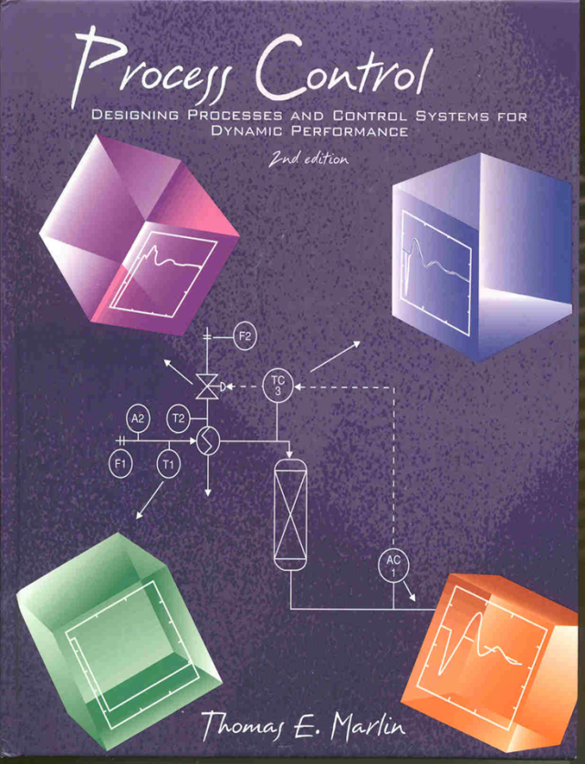
Process Control: Designing Process and Control Systems for Dynamic Performance
Chapter 17. Inferential Control
Copyright © Thomas Marlin 2013
The copyright holder provides a royalty-free license for use of this material at non-profit educational institutions

Slide 2
CHAPTER 17: Inferential Control
When I complete this chapter, I want to be
able to do the following.
Identify key aspects of conventional and inferential sensors
Determine good applications of inferential sensors
Determine how to evaluate potential inferential sensors

Slide 3
CHAPTER 17: Inferential Control
Outline of the lesson.
Conventional and inferential sensors
An example for a flash process
Inferential design criteria
Distillation example
Reactor example
Special considerations for dynamics

Slide 4
CHAPTER 17: Inferential Control

Slide 5
Let’s discuss
this process
T6
P1
Vapor
product
T1
T2
T5
P ≈ 1000 kPa
T ≈ 298 K
Feed
Methane
Ethane (LK)
Propane
Butane
Pentane
F1
T4
T3
L1
F2
F3
A1
Liquid
product
Process
fluid
Steam
L. Key

Slide 6
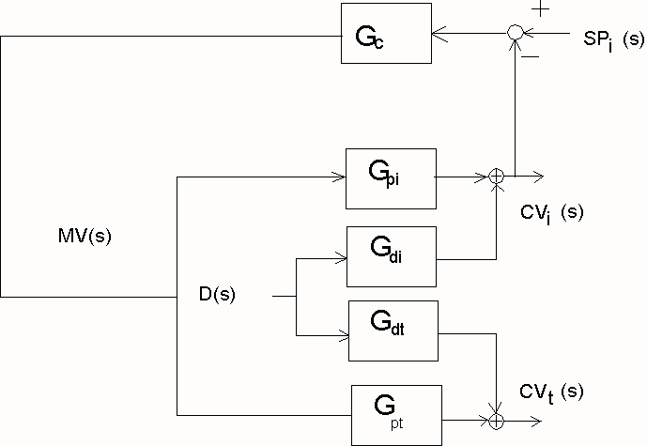
CHAPTER 17: Inferential Control

Slide 7
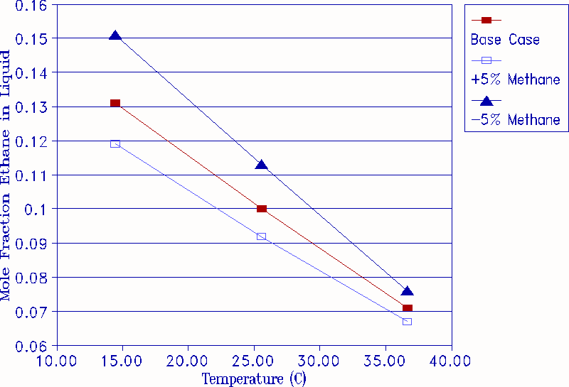
The relationship between the flash temperature and the concentration of ethane in the liquid at the base case pressure
(1000 kPa). Changes in methane are compensated by changes in butane of equal magnitude and opposite sign.

Slide 8
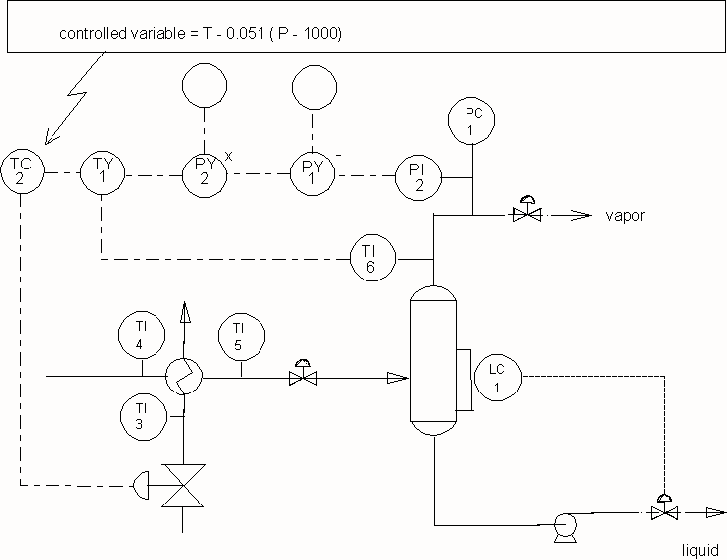
Inferential variable when pressure changes

Slide 9
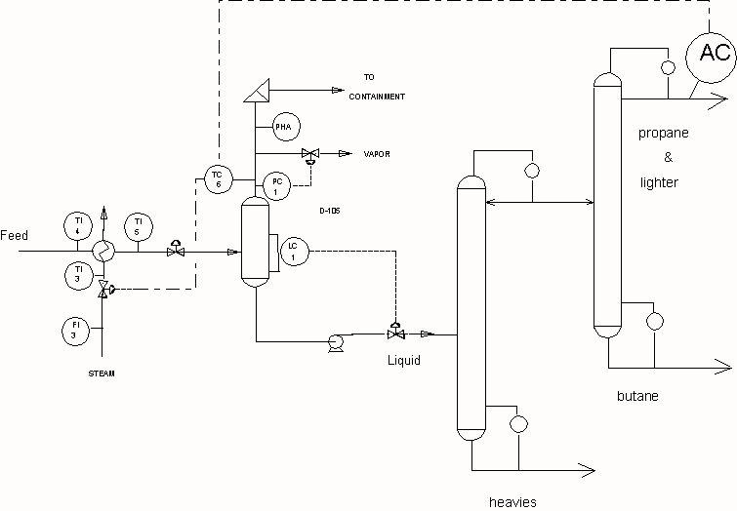
CHAPTER 17: Inferential Control

Slide 11
CHAPTER 17: Inferential Control

Slide 12
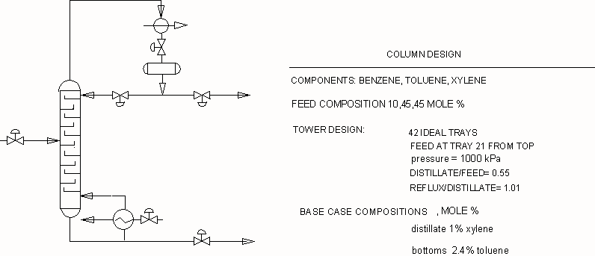
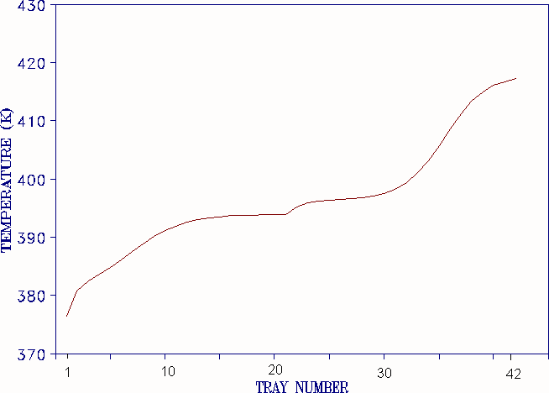
LC
Manp. variables
LC
Trays numbered from the top
XD= fraction xylene

Slide 13
Trays numbered from the top
Changes in temperatures and distillate composition for ± 5% change in distillate flow rate

Slide 14
Trays numbered from the top
Changes in temperatures and distillate composition for ± 5% change in reboiler duty

Slide 15
Trays numbered from the top
6%
10%
14%
Changes in temperatures and distillate composition for changes in feed composition

Slide 17
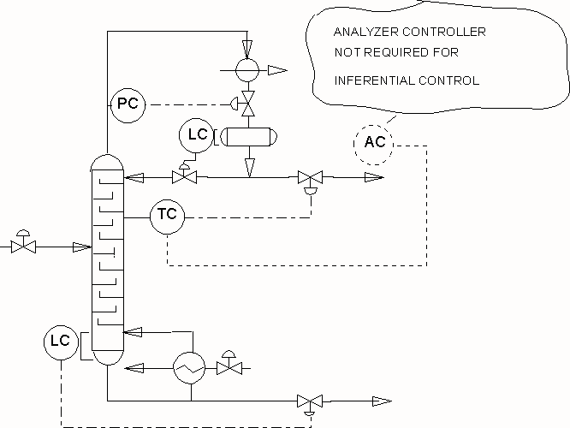
CHAPTER 17: Inferential Control

Slide 18
CHAPTER 17: Inferential Control

