Slide 1
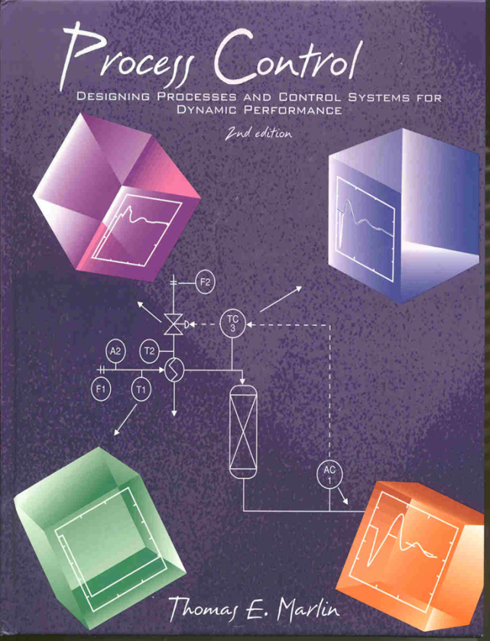
Process Control: Designing Process and Control Systems for Dynamic Performance
Chapter 15. Feedforward Control
Copyright © Thomas Marlin 2013
The copyright holder provides a royalty-free license for use of this material at non-profit educational institutions

Slide 2
CHAPTER 15: FEEDFORWARD CONTROL
When I complete this chapter, I want to be
able to do the following.
Identify situations for which feedforward is a good control enhancement
Design feedforward control using the five design rules
Apply the feedforward principle to other challenges in life

Slide 3
CHAPTER 15: FEEDFORWARD CONTROL
Outline of the lesson.
A process challenge - improve performance
Feedforward design rules
Good features and application guidelines
Several process examples
Analogy to management principle

Slide 4
CHAPTER 15: FEEDFORWARD CONTROL
F
1
L
1
feed
T
1
product
Discuss this
stirred tank
heat exchanger.
TC
2
PID controller
F
2
T
3
heating stream

Slide 5
CHAPTER 15: FEEDFORWARD CONTROL
Class exercise: What do
we do?
TC
IAE = 237.6971 ISE = 758.425
76
F
1
74
L
1
temperature
feed
72
minimum
T
1
70
0
20
40
60
80
100
120
140
160
180
200
Disturbance =
feed temperature
Control
performance
not acceptable!
TC
2
Let’s use
cascade
F
2
T
3
heating stream

Slide 6
CHAPTER 15: FEEDFORWARD CONTROL
CASCADE DESIGN CRITERIA FOR T1
Cascade is desired when
1. Single-loop performance unacceptable
2. A measured variable is available
A secondary variable must
3. Indicate the occurrence of an important disturbance
4. Have a causal relationship from valve to secondary
5. Have a faster response than the primary
OK
OK
OK
NO!
Cascade not possible. We need another enhancement!

Slide 7
CHAPTER 15: FEEDFORWARD CONTROL
Let’s think about the process behavior.
Causal relationship from T₁ disturbance to T₂ (without control)
How can we manipulate valve to compensate?
F
1
L
feed
1
T
product
1
TC
2
F
T
2
3
heating stream
v (valve) → Q → TC
T₀
(Feed temperature)

Slide 8
CHAPTER 15: FEEDFORWARD CONTROL
CV_{B}(t) = compensation effect
We want to
adjust the
valve to
cancel the
effect of the
disturbance.
76
CV_{A} + CV_{B} = no deviation
74
T
72
70
CV_{A}(t) = disturbance effect
68
66
0
20
40
60
80
100
120
140
160
180
200
60
58
v
56
MV(t) = v
54
52
50
0
20
40
60
80
100
120
140
160
180
200
Time
T₀
D_{m}(t) = T₀
0
20
40
60
80
100
120
140
160
180
200
Time

Slide 9
CHAPTER 15: FEEDFORWARD CONTROL
We use block diagram algebra to determine the form of the calculation [G_{ff}(s)] to achieve the desired performance.
Measured disturbance, T₀
D_{m}(s)
CV _{A}(s)
G_{d}(s)
Controlled
variable, T
G_{ff}(s)
Feedforward
controller
+
CV (s)
How do we
measure CV_{A}?
MV (s)
G_{p}(s)
CV _{B}(s)
Manipulated variable

Slide 10
CHAPTER 15: FEEDFORWARD CONTROL
??
Not a PID
algorithm!
Why?
This is general!

Slide 11
CHAPTER 15: FEEDFORWARD CONTROL
Special case of G_{p}(s) and G_{d}(s) being first order with dead time
Please
verify.
Gain
Lead-lag
Dead time

Slide 12
CHAPTER 15: FEEDFORWARD CONTROL
Lead-lag = (T_{ld}s+1)/T_{lg}s+1)
FF controller gain = K_{ff} = - K_{d}/K_{p}
controller dead time = θ_{ff} = θ_{d} - θ_{p} ≥ 0
Lead time = T_{ld} = τ_{p}
Lag time = T_{lg} = τ_{d}
How do we get values for these parameters?

Slide 13
CHAPTER 15: FEEDFORWARD CONTROL
Digital implementation is straightforward.
Its derived in textbook.

Slide 14
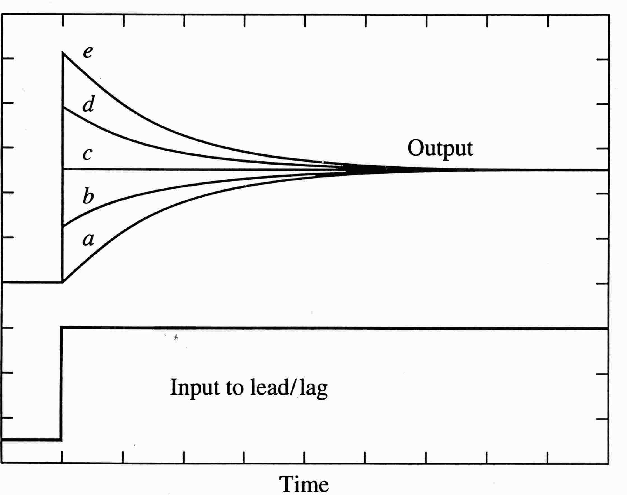
CHAPTER 15: FEEDFORWARD CONTROL
Typical dynamic responses from the lead-lag element in the feedforward controller. It synchronizes the compensation and disturbance effects.
Results for several cases of Tlead/Tlag :
a. 0.0
b. 0.5
c. 1.0
d. 1.5
e. 2.0

Slide 15
CHAPTER 15: FEEDFORWARD CONTROL
How do we combine
feedback with
feedforward?
F
1
L
1
feed
FF high-
lighted
in red
T
1
FF
TC
2
TY
1
MV_{fb}
+
MV_{ff}
TY
2
F
2
T
3
heating stream

Slide 16
CHAPTER 15: FEEDFORWARD CONTROL
Control Performance Comparison for CST Heater
Single-Loop Feedforward with feedback
IAE = 237.6971 ISE = 758.425
IAE = 27.772 ISE = 8.0059
76
76
75
74
74
temperature
temperature
73
72
72
71
70
70
0
20
40
60
80
100
120
140
160
180
200
0
20
40
60
80
100
120
140
160
180
200
Much better
performance!
WHY?

Slide 17
CHAPTER 15: FEEDFORWARD CONTROL
IAE = 27.772 ISE = 8.0059
75.4
TC
75.2
temperature
75
74.8
The MV changed before T
deviated from its set point!
74.6
74.4
0
20
40
60
80
100
120
140
160
180
200
SAM = 11.4394 SSM = 774.0613
60
58
56
heating valve (% open)
54
Valve adjustment not too aggressive
52
T1
50
0
20
40
60
80
100
120
140
160
180
200
Time
Why wait after disturbance?
Disturbance occurred at this time

Slide 18
CHAPTER 15: FEEDFORWARD CONTROL
F
1
What have we gained and lost using feedforward and feedback?
For each case, is FF with FB better, same, worse than single-loop feedback (TC2 → v)??
L
1
feed
T
1
FF
TC
2
TY
1
+
TY
2
F
2
T
3
heating stream
A disturbance in feed inlet temperature
A disturbance in heating medium inlet pressure
A disturbance in feed flow rate
A change to the TC set point

Slide 19
CHAPTER 15: FEEDFORWARD CONTROL
F
1
What have we gained and lost using feedforward and feedback?
For each case, is FF and FB better, same, worse than single-loop feedback (TC2 → v)??
L
1
feed
T
1
FF
TC
2
TY
1
+
TY
2
F
2
T
3
heating stream
A disturbance in feed inlet temperature
A disturbance in heating medium inlet pressure
A disturbance in feed flow rate
A change to the TC set point
FF/FB better
Both the same
Both the same
Both the same

Slide 20
CHAPTER 15: FEEDFORWARD CONTROL
FEEDFORWARD DESIGN CRITERIA
Feedforward is desired when
1. Single-loop performance unacceptable
2. A measured variable is available
A measured disturbance variable must
3. Indicate the occurrence of an important disturbance
4. NOT have a causal relationship from valve to measured disturbance sensor
5. Not have a much faster effect on the CV than the MV (when combined with feedback)

Slide 21
CHAPTER 15: FEEDFORWARD CONTROL
Feedforward and Feedback are complementary

Slide 22
CHAPTER 15: FEEDFORWARD CONTROL
CLASS EXERCISE: SOME QUESTIONS ABOUT FEEDFORWARD CONTROL
Why do we retain the feedback controller?
When would feedforward give zero steady-state offset?
Why does the feedforward controller sometimes delay its compensation? Don’t we always want fast control?
What is the additional cost for feedforward control?
How can we design a strategy that has two controllers both adjusting the same valve?
What procedure is used for tuning feedforward control?

Slide 23
CHAPTER 15: FEEDFORWARD CONTROL
Discuss this
packed bed
reactor.

Slide 24
CHAPTER 15: FEEDFORWARD CONTROL
Class exercise: Design feedforward control to improve the performance.
Performance
not acceptable for
feed composition
disturbance
heating stream
What about
cascade?
F
2
F
1
T
2
feed
T
T
A
3
AC
1
2
packed bed
IAE = 22.9349 ISE = 3.0248
reactor
0.2
0.15
maximum
Disturbance in feed composition
0.1
CV1
0.05
AC
0
1
-0.05
0
100
200
300
400
500
product

Slide 25
CHAPTER 15: FEEDFORWARD CONTROL
Class exercise: Design feedforward control to improve the performance.
Let’s use the
feedforward
design
rules!
Remember: The disturbance is the feed composition.

Slide 26
CHAPTER 15: FEEDFORWARD CONTROL
Class exercise: Design feedforward control to improve the performance.
A2 satisfies all of the rules and can be used as a feedforward variable.

Slide 27
CHAPTER 15: FEEDFORWARD CONTROL
heating stream
MV_{ff}
F
2
MV
+
AC
1
F
1
T
2
T
3
feed
T
1
A
2
D_{m}
MV_{fb}
FF
packed bed
reactor
AY
2
AC
1
SP₁ from
person
CV₁
product

Slide 28
CHAPTER 15: FEEDFORWARD CONTROL
Control Performance Comparison for Packed Bed Reactor
Single-Loop Feedforward and feedback
IAE = 22.9349 ISE = 3.0248
IAE = 2.1794 ISE = 0.017852
0.2
0.15
AC
AC
0.1
CV1
0.05
0
0.01
0
-0.01
-0.02
-0.05
-0.03
0
100
200
300
400
500
0
100
200
300
400
500
Little model error, most experimental feedforward not this good!
Much better
performance!
WHY?

Slide 29
CHAPTER 15: FEEDFORWARD CONTROL
What have we gained and lost using feedforward and feedback?
How does the system respond to the following?
F
2
MV_{ff}
heating stream
MV
+
AC
1
F
1
T
2
T
3
feed
T
1
A
2
FF
D_{m}
MV_{fb}
AY
2
packed bed
reactor
AC
1
SP₁ from
person
A disturbance in T2
A disturbance in heating medium inlet pressure
A disturbance inT1
A disturbance to feed composition, A2
A change to the AC-1 set point
Both the same
CV₁
product
Both the same
Both the same
FF/FB better
Both the same

Slide 30
CHAPTER 15: FEEDFORWARD CONTROL
We can combine cascade and feedforward to gain the advantages of both.
heating stream
F
2
MV₂
MV_{ff}
F
1
T
2
CV₂
TC
3
TY
3
feed
T
1
A
2
secondary
MV₁
AY
2
packed bed
reactor
primary
AC
1
SP₁ from
person
CV₁

Slide 31
CHAPTER 15: FEEDFORWARD CONTROL
Ratio control is a simple and frequently used feedforward application. In ratio control, the dynamics are negligible.
Uncontrolled
(wild) flow
F
2
Blended flow
x
Desired F1/F2 = R
FY
1
Goal is to keep
F1/F2
constant.
SP_{F1} = F2*R
FC
1
Manipulated
flow

Slide 32
CHAPTER 15: FEEDFORWARD CONTROL
CLASS EXERCISE: Use analyzer in automatic control while retaining the good aspects of ratio control.
Uncontrolled
(wild) flow
F
2
A
1
Blended flow
x
Desired F1/F2 = R
FY
1
Goal is to keep
A1
constant.
SP_{F1} = F2*R
FC
1
Manipulated
flow

Slide 33
CHAPTER 15: FEEDFORWARD CONTROL
CLASS EXERCISE: Use analyzer in automatic control while retaining the good aspects of ratio control.
Uncontrolled
(wild) flow
Feedback PID
F
2
AC
1
Blended flow
x
R
FY
1
Goal is to keep
A1
constant.
SP_{F1} = F2*R
FC
1
Manipulated
flow

Slide 34
CHAPTER 15: FEEDFORWARD CONTROL
In many organizations, we take actions on inputs to prevent large disturbances to outputs. Sometimes, these are called “pre-actions”.
What would you do if?
Number of births per year increases by 10% in your country
A drought occurs in in the most fertile area of your country
New legislation will impose stricter emissions regulations in three years
Do we need feedback? What is your algorithm? What would you do if the measurement were noisy?
After you have measured the change, you have some time to react before it hits you

Slide 35
CHAPTER 15: FEEDFORWARD WORKSHOP 1
Evaluate feedforward control for a disturbance in the heating medium inlet temperature. You may add a sensor but make no other changes to the equipment.
F
1
L
1
feed
T
1
product
TC
2
F
2
T
3
heating stream

Slide 36
CHAPTER 15: FEEDFORWARD WORKSHOP 2
Prepare a flowchart for the calculations performed by the packed bed feedforward controller. Show every calculation and use process variable symbols (e.g., A1), not generic symbols (CV₁). Report the equations for digital control.
MV_{ff}
heating stream
F
2
MV
+
AC
1
F
1
T
2
T
3
feed
T
1
A
2
FF
D_{m}
MV_{fb}
AY
2
packed bed
reactor
AC
1
SP₁ from
person
CV₁

Slide 37
CHAPTER 15: FEEDFORWARD WORKSHOP 3
Answer each of the following questions true or false
1. The feedback controller tuning does not change when combined with feedforward compensation.
2. The feedforward controller has no tuning parameter.
3. The feedforward controller should react immediately when the measured disturbance is measured.
4. Feedforward could be applied for a set point change.

Slide 38
CHAPTER 15: FEEDFORWARD WORKSHOP 4
Identify a process that would benefit from ratio control. You may select from examples in your summer/co-op jobs, engineering laboratories, and course projects.
Draw a sketch of the process with ratio control. Explain the advantages and any disadvantages of the design.

Slide 39
CHAPTER 15: FEEDFORWARD
When I complete this chapter, I want to be
able to do the following.
Identify situations for which feedforward is a good control enhancement
Design feedforward control using the five design rules
Apply the feedforward principle to other challenges in life
Lot’s of improvement, but we need some more study!
Read the textbook
Review the notes, especially learning goals and workshop
Try out the self-study suggestions
Naturally, we’ll have an assignment!

Slide 40
CHAPTER 15: LEARNING RESOURCES
SITE PC-EDUCATION WEB
- Instrumentation Notes
- Interactive Learning Module (Chapter 15)
- Tutorials (Chapter 15)
The Textbook, naturally, for many more examples

Slide 41
CHAPTER 15: SUGGESTIONS FOR SELF-STUDY
1. Suggest some methods for fine-tuning a feedforward controller.
2. Program a feedforward controller for one of the processes modelled in Chapters 3-5.
3. Explain why the feedforward compensation should not be much slower than the disturbance. Why doesn’t this guideline apply when no feedback is implemented?
4. Discuss whether you would recommend more than one feedforward controller on the same process.
5. Write a memorandum explaining feedforward compensation for a company with non-technical employees

Slide 42
CHAPTER 15: SUGGESTIONS FOR SELF-STUDY
6. A friend asks whether the general sketch for feedback, textbook Figure 1.4, applies to feedforward. Answer completely, including any changes to the sketch.
7. Discuss why the feedforward controller dead time must be positive.

