Slide 1
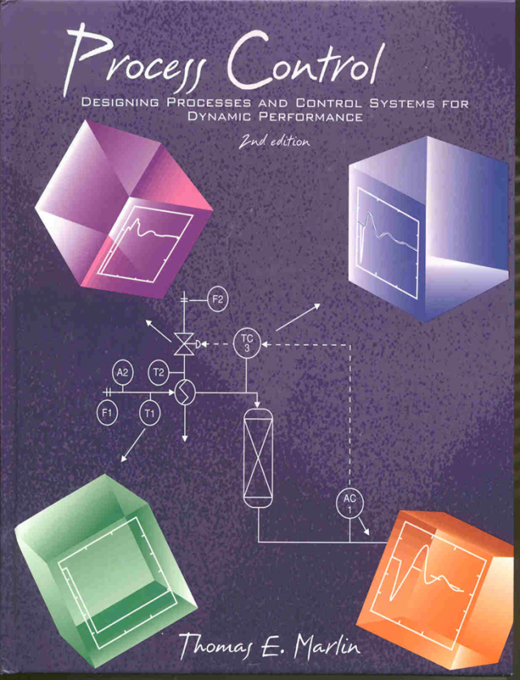
Process Control: Designing Process and Control Systems for Dynamic Performance
Chapter 14. Cascade Control
Copyright © Thomas Marlin 2013
The copyright holder provides a royalty-free license for use of this material at non-profit educational institutions

Slide 2
CHAPTER 14: CASCADE CONTROL
When I complete this chapter, I want to be
able to do the following.
Identify situations for which cascade is a good control enhancement
Design cascade control using the five design rules
Apply the tuning procedure to cascade control

Slide 3
CHAPTER 14: CASCADE CONTROL
Outline of the lesson.
A process challenge - improve performance
Cascade design rules
Good features and application guidelines
Several process examples
Analogy to management principle

Slide 4
CHAPTER 14: CASCADE CONTROL
F
1
L
1
feed
T
1
product
Discuss this
stirred tank
heat exchanger.
TC
2
PID controller
F
2
T
3
heating stream

Slide 5
CHAPTER 14: CASCADE CONTROL
Class exercise: What do
we do?
TC
IAE = 147.9971 ISE = 285.4111
76
75
F
1
L
1
74
temperature
feed
73
minimum
T
1
72
Disturbance =
heating pressure
Control
performance
not acceptable!
0
20
40
60
80
100
120
140
160
180
200
TC
2
Pressure disturbance
F
2
T
3
heating stream

Slide 6
CHAPTER 14: CASCADE CONTROL
Let’s think about the process behavior.
Causal relationship from P disturbance to T (without control)
What measurable effect always occurs when P changes?
P
v (valve) → ??? → Q → TC
P
(heating oil)

Slide 7
CHAPTER 14: CASCADE CONTROL
Let’s think about the process behavior.
If we can maintain this variable approximately constant, can we reduce the effect of the disturbance?
P
v (valve) → ??? → Q → TC
P
(heating oil)

Slide 8
CHAPTER 14: CASCADE CONTROL
F
1
L
1
feed
T
1
product
Sketch a
Proposal
here.
TC
2
PID controller
F
2
T
3
heating stream

Slide 9
CHAPTER 14: CASCADE CONTROL
A New Control Structure!!
F
1
L
1
feed
T
1
product
T2=CV₁
Key variables
for the two
PID controllers.
primary
TC
2
SP₁ from person
SP₂ = MV₁
FC
2
secondary
T
3
v=MV₂
F2=CV₂
heating stream

Slide 10
CHAPTER 14: CASCADE CONTROL
Class exercise
plant
computer
computer
person
T
2
T2_{SP}
Define the
calculations
performed in
the computer.
F
2

Slide 11
CHAPTER 14: CASCADE CONTROL
Class exercise
plant
computer
computer
person
T
2
T2_{SP}
Each controller
is a PID!
F
2

Slide 12
CHAPTER 14: CASCADE CONTROL
Control Performance Comparison for CST Heater
Single-Loop Cascade
IAE = 147.9971 ISE = 285.4111
IAE = 11.5025 ISE = 1.6655
76
76
75
75
74
74
temperature
73
73
72
72
0
20
40
60
80
100
120
140
160
180
200
0
50
100
150
200
Much better
performance!
WHY?

Slide 13
CHAPTER 14: CASCADE CONTROL
Cascade Control Performance for CST Heater
IAE = 11.5025 ISE = 1.6655
76
WHY?
Disturbance in
flow is quickly
corrected.
This compensates for
the disturbance!
75
TC
74
temperature
Small deviation, returns to set point
73
72
0
50
100
150
200
IAE = 11.6538 ISE = 11.2388
SAM = 5.8711 SSM = 4.4807
20.5
58
20
56
FC
19.5
heating flow
54
heating valve (% open)
Valve adjustment is not aggressive!
19
Disturbance affects flow sooner than T2
52
18.5
18
0
50
100
150
200
50
0
50
100
150
200
Time
Time

Slide 14
CHAPTER 14: CASCADE CONTROL
F
1
What have we gained and lost using cascade control?
For each case, is cascade better, same, worse than single-loop feedback (TC2 → v)?
L
1
feed
T
1
product
CV₁
TC
2
SP₁ for person
SP₂ = MV₁
FC
2
T
3
MV₂
CV₂
heating stream
A disturbance in heating medium inlet pressure
A disturbance in heating medium inlet temperature
A disturbance in feed flow rate
A change to the TC set point

Slide 15
CHAPTER 14: CASCADE CONTROL
F
1
What have we gained and lost using cascade control?
For each case, is cascade better, same, worse than single-loop feedback (TC2 → v)?
L
1
feed
T
1
product
CV₁
TC
2
SP₁ for person
SP₂ = MV₁
FC
2
T
3
MV₂
CV₂
heating stream
A disturbance in heating medium inlet pressure
A disturbance in heating medium inlet temperature
A disturbance in feed flow rate
A change to the TC set point
Cascade better
Both the same
Both the same
Both the same

Slide 16
CHAPTER 14: CASCADE CONTROL
Very important
CASCADE DESIGN CRITERIA
Cascade is desired when
1. Single-loop performance unacceptable
2. A measured variable is available
A secondary variable must
3. Indicate the occurrence of an important disturbance
4. Have a causal relationship from valve to secondary (cause → effect)
5. Have a faster response than the primary

Slide 17
CHAPTER 14: CASCADE CONTROL
ADVANTAGES OF CASCADE CONTROL
Large improvement in performance when the secondary is much faster than primary
Simple technology with PID algorithms
Use of feedback at all levels. Primary has zero offset for “step-like” disturbances.
Plant operating personnel find cascades easy to operate. Open a cascade at one level, and all controllers above are inactive.

Slide 18
CHAPTER 14: CASCADE CONTROL
CLASS EXERCISE: SOME QUESTIONS ABOUT CASCADE CONTROL
Why do we retain the primary controller?
Which modes are required for zero steady-state offset?
Which modes are recommended?
What is the additional cost for cascade control?
Normally, each PID controller represents one independent controlled variable. Is anything different in a cascade structure?
What procedure is used for tuning cascade control?

Slide 19
CHAPTER 14: CASCADE CONTROL
Discuss this
packed bed
reactor.

Slide 20
CHAPTER 14: CASCADE CONTROL
Class exercise: Design a cascade control structure to improve performance.
heating stream
Performance
not acceptable
Disturbance in heating medium temperature
F
2
F
1
T
2
feed
T
T
A
3
1
2
packed bed
0.2
AC
reactor
0.15
maximum
CV1
0.1
0.05
AC
1
0
-0.05
product
0
100
200
300
400
500

Slide 21
CHAPTER 14: CASCADE CONTROL
Class exercise: Design a cascade control structure to improve performance.
Let’s use the
cascade design
rules!
Remember: The disturbance is the heating medium inlet temperature and the primary is AC-1.

Slide 22
CHAPTER 14: CASCADE CONTROL
Class exercise: Design a cascade control structure to improve performance.
T2 is the disturbance but cannot be used in cascade!
Let’s use the
cascade design
rules!
T3 satisfies all of the rules and can be used as a secondary in a cascade.

Slide 23
CHAPTER 14: CASCADE CONTROL
Sketch your
design on this
drawing.

Slide 24
CHAPTER 14: CASCADE CONTROL
heating stream
F
2
MV₂
F
1
T
2
CV₂
TC
3
feed
T
1
A
2
secondary
SP₂ = MV₁
packed bed
reactor
primary
SP₁ from
person
AC
1
CV₁
product

Slide 25
CHAPTER 14: CASCADE CONTROL
Control Performance Comparison for Packed Bed Reactor
Single-Loop Cascade
IAE = 24.4229 ISE = 3.4639
IAE = 6.3309 ISE = 0.19017
0.2
0.2
0.15
0.15
CV1
0.1
0.1
0.05
0.05
0
0
-0.05
-0.05
0
100
200
300
400
500
0
100
200
300
400
500
Much better
performance!
WHY?

Slide 26
CHAPTER 14: CASCADE CONTROL
Cascade Control Performance for Packed Bed Reactor
IAE = 6.3309 ISE = 0.19017
0.2
WHY?
Disturbance in
temperature is quickly
corrected.
This compensates for
the disturbance!
AC
0.15
CV1
0.1
0.05
0
-0.05
0
100
200
300
400
500
IAE = 37.2971 ISE = 18.6031
SAM = 4.3428 SSM = 0.59949
0.5
4
3
0
TC
CV2
MV
2
Valve adjustment is not aggressive!
-0.5
Disturbance affects T sooner
1
-1
0
100
200
300
400
500
0
0
100
200
300
400
500
Time
Time

Slide 27
CHAPTER 14: CASCADE CONTROL
What have we gained and lost using cascade control?
How does the system respond to the following?
A disturbance in T1
A disturbance in heating medium inlet pressure
A disturbance in feed pressure
A disturbance to feed composition, A2
A change to the AC-1 set point

Slide 28
CHAPTER 14: CASCADE CONTROL
What have we gained and lost using cascade control?
How does the system respond to the following?
A disturbance in T1
A disturbance in heating medium inlet pressure
A disturbance in feed pressure
A disturbance to feed composition, A2
A change to the AC-1 set point
A disturbance in T1
A disturbance in heating medium inlet pressure
A disturbance in feed pressure
A disturbance to feed composition, A2
A change to the AC-1 set point
Cascade better
Cascade better
Cascade better, but not “perfect”
Both the same
Both the same

Slide 29
CHAPTER 14: CASCADE CONTROL
Three-Level Cascade!
CV₃
F
2
MV₃
SP₃ = MV₂
F
1
T
2
CV₂
TC
3
feed
T
1
A
2
SP₂ = MV₁
No limit to number
of levels of cascade!
Each must
meet criteria.
AC
1
SP₁ from
person
CV₁
product

Slide 30
CHAPTER 14: CASCADE CONTROL
Does cascade apply to instrumentation? Yes, a valve positioner is a secondary that reduces effects of friction!!
F
1
L
1
feed
T
1
product
TC
2
Valve positioner: Measures the stem position and adjusts the air pressure to (closely) achieve the desired position. This is located at the valve.
T
3
heating stream

Slide 31
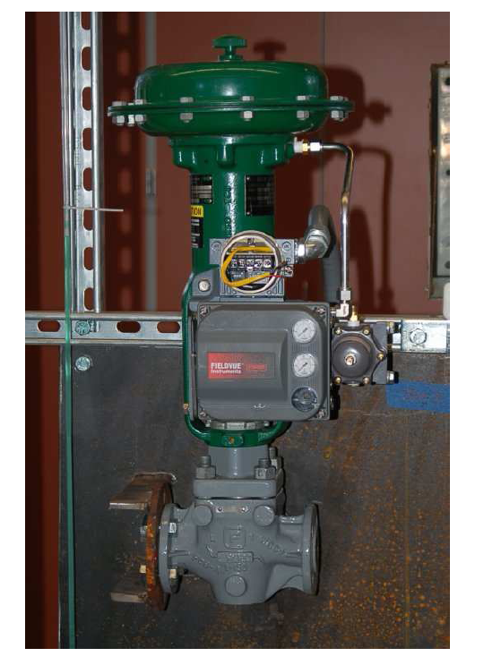
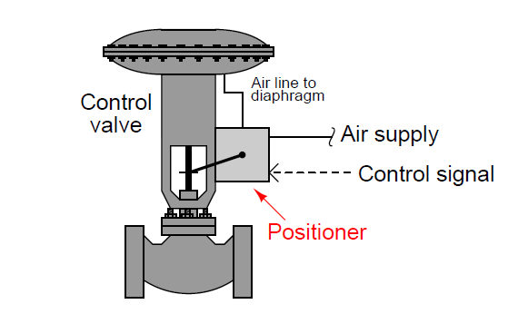
CHAPTER 14: CASCADE CONTROL
Does cascade apply to instrumentation? Yes, a valve positioner is a secondary that reduces effects of friction!!
Kuphalt, T. (2012) Lessons in Industrial Instrumentation, http://www.openbookproject.net/books/socratic/sinst/

Slide 32
CHAPTER 14: CASCADE CONTROL
A cascade is a hierarchy, with decisions transmitted from upper to lower levels.
What are advantages of a hierarchy?
What information should be transmitted up the hierarchy?
What information should flow from secondary to primary in a cascade?

Slide 33
CHAPTER 14: CASCADE CONTROL WORKSHOP 1
Evaluate cascade control for a disturbance in the heating medium inlet temperature. You may add a sensor but make no other changes to the equipment.
F
1
L
1
feed
T
1
product
TC
2
F
2
T
3
heating stream

Slide 34
CHAPTER 14: CASCADE CONTROL WORKSHOP 2
Prepare a detailed plan for tuning the two cascade controllers shown in the following sketch.
F
1
L
1
feed
T
1
product
CV₁
TC
2
SP₁ for person
SP₂ = MV₁
FC
2
T
3
MV₂
CV₂
heating stream

Slide 35
CHAPTER 14: CASCADE CONTROL WORKSHOP 3
Prepare a flowchart for the calculations performed by the packed bed cascade controllers. Show every calculation and use process variable symbols (e.g., A1), not generic symbols (CV₁).

Slide 36
CHAPTER 14: CASCADE CONTROL WORKSHOP 4
Identify process examples in which a valve positioner will improve performance and not improve performance.
Draw a sketch of each process and discuss your recommendation of whether or not to use a positioner.
Note: Modern positioners provide diagnosis of the valve behavior that can be transmitted digitally for later evaluation. This can be very useful in maintenance and trouble shooting.

Slide 37
CHAPTER 14: CASCADE CONTROL
When I complete this chapter, I want to be
able to do the following.
Identify situations for which cascade is a good control enhancement
Design cascade control using the five design rules
Apply the tuning procedure to cascade control
Lot’s of improvement, but we need some more study!
Read the textbook
Review the notes, especially learning goals and workshop
Try out the self-study suggestions
Naturally, we’ll have an assignment!

Slide 38
CHAPTER 14: LEARNING RESOURCES
SITE PC-EDUCATION WEB
- Instrumentation Notes
- Interactive Learning Module (Chapter 14)
- Tutorials (Chapter 14)
S_LOOP
- Dynamic simulation of linear system
The Textbook, naturally, for many more examples

Slide 39
CHAPTER 14: SUGGESTIONS FOR SELF-STUDY
1. Prove that an integral mode is required for zero steady-state offset of the primary.
Do we achieve zero offset for the secondary. Why or why not?
Is there any advantage for achieving zero offset for the secondary?
2. Program a cascade control for one of the processes modelled in Chapters 3-5.
3. Determine a guideline for how much faster the secondary must be than the primary for cascade to function well.

Slide 40
CHAPTER 14: SUGGESTIONS FOR SELF-STUDY
4. Using block diagram algebra, derive the transfer functions in textbook equations (14.6) to (14.8).
5. Review the following publication to find other advantages for cascade control.
Verhaegen, S., When to use cascade control, Intech, 38-40 (Oct. 1991).
6. Discuss applications of cascade control (hierarchical decision systems) in business, government, and university. Explain advantages and disadvantages of these systems.

