Slide 1
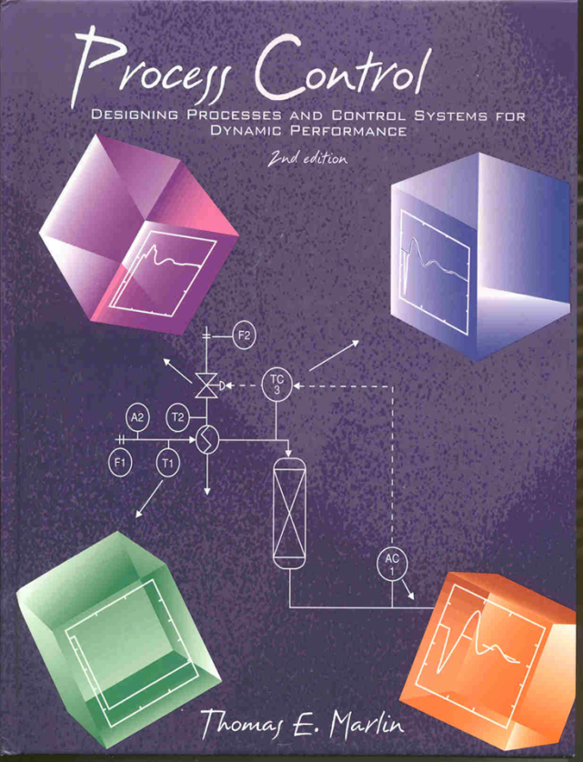
Process Control: Designing Process and Control Systems for Dynamic Performance
Chapter 11. Digital Control
Copyright © Thomas Marlin 2013
The copyright holder provides a royalty-free license for use of this material at non-profit educational institutions

Slide 2
CHAPTER 11: DIGITAL CONTROL
When I complete this chapter, I want to be
able to do the following.
Identify examples of analog and digital computation and signal transmission.
Program a digital PID calculation
Select a proper execution rate for a feedback controller.
Tune a digital PID

Slide 3
CHAPTER 11: DIGITAL CONTROL
Outline of the lesson.
Brief history of control equipment
Sampling the measurement
Digital PID calculation
Effect of digital execution period on tuning and performance

Slide 4
CHAPTER 11: DIGITAL CONTROL
A BRIEF HISTORY OF PROCESS CONTROL
A little history helps us to understand the common approaches to process control. The realities of available equipment have shaped the theory and practice of process control.
While digital technology has revolutionized what is possible today, equipment has a life of many decades. Therefore, we see older approaches in most plants, and will for a long time.
Let’s start from about the late 18th and early 19th century to today. What happened that “got things going”?

Slide 5
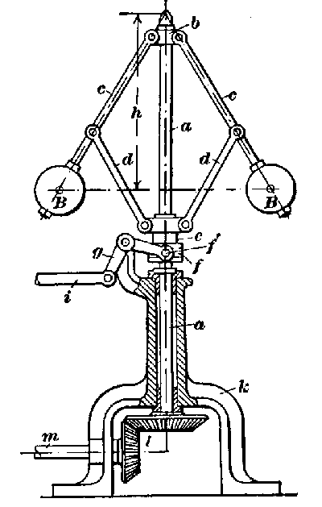
CHAPTER 11: DIGITAL CONTROL
Making the steam engine work all the time
governor
Inventors wanted to control the pressure of the boiler and the speed of the device driven by the steam (using a governor).
People experienced
- Explosions!
- Unstable behavior
And control engineering was born!
http://oldenginehouse.users.btopenworld.com/watt.htm

Slide 6
CHAPTER 11: DIGITAL CONTROL
Manual Operation
People know more than machines, so leave decisions to them.
Manual operation
Mechanical devices
Pneumatic devices
Electronic devices
Digital calculations
Digital calc. & communication
Temperature indicator
Should I adjust the
valve or should
I run?
Emergency cooling

Slide 7
CHAPTER 11: DIGITAL CONTROL
Mechanical Device
The value of the variable is represented by position of equipment.
Manual operation
Mechanical devices
Pneumatic devices
Electronic devices
Digital calculations
Digital calc. & communication
How do I change the set point?
Location of the fulcrum determines the Δgate/Δlevel
Float measures the liquid level
Raising and lowering the gate affects the flowin

Slide 8
CHAPTER 11: DIGITAL CONTROL
Pneumatic Device
The value of the variable is proportional to air pressure (50 - 150 C = 3 -15 psi).
Manual operation
Mechanical devices
Pneumatic devices
Electronic devices
Digital calculations
Digital calc. & communication
How do I
perform the
PID
calculation?
v1
TC
v2
The signal is 3-15 psi air pressure in a pipe.
Air pressure moves flexible diaphragm

Slide 9
CHAPTER 11: DIGITAL CONTROL
Pneumatic & Electronic Devices
Principle of analog computation!
Manual operation
Mechanical devices
Pneumatic devices
Electronic devices
Digital calculations
Digital calc. & communication
Build a physical system that (approximately) obeys the same model.
Pneumatic - force balance (Newton’s laws)
Electronic - current balance (Kirkoff’s laws)
I wonder what these devices look like.

Slide 10
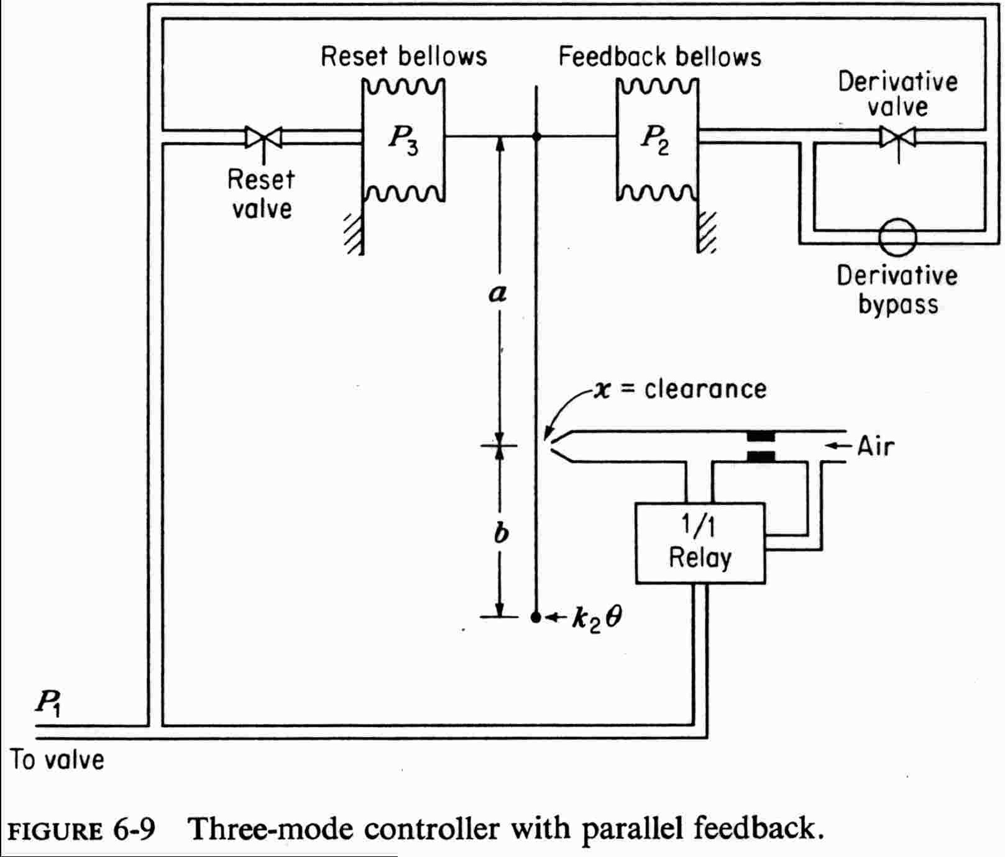
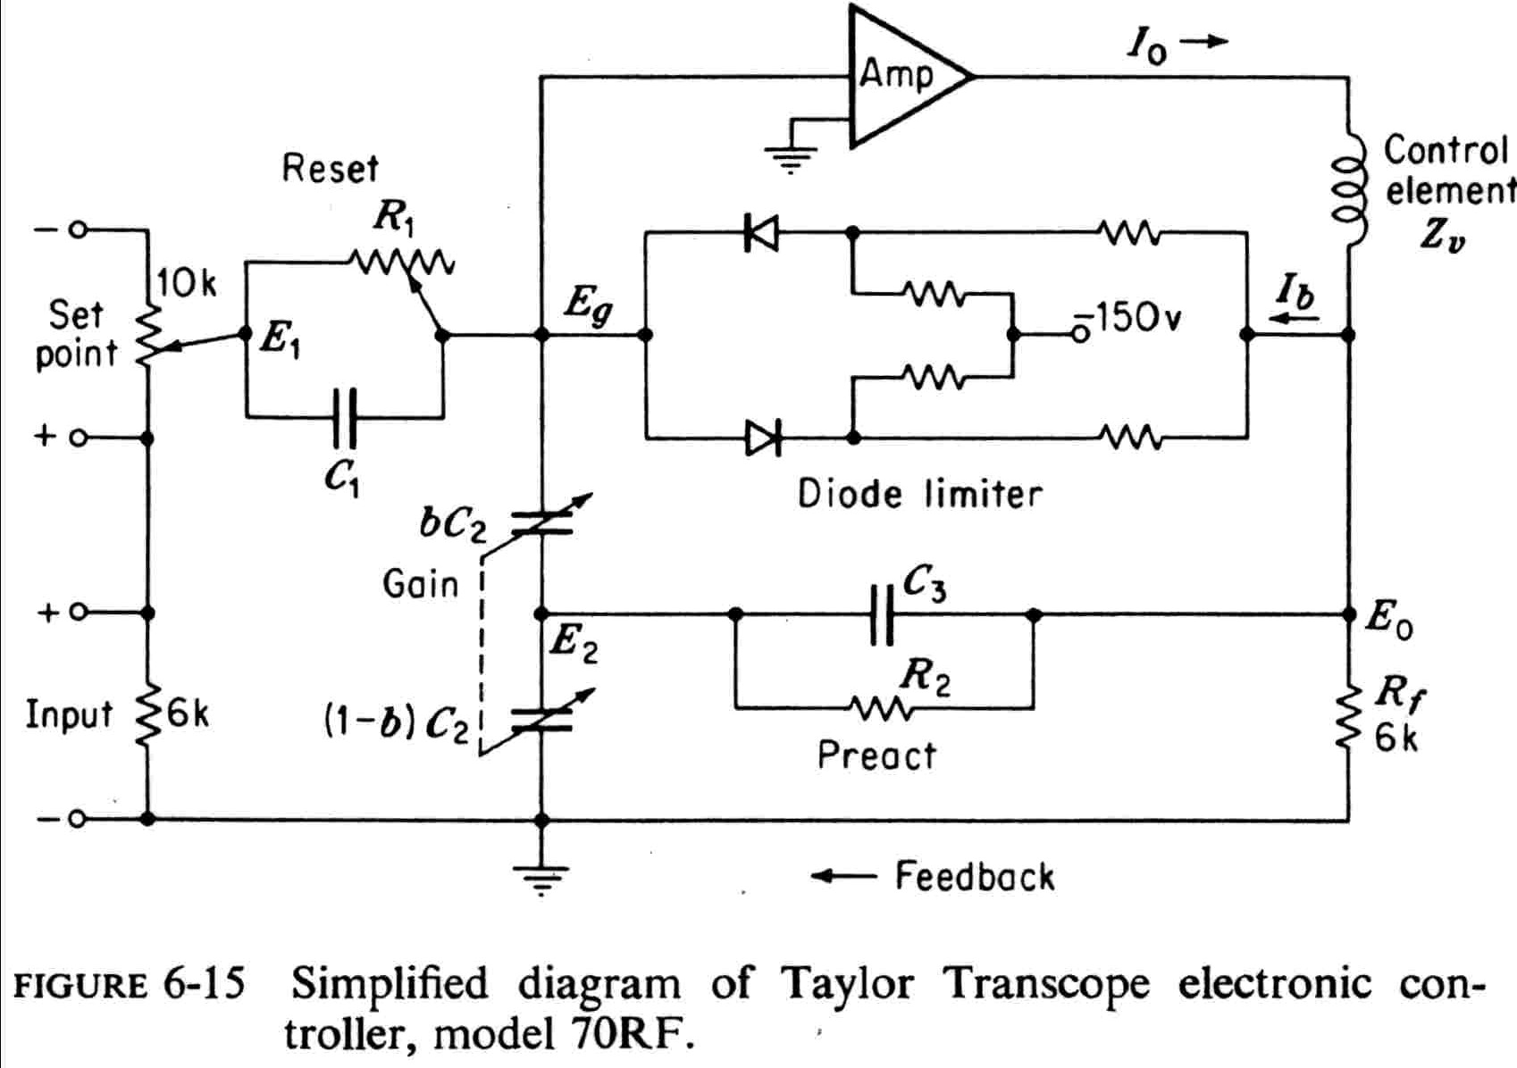
CHAPTER 11: DIGITAL CONTROL
Analog computation!
Pneumatic
Electronic
From Harriott, P., Process Control, McGraw-Hill, New York, 1964

Slide 11
CHAPTER 11: DIGITAL CONTROL
Electronic Device
The variable is proportional to current or voltage (50 - 150 C = 4 - 20 mA).
Manual operation
Mechanical devices
Pneumatic devices
Electronic devices
Digital calculations
Digital calc. & communication
I’ll use
analog
computation
again.
v1
TC
v2
The signal is 4-20 mA transmitted by wire.
Current converted to air pressure to affect valve

Slide 12
CHAPTER 11: DIGITAL CONTROL
Digital Calculation
Digital calculations with electronic transmission.
Manual operation
Mechanical devices
Pneumatic devices
Electronic devices
Digital calculations
Digital calc. & communication
We’ll soon see
how to
calculate PID
digitally.
v1
TC
Digital
PID
v2
The signal is 4-20 mA transmitted by wire.
Current converted to air pressure to affect valve

Slide 13
CHAPTER 11: DIGITAL CONTROL
Digital Calculation & Communication
Digital calculations with transmission by local area network. Sensor and valve can have microprocessors too!
Manual operation
Mechanical devices
Pneumatic devices
Electronic devices
Digital calculations
Digital calc. & communication
We soon see
how to
calculate PID
digitally.
v1
Digital
PID
TC
v2
The signal transmitted digitally.
converted to air pressure to affect valve

Slide 14
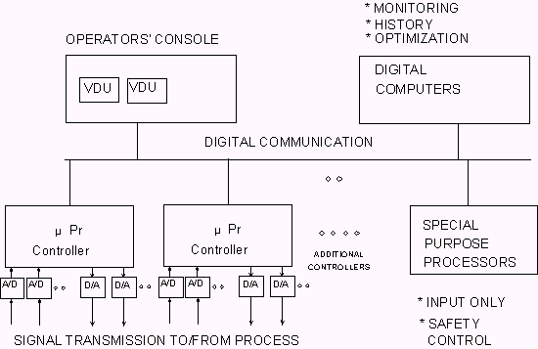
CHAPTER 11: DIGITAL CONTROL
Digital control employs a distributed computing network
Why?

Slide 15
CHAPTER 11: DIGITAL CONTROL
Digital control employs a distributed computing network

Slide 16
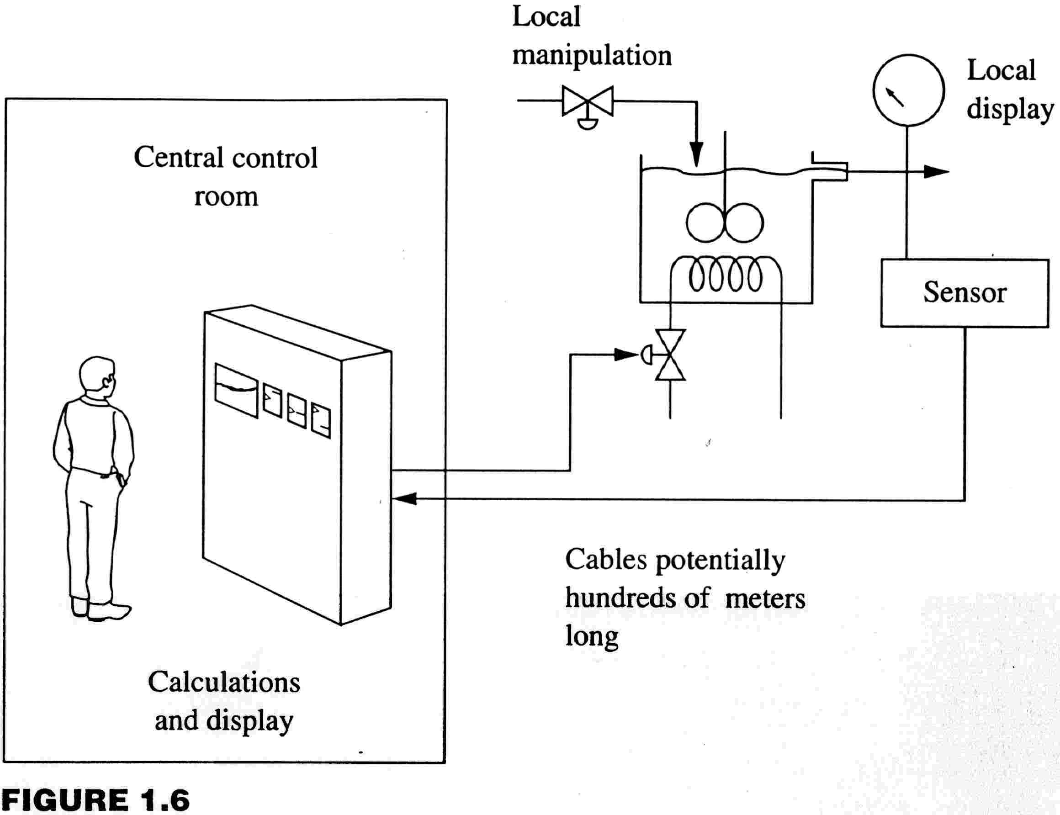
CHAPTER 11: DIGITAL CONTROL
Let’s remember that control is performed many places; locally and remotely by people and equipment.
Sensors, local indicators, and valves in the process.
Some actions and automation done here.
Central control room
Displays of variables, calculations, and commands to valves are in the centralized control center.

Slide 17
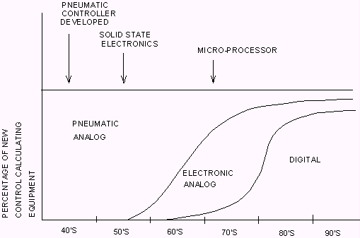
CHAPTER 11: DIGITAL CONTROL
A rough indication of the use of various devices for control calculations for new industrial process control systems.

Slide 18
CHAPTER 11: DIGITAL CONTROL
The techniques presented will be applicable for digital sampling and calculation. Transmission can be electronic or digital.
Periodically, the measurement is sampled and a calculation is performed.
Manual operation
Mechanical devices
Pneumatic devices
Electronic devices
Digital calculations
Digital calc. & communication
v1
TC
Digital
PID
v2

Slide 19
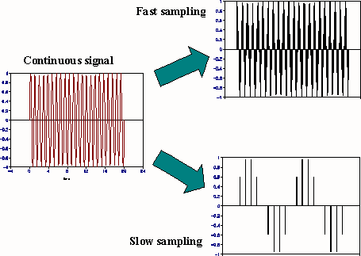
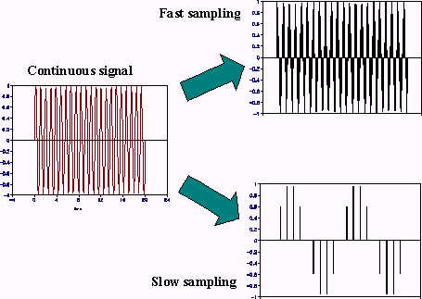
CHAPTER 11: DIGITAL CONTROL
Not much
information lost
What happened
here?

Slide 20
CHAPTER 11: DIGITAL CONTROL
Aliasing: Sampling much slower than the measurement changes causes significant loss of information.
Engineer should design for sampling “fast enough”.
What happened
here?
ALIASING

Slide 21
CHAPTER 11: DIGITAL CONTROL
We “hold” the last sampled value between control executions.
1.5
Signal after the zero-order hold, samples every 2.5 time units
0.9
0.3
Continuous signal
-0.3
Does the sample/
hold change the
dynamics?
-0.9
-1.5
0
5
10
15
20
25
30
Time

Slide 22
CHAPTER 11: DIGITAL CONTROL
The red line is the continuous approximation of the signal after the sample & hold. This shows that the effect is to introduce a “dead time” of about Δt/2.
Continuous signal
Continuous signal that is approximately the output of the hold.
θ ≈ Δt/2 due to sampling

Slide 23
CHAPTER 11: DIGITAL CONTROL
We have a sample of values; CV₁, CV₂, …., CV_{N}
Proportional:
Integral:
Derivative:
Hint: How would you estimate
each mode using numerical
methods?

Slide 24
CHAPTER 11: DIGITAL CONTROL
We have a sample of values; CV₁, CV₂, …., CV_{N}
Proportional:
Integral:
Derivative:
Calculated every time the
controller is executed.

Slide 25
CHAPTER 11: DIGITAL CONTROL
We have a sample of values; CV₁, CV₂, …., CV_{N}
Proportional:
Integral:
Derivative:
Calculated every time the
controller is executed.
Δt = constant
How many elements in sum?

Slide 26
CHAPTER 11: DIGITAL CONTROL
We have a sample of values; CV₁, CV₂, …., CV_{N}
Proportional:
Integral:
Derivative:
Efficient calculation in realtime!

Slide 27
CHAPTER 11: DIGITAL CONTROL
We have a sample of values; CV₁, CV₂, …., CV_{N}
Proportional:
Integral:
Derivative:
Calculated every time the
controller is executed.

Slide 28
CHAPTER 11: DIGITAL CONTROL
We have a sample of values; CV₁, CV₂, …., CV_{N}
$$I={MV}_{t}−K_{C}\left[E_{1}−\frac{T_{d}}{∆t}({CV}_{1}−{CV}_{0}\right]$$
“I” is sometimes called the bias.
Calculated only when
the controller is turned on, N=1.
Thereafter, I is constant
Bumpless transfer:No change to the MV when controller is first executed

Slide 29
CHAPTER 11: DIGITAL CONTROL
Digital PID, positional form calculates the output to the final element
$${MV}_{N}=K_{C}\left[E_{N}+\frac{∆t}{T_{I}}\sum_{i=1}^{N}{E_{i}}−\frac{T_{d}}{∆t}({CV}_{N}−{CV}_{N−1})\right]+I$$
Put all modes together.

Slide 30
CHAPTER 11: DIGITAL CONTROL
$${MV}_{N}=K_{C}\left[E_{N}+\frac{∆t}{T_{I}}\sum_{i=1}^{N}{E_{i}}−\frac{T_{d}}{∆t}({CV}_{N}−{CV}_{N−1})\right]+I$$
Digital PID, Velocity form - Alternatively, we can calculate the change in the signal at every execution.
$$∆{MV}_{N}=K_{C}\left[E_{N}−E_{N−1}+\frac{∆t}{T_{I}}E_{N}−\frac{T_{d}}{∆t}({CV}_{N}−2{CV}_{N−1}{+ CV}_{N−2})\right]$$
$${MV}_{N}={MV}_{N−1}+∆{MV}_{N}$$

Slide 31
CHAPTER 11: DIGITAL CONTROL
What is the effect of digital execution of the PID controller on tuning and performance?
Hint: things
don’t get
better by
slowing the
loop.
F_{S}
solvent
F_{A}
pure A
AC
SP
Continuous tuning
Kc = 30
TI = 11
Td = 0.80
$${MV}_{N}=K_{C}\left[E_{N}+\frac{∆t}{T_{I}}\sum_{i=1}^{N}{E_{i}}−\frac{T_{d}}{∆t}({CV}_{N}−{CV}_{N−1})\right]+I$$

Slide 32
CHAPTER 11: DIGITAL CONTROL
S-LOOP plots deviation variables (IAE = 12.2909)
1.5
S-LOOP plots deviation variables (IAE = 20.0491)
1.5
1
1
Controlled Variable
Controlled Variable
0.5
Continuous PID
0.5
Digital PID, Δt=5
0
0
50
100
150
200
250
0
0
50
100
150
200
250
Time
Time
40
60
30
40
Manipulated Variable
Manipulated Variable
20
10
20
0
0
50
100
150
200
250
0
0
50
100
150
200
250
Time
Time
2
S-LOOP plots deviation variables (IAE = 37.1005)
2
S-LOOP plots deviation variables (IAE = 45.5197)
1.5
1.5
Controlled Variable
Controlled Variable
1
1
0.5
Digital PID, Δt=10
0.5
Digital PID, Δt=15
0
0
50
100
150
200
250
0
0
50
100
150
200
250
CONCLUSION: We should retune the controller when the execution is slow compared with the feedback dynamics!
Time
Time
60
80
60
40
40
Manipulated Variable
Manipulated Variable
20
20
0
0
-20
0
50
100
150
200
250
0
50
100
Time
150
200
250
Time

Slide 33
CHAPTER 11: DIGITAL CONTROL
S-LOOP plots deviation variables (IAE = 12.2909)
1.5
S-LOOP plots deviation variables (IAE = 20.0491)
1.5
1
1
Controlled Variable
Controlled Variable
0.5
Continuous PID
0.5
Digital PID, Δt=5
Δt = 0.33(θ+τ) >> 0.05 (θ+τ)
0
0
50
100
150
200
250
0
0
50
100
150
200
250
Time
Time
40
60
30
40
Manipulated Variable
Manipulated Variable
20
10
20
0
0
50
100
150
200
250
0
0
50
100
150
200
250
Time
Time
Guideline for selecting the execution time:
To prevent degradation of control loop performance, select a controller execution time of Δt ≤ 0.05(θ+τ).
Note: Typical sample period for chemical process control is 1/3-1/2 second. Much faster is possible, if needed.

Slide 34
CHAPTER 11: DIGITAL CONTROL
Modified PID tuning for digital controllers - this is a guideline that usually works adequately.
Continuous signal
Continuous signal that is approximately the output of the hold.
θ ≈ Δt/2 due to sampling
We learned that sampling introduces an additional dead time of about Δt/2.
1. Obtain model, usually using empirical method
2. Determine the sample period, Δt ≤ 0.05(θ+τ), if possible
3. Recalculate the dead time as θ’ = θ + Δt/2
4. Calculate tuning using continuous method
5. Implement and fine tune as needed

Slide 35
CHAPTER 11: DIGITAL CONTROL
Let’s apply this guideline for the three-tank mixer with a long sample time = 15 minutes.
F_{S}
solvent
F_{A}
pure A
AC
Process reaction curve
Kp = 0.039 %A/%open
θ = 5.5 + ?? = ?? min
τ = 10.5 min
Tuning from chart
Kc = ??
TI = ??
Td = ??

Slide 36
CHAPTER 11: DIGITAL CONTROL
The performance is about as good as possible with this very long sampling time! Would you fine tune further?
1.5
S-LOOP plots deviation variables (IAE = 20.0383)
Tuning from chart
Kc = 20
TI = 14
Td = 2.35
IAE increased from 12.2 to 20+
1
Controlled Variable
0.5
0
0
50
100
150
200
250
Time
50
40
30
Manipulated Variable
20
10
0
0
50
100
150
200
250
Time

Slide 37
CHAPTER 11: DIGITAL CONTROL
If the PID is no better in digital form, why did we spend decades of engineering time and billions of dollars converting the world’s control to digital?

Slide 38
CHAPTER 11: DIGITAL CONTROL
Why did we convert the world’s control to digital - Complex controllers
0.995
0.99
Improved performance can be achieved with algorithms that optimize the path to the set point, every controller execution!
(See Chapters 19 and 23)
Distillate Light key
0.985
Good performance!
F_{R}
0.98
0
50
100
150
200
Time
F_{V}
0.04
0.035
Almost no disturbance!
Bottoms Light Key
0.03
0.025
0.02
0
50
100
150
200
Time

Slide 39
CHAPTER 11: DIGITAL CONTROL
Why did we convert the world’s control to digital - Process monitoring
We have a digital history of measurements for
Recall at any time for trouble shooting
Calculation of process performance indicators, heat transfer coefficients, reactor yields, energy/kg of product, and so forth
Excellent graphical displays with data in context of process schematic
(See Chapter 26)

Slide 40
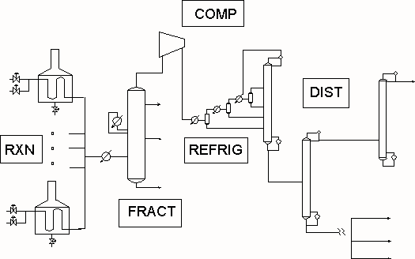
CHAPTER 11: DIGITAL CONTROL
Why did we convert the world’s control to digital - Process optimization
Best suction pressure?
Best reactor conversions?
Best product/ recycle purities?
Best feed rates, each feed type
(See Chapter 26)

Slide 41
CHAPTER 11: DIGITAL CONTROL
Why did we convert the world’s control to digital -Diagnostics
We have digital monitors at sensor, controller and valve!
Compare signal to valve with actual valve position - report significant errors
Diagnose problems with sensor (voltage, etc.)
Do not take feedback control action on questionable loop - alarm operator
And many other
reasons that
digital is
a winner.

Slide 42
CHAPTER 11: DIGITAL CONTROL, WORKSHOP 1
1. Select all of the appropriate answers. Mechanical implementation of feedback control employs
a. Digital computation
b. Analog computation
c. Neither a nor b
d. Both a and b
2. A digital PID controller is operating “in automatic”, i.e., it is calculating the signal to the final element. You are fine tuning the loop. You change the controller gain by -30% of its original value.
Describe what happens.

Slide 43
CHAPTER 11: DIGITAL CONTROL, WORKSHOP 2
You are tuning the temperature controller shown in the figure. You have determined the dynamic model below.
Determine the PID tuning for this loop for execution periods below and simulate the results using S_LOOP.
Δt = 0.10
Δt = 1.0
Δt = 5.0
v1
TC
v2
(All times are in minutes.)

Slide 44
CHAPTER 11: DIGITAL CONTROL, WORKSHOP 3
Develop a table with advantages and disadvantages for the six control equipment categories for many important issues.

Slide 45
CHAPTER 11: DIGITAL CONTROL
When I complete this chapter, I want to be
able to do the following.
Identify examples of analog and digital computation and signal transmission.
Program a digital PID calculation
Select a proper execution rate for a feedback controller.
Tune a digital PID
Lot’s of improvement, but we need some more study!
Read the textbook
Review the notes, especially learning goals and workshop
Try out the self-study suggestions
Naturally, we’ll have an assignment!

Slide 46
CHAPTER 11: LEARNING RESOURCES
SITE PC-EDUCATION WEB
- Instrumentation Notes
- Interactive Learning Module (Chapter 11)
- Tutorials (Chapter 11)
Software Laboratory, S_LOOP
- You can simulate a PID loop with continuous of digital control to determine the effect of execution period.

Slide 47
CHAPTER 11: SUGGESTIONS FOR SELF-STUDY
1. Find some process reaction curve plots in Chapters 3-5. Determine the maximum PID execution period. Then, for a controller execution period ten times the minimum, determine the tuning for PID and PI controllers using the tuning charts.
2. Using S_LOOP, simulate the system(s) in question 1.
3. Develop a flowchart for an excellent computer program to calculate the PID control. This should be a subroutine that can be called for every controller in the plant.

Slide 48
CHAPTER 11: SUGGESTIONS FOR SELF-STUDY
4. Take an inventory of your house and identify analog and digital control systems.
5. Develop a simulation that accepts a continuous signal and determines the output of a zero-order hold and first-order hold.

