Slide 1
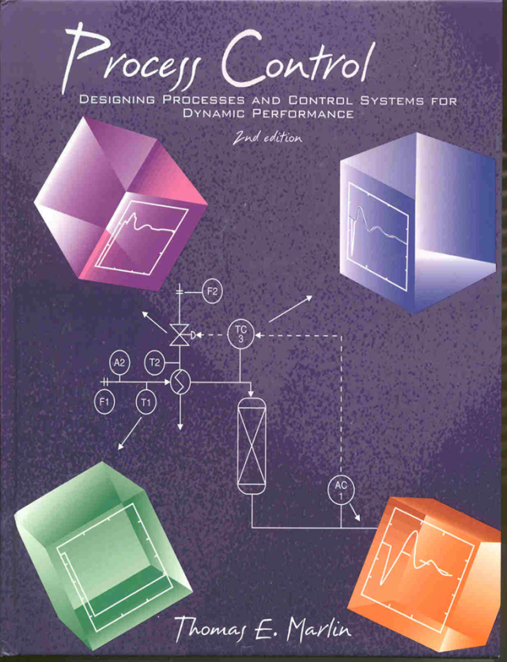
Process Control: Designing Process and Control Systems for Dynamic Performance
Chapter 10. Stability and Tuning
Copyright © Thomas Marlin 2013
The copyright holder provides a royalty-free license for use of this material at non-profit educational institutions

Slide 2
CHAPTER 10: STABILITY &TUNING
When I complete this chapter, I want to be
able to do the following.
Determine the stability of a process without control
Determine the stability of a closed-loop feedback control system
Use these approaches to learn how dead time affects stability.

Slide 3
CHAPTER 10: STABILITY &TUNING
Outline of the lesson.
Define stability
Review determining the roots of the characteristic equation
Introduce the Bode stability method
Apply to determine some general trends in feedback systems

Slide 4
CHAPTER 10: STABILITY &TUNING
20
No!
0
v1
-20
TC
-40
0
20
40
60
80
100
120
or
v2
0.8
Yes!
0.6
0.4
0.2
0
-0.2
0
20
40
60
80
100
120
We influence stability when we implement control. How do we achieve the influence we want?

Slide 5
CHAPTER 10: STABILITY &TUNING
First, let’s define stability: A system is stable if all bounded inputs to the system result in bounded outputs.
Sample
Inputs
Sample
Outputs
Process
1
1
0.5
0.5
bounded
0
bounded
0
-0.5
-0.5
-1
0
0.5
1
1.5
-1
0
0.5
1
1.5
unbounded
unbounded

Slide 6
CHAPTER 10: STABILITY &TUNING
Let’s review how we
determine the
stability of a model.
G(s) = Y(s)/X(s)
Y(s) = [N(s)/D(s)] X(s)
With α_{i} the solution to the denominator of the transfer function being zero, D(s) = 0 giving s = α₁, α₂ , α_{i ...} .
Real, repeated α_{i}
Real, distinct α_{i}
Complex α_{i}
Class exercise
If all α_{i} are ???, Y(t) is stable
If any one α_{i} is ???, Y(t) is unstable

Slide 7
CHAPTER 10: STABILITY &TUNING
With α_{i} the solutions to D(s) = 0, which is a polynomial.
1. If all real [α_{i}] are < 0, Y(t) is stable
If any one real [α_{i}] is ≥ 0, Y(t) is unstable
2. If all α_{i} are real, Y(t) is overdamped (does not oscillate)
If one pair of α_{i} are complex, Y(t) is underdamped

Slide 8
CHAPTER 10: STABILITY &TUNING
Quick review of model for closed-loop feedback system.
D(s)
G_{d}(s)
SP(s)
E(s)
MV(s)
CV(s)
+
G_{C}(s)
G_{v}(s)
G_{P}(s)
+
-
+
CV_{m}(s)
G_{S}(s)
Transfer functions
G_{C}(s) = controller
G_{v}(s) = valve +
G_{P}(s) = feedback process
G_{S}(s) = sensor +
G_{d}(s) = disturbance process
Variables
CV(s) = controlled variable
CV_{m}(s) = measured value of CV(s)
D(s) = disturbance
E(s) = error
MV(s) = manipulated variable
SP(s) = set point

Slide 9
CHAPTER 10: STABILITY &TUNING
D(s)
G_{d}(s)
SP(s)
E(s)
MV(s)
CV(s)
+
G_{C}(s)
G_{v}(s)
G_{P}(s)
+
-
+
CV_{m}(s)
G_{S}(s)
Set point response
Disturbance Response
The denominator determines the stability of
the closed-loop feedback system! We call it the
characteristic equation.

Slide 10
CHAPTER 10: STABILITY &TUNING
Direction Solution for the Roots to determine the stability
Controller is a P-only controller. Is the system stable? Let’s evaluate the roots of the characteristic equation.
F_{S}
solvent
F_{A}
pure A
AC

Slide 11
CHAPTER 10: STABILITY &TUNING
Plot of real and imaginary parts of the roots of the characteristic equation - three roots for cubic
0.5
0.4
0.3
0.2
Kc
250 0
0.1
Imaginary
0
-0.1
As the controller gain, K_{C}, is increased,
some roots approach, then cross the
boundary (s=0) between stable and
Unstable. Shaded is the unstable region.
-0.2
-0.3
-0.4
-0.5
-0.7
-0.6
-0.5
-0.4
-0.3
-0.2
-0.1
0
0.1
Real
Stable
Unstable

Slide 12
CHAPTER 10: STABILITY &TUNING
The denominator
determines
the stability of
the closed-loop
feedback system!
Set point response
Bode Stability Method
Calculating the roots is easy with standard software. However, if the equation has a dead time, the term e ^{-θs} appears. Therefore, we need another method.
Th method we will use next is the Bode Stability Method.

Slide 13
CHAPTER 10: STABILITY &TUNING
Bode Stability: To understand, let’s do a thought experiment
SP(s)
E(s)
MV(s)
CV(s)
+
G_{C}(s)
G_{v}(s)
G_{P}(s)
+
-
+
Loop open
CV_{m}(s)
G_{S}(s)
F_{S}
solvent
Loop open
F_{A}
pure A
AC
SP

Slide 14
CHAPTER 10: STABILITY &TUNING
Bode Stability: To understand, let’s do a thought experiment
No forcing!!
No forcing!!
SP(s)
SP(s)
E(s)
E(s)
CV(s)
MV(s)
CV(s)
MV(s)
+
+
+
+
G_{C}(s)
G_{C}(s)
G_{v}(s)
G_{v}(s)
G_{P}(s)
G_{P}(s)
+
-
+
-
CV_{m}(s)
Loop closed
CV_{m}(s)
Loop closed
G_{S}(s)
G_{S}(s)
No forcing!!
F_{S}
Loop closed
solvent
F_{A}
pure A
AC
SP

Slide 15
CHAPTER 10: STABILITY &TUNING
Bode Stability: To understand, let’s do a thought experiment
SP(s)
E(s)
MV(s)
CV(s)
+
G_{C}(s)
G_{v}(s)
G_{P}(s)
+
-
+
Loop closed
CV_{m}(s)
G_{S}(s)
Under what conditions is the system stable (unstable)?
Hint: think about the sine wave as it travels around the loop once.

Slide 16
CHAPTER 10: STABILITY &TUNING
Bode Stability: To understand, let’s do a thought experiment
SP(s)
E(s)
MV(s)
CV(s)
+
G_{C}(s)
G_{v}(s)
G_{P}(s)
+
-
+
Loop closed
CV_{m}(s)
G_{S}(s)
Under what conditions is the system stable (unstable)?
If the sine is larger in amplitude after one cycle; then it will increase each “time around” the loop. The system will be unstable.
Now: at what frequency does the sine most reinforce itself?

Slide 17
CHAPTER 10: STABILITY &TUNING
Bode Stability: To understand, let’s do a thought experiment
SP(s)
E(s)
MV(s)
CV(s)
+
G_{C}(s)
G_{v}(s)
G_{P}(s)
+
-
+
Loop closed
CV_{m}(s)
G_{S}(s)
Now: at what frequency does the sine most reinforce itself?
When the sine has a lag of 180° due to element dynamics, the feedback will reinforce the oscillation (remember the - sign).
This is the critical frequency.

Slide 18
CHAPTER 10: STABILITY &TUNING
Bode Stability: To understand, let’s do a thought experiment
SP(s)
E(s)
MV(s)
CV(s)
+
G_{C}(s)
G_{v}(s)
G_{P}(s)
+
-
+
Loop closed
CV_{m}(s)
G_{S}(s)
Let’s put the results together. G_{OL}(s) includes all elements in the closed loop.
At the critical frequency: ∠ G_{OL}(ω_{c}j) = -180°
The amplitude ratio: |G_{OL}(ω_{c}j) | < 1 for stability
|G_{OL}(ω_{c}j) | > 1 for stability
See textbook for limitations

Slide 19
CHAPTER 10: STABILITY &TUNING
Bode Stability: Let’s do an example: three-tank mixer
with 5 minutes dead time added
∠ G_{OL}(ω_{c}j) = -180° |G_{OL}(ω_{c}j) | < 1 for stability
Process
Controller tuning w/o dead time
From Ciancone correlations

Slide 20
CHAPTER 10: STABILITY &TUNING
Bode Stability: ∠ G_{OL}(ω_{c}j) = -180° |G_{OL}(ω_{c}j) | < 1 for stability
10
2
|G_{OL}(ω_{c}j) | = 0.75
Conclusion?
10
1
Amplitude Ratio
10
0
10
-1
10
-2
10
-1
10
0
Frequency, w (rad/time)
-50
-100
-150
-180°
Phase Angle (degrees)
Critical frequency
-200
-250
-300
10
-2
10
-1
10
0
Frequency, w (rad/time)

Slide 21
CHAPTER 10: STABILITY &TUNING
Bode Stability: ∠ G_{OL}(ω_{c}j) = -180° |G_{OL}(ω_{c}j) | < 1 for stability
10
2
|G_{OL}(ω_{c}j) | = 0.75 < 1
Conclusion:
stable!!
10
1
Amplitude Ratio
10
0
10
-1
-2
-1
0
10
10
The sine will decrease in amplitude each time around the loop.
10
Frequency, w (rad/time)
-50
-100
-150
-180°
Phase Angle (degrees)
Critical frequency
-200
-250
-300
10
-2
10
-1
10
0
Frequency, w (rad/time)

Slide 22
CHAPTER 10: STABILITY &TUNING
S-LOOP plots deviation variables (IAE = 42.1962)
2
1.5
Stable, but
performance
poor, why?
Controlled Variable
1
0.5
0
0
50
100
150
200
250
Time
60
40
Manipulated Variable
20
0
0
50
100
150
200
250
Time

Slide 23
CHAPTER 10: STABILITY &TUNING
S-LOOP plots deviation variables (IAE = 42.1962)
2
1.5
Stable, but
performance
poor, why?
Controlled Variable
1
0.5
0
0
50
100
150
200
250
Key lesson: Stability is required, but more is required for good performance.
Time
PI tuning was for the process without dead time. The process with dead time is more difficult to control. Must make controller less agressive!
60
40
Manipulated Variable
20
0
0
50
100
150
200
250
Time

Slide 24
Bode calculations can be done by hand, easier with S_LOOP
*************************************************************
* S_LOOP: SINGLE LOOP CONTROL SYSTEM ANALYSIS *
* BODE PLOT OF GOL(s) = Gp(s)Gc(s) *
* *
* Characteristic Equation = 1 + GOL(s) *
*************************************************************
SELECT THE APPROPRIATE MENU ITEM
MODIFY...
PRESENT VALUES
1) Lowest Frequency 0.01
2) Highest Frequency 0.30
3) Create Bode plot
and calculate the results at critical frequency
4) Return to main menu
Enter the desired selection:
2
*************************************************
Critical frequency and amplitude ratio
from Bode plot of GOL
*************************************************
Caution: 1) cross check with plot because of possible
MATLAB error in calculating the phase angle
2) the program finds the first crossing of -180
The critical frequency is between 0.14263
and 0.14287
The amplitude ratio at the critical frequency is 0.74797
10
1
10
Amplitude Ratio
0
10
10
-1
-2
-1
0
10
10
10
Frequency, w (rad/time)
-50
-100
-150
Phase Angle (degrees)
-200
-250
Or, write your own program in MATLAB.
-300
-2
-1
0
10
10
10
Frequency, w (rad/time)

Slide 25
CHAPTER 10: STABILITY &TUNING
Let’s review what we have accomplished so far.
We can evaluate the stability of a process without control by evaluating the roots of char. equation
We can evaluate the stability of a process under feedback by either
- evaluating the roots of char. equation
- Bode method (required for process with dead time)
These are local tests, caution about non-linearity
Stability does not guarantee good performance !!!!
Unstable system performance always poor!!!

Slide 26
CHAPTER 10: STABILITY &TUNING
What else can we do with this neat technology?
Tune controllers
F_{S}
solvent
F_{A}
pure A
AC
Ziegler-Nichols Tuning
We can tune controllers. The basic idea is to keep a “reasonable” margin from instability limit. This “reasonable” margin might give good performance.

Slide 27
CHAPTER 10: STABILITY &TUNING
What else can we do with this neat technology?
Tune controllers
Controller | Kc | TI | Td
P-only | Ku/2 | --- | ---
PI | Ku/2.2 | Pu/1.2 | ---
PID | Ku/1.7 | Pu/2.0 | Pu/8
Gain margin is approximately 2
Integral mode is required for zero s-s offset
Derivative has stabilizing effect

Slide 28
CHAPTER 10: STABILITY &TUNING
F_{S}
solvent
Ziegler-Nichols tuning
Generally, Ziegler-Nichols tuning is not the best initial tuning method.
However, these two guys were real pioneers in the field! It has taken 50 years to surpass their guidelines.
F_{A}
pure A
AC
2
S-LOOP plots deviation variables (IAE = 23.3131)
1.5
Controlled Variable
1
0.5
0
0
50
100
150
200
250
Time
150
100
Manipulated Variable
50
0
-50
0
50
100
150
200
250
Time

Slide 29
CHAPTER 10: STABILITY &TUNING
What else can we do with this neat technology?
Understand why detuning is required for tough processes.
10
As dead time
increases, we
must detune
the controller.
KcKp
1
0.1
0
0.2
0.4
0.6
0.8
1
fraction dead time
In this plot, (θ+τ) is constant and θ/ (θ+τ) is changed.
Ziegler-Nichols
Ciancone

Slide 30
CHAPTER 10: STABILITY &TUNING
What else can we do with this neat technology?
Understand need for “robustness”.
After we tune the controller,
we change the flow of solvent.
What happens?
F_{S}
solvent
F_{S} = 3.0 to 6.9 m3/min
F_{A}
pure A
AC

Slide 31
CHAPTER 10: STABILITY &TUNING
What else can we do with this neat technology?
Understand need for “robustness”.
10
0
Must consider the
model error when
selecting controller
tuning
amplitude ratio
10
-5
10
-2
10
-1
10
0
frequency (rad/time)
Range of critical frequencies. Smallest is most conservative
0
-100
phase angle
-180°
-200
-300
10
-2
10
-1
10
0
frequency (rad/time)

Slide 32
CHAPTER 10: STABILITY &TUNING
What else can we do with this neat technology?
Understand need for “robustness”.
Tune for the process response that is slowest,
has highest fraction dead time, and largest
process gain.
This will give least aggressive controller.
F_{S}
solvent
F_{S} = 3.0 to 6.9 m3/min
F_{A}
pure A
AC

Slide 33
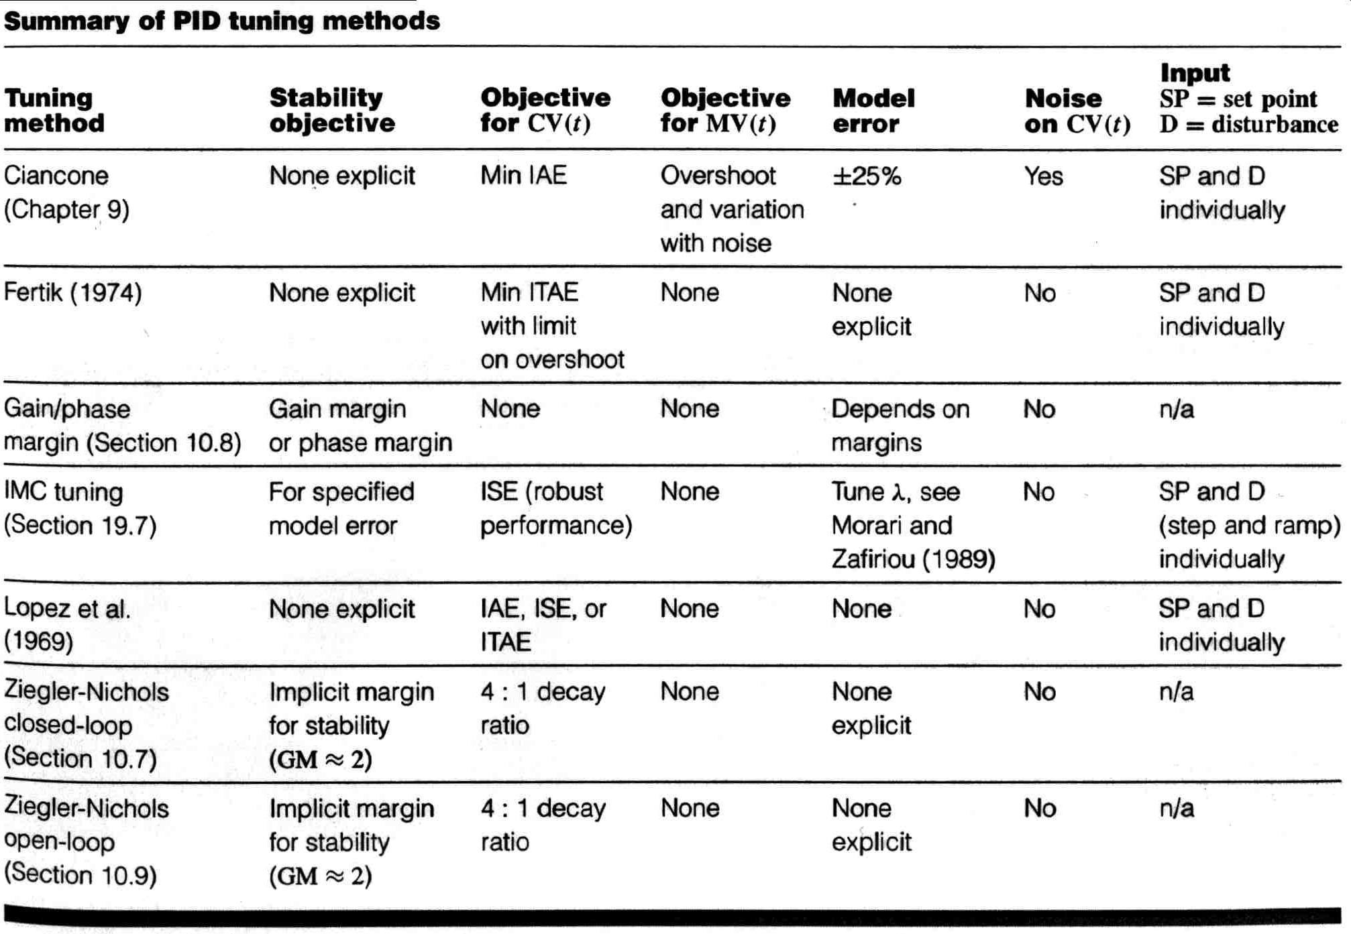
CHAPTER 10: STABILITY &TUNING
Match your select of tuning method to tuning goals!

Slide 34
CHAPTER 10: TUNING & STABILITY WORKSHOP 1
The data below is a process reaction curve for a process, plotted in deviation variables. Determine the tuning for a PID controller using the Ziegler-Nichols method.
4
3
2
Controlled Variable
1
0
v1
-1
TC
0
5
10
15
20
25
30
35
40
45
50
Time
15
v2
10
Manipulated Variable
5
0
0
5
10
15
20
25
30
35
40
45
50
Time

Slide 35
CHAPTER 10: TUNING & STABILITY WORKSHOP 2
Answer true or false to each of the following questions and explain each answer.
A. A closed-loop system is stable only if the process and the controller are both stable.
B. The Bode stability method proves that the closed-loop system is stable for only sine inputs.
C. G_{OL}(s) is the process model, G_{P}(s), and sensor, final element, and signal transmission dynamics
D. A process would be stable if it had three poles with the following values: -1, -.2, and 0.

Slide 36
CHAPTER 10: TUNING & STABILITY WORKSHOP 3
The PID controller has been tuned for a three-tank mixer. Later, we decide to include another mixing tank in the process. If we do not retune the controller, will the control system be stable with the four-tank mixer?
F_{S}
solvent
F_{A}
pure A
K_{c} = 30
T_{I} = 11
T_{d} = 0.8
AC

Slide 37
CHAPTER 10: STABILITY &TUNING
When I complete this chapter, I want to be
able to do the following.
Determine the stability of a process without control
Determine the stability of a closed-loop feedback control system
Use these approaches to learn how dead time affects stability.
Lot’s of improvement, but we need some more study!
Read the textbook
Review the notes, especially learning goals and workshop
Try out the self-study suggestions
Naturally, we’ll have an assignment!

Slide 38
CHAPTER 10: LEARNING RESOURCES
SITE PC-EDUCATION WEB
- Instrumentation Notes
- Interactive Learning Module (Chapter 10)
- Tutorials (Chapter 10)
S_LOOP
- You can perform the stability and frequency response calculations uses menu-driven features. Then, you can simulate in the time domain to confirm your conclusions.

Slide 39
CHAPTER 10: SUGGESTIONS FOR SELF-STUDY
1. Determine the stability for the example in textbook Table 9.2 (recommended tuning). Use the nominal process parameters. How much would K_{C} have to be increased until the system became unstable?
2. Determine the Ziegler-Nichols tuning for the three-tank mixer process. Simulate the dynamic response using S_LOOP.
3. Discuss applying the Bode stability method to a process without control.

Slide 40
CHAPTER 10: SUGGESTIONS FOR SELF-STUDY
4. We do not want to operate a closed-loop system “too close” to the stability limit. Discuss measures of the closeness to the limit and how they could be used in calculating tuning constant values.

