Slide 1
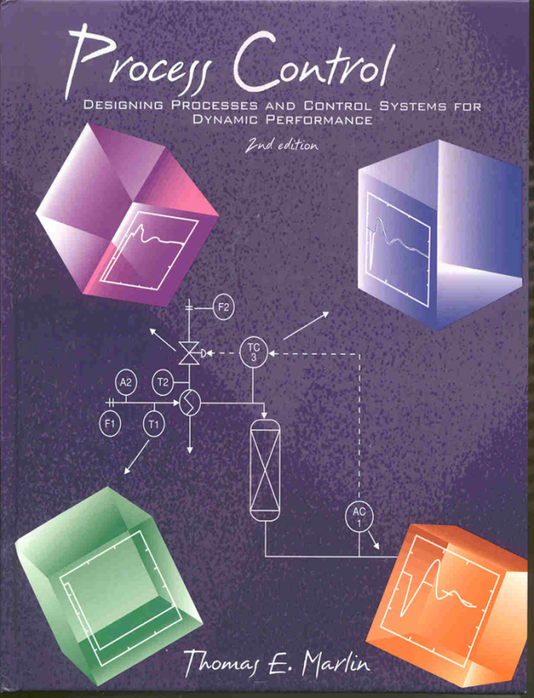
Process Control: Designing Process and Control Systems for Dynamic Performance
Chapter 9. PID Tuning
Copyright © Thomas Marlin 2013
The copyright holder provides a royalty-free license for use of this material at non-profit educational institutions

Slide 2
CHAPTER 9: PID TUNING
When I complete this chapter, I want to be
able to do the following.
Explain the performance goals that we seek to achieve via tuning.
Apply a tuning procedure using the process reaction curve and tuning correlations.
Further improve performance by fine tuning

Slide 3
CHAPTER 9: PID TUNING
Outline of the lesson.
A trial and error approach - why we don’t use it
Define the tuning problem
Solve and develop correlations
Apply correlations to examples
Fine tune - the personal touch

Slide 4
CHAPTER 9: PID TUNING
PROPERTIES THAT WE SEEK IN A CONTROLLER
Good Performance - feedback measures from Chapter 7
Wide applicability - adjustable parameters
Timely calculations - avoid convergence loops
Switch to/from manual - bumplessly
Extensible - enhanced easily
This chapter
Previous chapter
Later chapters

Slide 5
CHAPTER 9: PID TUNING
How do we apply the same equation to many processes?
How to achieve the dynamic performance that we desire?
TUNING!!!
The adjustable parameters are called tuning constants. We can match the values to the process to affect the dynamic performance

Slide 6
CHAPTER 9: PID TUNING
Is there
an easier
way than
trial & error?
40
S-LOOP plots deviation variables (IAE = 608.1005)
Trial 1: unstable, lost $25,000
20
0
Controlled Variable
-20
-40
0
20
40
60
80
100
120
100
Time
50
0
Manipulated Variable
-50
-100
0
20
40
60
80
100
120
Time
1
S-LOOP plots deviation variables (IAE = 23.0904)
Trial 2: too slow, lost $3,000
0.8
0.6
Controlled Variable
0.4
0.2
0
0
20
40
60
80
100
120
1
Time
0.8
0.6
Manipulated Variable
0.4
0.2
0
0
20
40
60
80
100
120
Time
AC
1.5
S-LOOP plots deviation variables (IAE = 9.7189)
Trial n: OK, finally, but took way too long!!
1
Controlled Variable
0.5
0
0
20
40
60
80
100
120
1.5
Time
1
Manipulated Variable
0.5
0
0
20
40
60
80
100
120
Time

Slide 7
CHAPTER 9: PID TUNING
Yes, we can
prepare good
correlations!
S-LOOP plots deviation variables (IAE = 608.1005)
1
DYNAMIC SIMULATION
0.8
Determine a model using the process reaction curve experiment.
0.6
Controlled Variable
0.4
0.2
0
0
5
10
15
20
25
30
35
40
45
50
1
Time
0.8
Manipulated Variable
0.6
0.4
0.2
0
0
5
10
15
20
25
30
35
40
45
50
Time
Determine the initial tuning constants from a correlation.
Kc
TI
Define the tuning problem
1. Process Dynamics
2. Measured variable
3. Model error
4. Input forcing
5. Controller
6. Performance measures
1.5
S-LOOP plots deviation variables (IAE = 9.7189)
Apply and fine tune as needed.
1
Controlled Variable
0.5
0
0
20
40
60
80
100
120
1.5
Time
1
Manipulated Variable
0.5
0
0
20
40
60
80
100
120
Time

Slide 8
CHAPTER 9: PID TUNING
Define the tuning problem
1. Process Dynamics
2. Measured variable
3. Model error
4. Input forcing
5. Controller
6. Performance measures
The PID controller will function successfully for the wide range of feedback process dynamics shown here.
1.5
DYNAMIC SIMULATION
1
Controlled Variable
0.5
DYNAMIC SIMULATION
0
0
5
10
15
20
25
30
35
40
45
50
Time
1
1.5
DYNAMIC SIMULATION
0.8
0.6
1
0.4
Controlled Variable
Controlled Variable
0.2
0.5
0
0
5
10
15
20
25
30
35
40
45
50
0
0
5
10
15
20
25
30
35
40
45
50
Time
Time
1
DYNAMIC SIMULATION
1.5
DYNAMIC SIMULATION
0.8
1
0.6
Controlled Variable
0.4
Controlled Variable
0.2
0.5
0
0
5
10
15
20
25
30
35
40
45
50
0
0
5
10
15
20
25
30
35
40
45
50
Time
Time
1
Describe the dynamics
from the step
change data.
0.8
0.6
Manipulated Variable
0.4
0.2
0
0
5
10
15
20
25
30
35
40
45
50
Time

Slide 9
CHAPTER 9: PID TUNING
Define the tuning problem
1. Process Dynamics
2. Measured variable
3. Model error
4. Input forcing
5. Controller
6. Performance measures
The PID controller will function successfully for the wide range of feedback process dynamics shown here.
1.5
DYNAMIC SIMULATION
1
unstable
Controlled Variable
0.5
DYNAMIC SIMULATION
0
0
5
10
15
20
25
30
35
40
45
50
Time
1
1.5
DYNAMIC SIMULATION
0.8
nth order with dead time
0.6
1
Integrator, see Chapter 18
0.4
Controlled Variable
Controlled Variable
0.2
0.5
0
0
5
10
15
20
25
30
35
40
45
50
0
0
5
10
15
20
25
30
35
40
45
50
Time
Time
1
DYNAMIC SIMULATION
1.5
DYNAMIC SIMULATION
0.8
1
0.6
First order with dead time
Controlled Variable
0.4
Controlled Variable
underdamped
0.2
0.5
0
0
5
10
15
20
25
30
35
40
45
50
0
0
5
10
15
20
25
30
35
40
45
50
Time
Time
1
Describe the dynamics
from the step
change data.
0.8
0.6
Input step change
Manipulated Variable
0.4
0.2
0
0
5
10
15
20
25
30
35
40
45
50
Time

Slide 10
CHAPTER 9: PID TUNING
Define the tuning problem
1. Process Dynamics
2. Measured variable
3. Model error
4. Input forcing
5. Controller
6. Performance measures
The PID controller will function successfully for a wide range of feedback process dynamics
We will develop tuning correlations for these dynamics.
Most commonly occurring
Fit model using process reaction curve
Other processes can be controlled with PID; need more trial and error
1
DYNAMIC SIMULATION
0.8
0.6
0.4
Controlled Variable
0.2
0
0
5
10
15
20
25
30
35
40
45
50
Time
1
DYNAMIC SIMULATION
0.8
0.6
Controlled Variable
0.4
0.2
0
0
5
10
15
20
25
30
35
40
45
50
Time
1
0.8
0.6
Manipulated Variable
0.4
0.2
0
0
5
10
15
20
25
30
35
40
45
50
Time

Slide 11
CHAPTER 9: PID TUNING
Define the tuning problem
1. Process Dynamics
2. Measured variable
3. Model error
4. Input forcing
5. Controller
6. Performance measures
Realistic situation: The measured variable will include the effects of sensor noise and higher frequency process disturbances.
1.5
DYNAMIC SIMULATION
1
Controlled Variable
0.5
0
-0.5
0
5
10
15
20
25
30
35
40
45
50
Time
1
0.8
0.6
Manipulated Variable
0.4
0.2
0
0
5
10
15
20
25
30
35
40
45
50
Time

Slide 12
CHAPTER 9: PID TUNING
Define the tuning problem
1. Process Dynamics
2. Measured variable
3. Model error
4. Input forcing
5. Controller
6. Performance measures
Realistic situation: The model does not represent the process exactly. We will assume that the model has ± 25% errors in gain, time constant and dead time, for example:
1
1
DYNAMIC SIMULATION
0.8
0.8
0.6
0.6
Manipulated Variable
Controlled Variable
0.4
0.4
0.2
0.2
0
0
0
5
10
15
20
25
30
35
40
45
50
gain
0
5
10
15
20
25
30
35
40
45
50
Time
Time
Dead time
1.5 - 2.5
3.75 - 6.25
Time constant
7.5 -1 2.5

Slide 13
CHAPTER 9: PID TUNING
Define the tuning problem
1. Process Dynamics
2. Measured variable
3. Model error
4. Input forcing
5. Controller
6. Performance measures
Realistic situation: Two typical inputs will be considered, changes in set point and disturbance. For correlations, step inputs, but controller will function for other inputs.
Solvent % A
F_{S}
solvent
F_{A}
pure A
AC
SP

Slide 14
CHAPTER 9: PID TUNING
Define the tuning problem
1. Process Dynamics
2. Measured variable
3. Model error
4. Input forcing
5. Controller
6. Performance measures
Realistic situation: We will consider the PID controller, which is used for nearly all single-loop (1CV, 1MV) controllers.
F_{S}
solvent
F_{A}
pure A
AC
SP

Slide 15
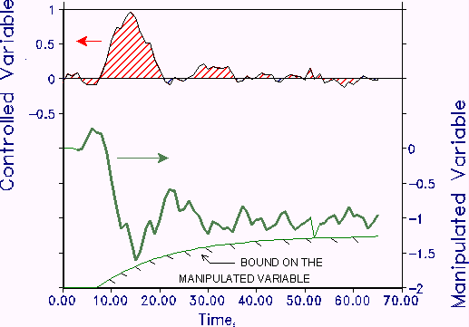
CHAPTER 9: PID TUNING
Define the tuning problem
1. Process Dynamics
2. Measured variable
3. Model error
4. Input forcing
5. Controller
6. Performance measures
CV Dynamic Behavior:
Stable, zero offset, minimum IAE
MV Dynamic Behavior:
damped oscillations and small fluctuations due to noise.
MV can be more aggressive in early part of transient

Slide 16
CHAPTER 9: PID TUNING
Define the tuning problem
1. Process Dynamics
2. Measured variable
3. Model error
4. Input forcing
5. Controller
6. Performance measures
Our primary goal is to maintain the CV near
the set point. Besides not wearing out
the valve, why do we have goals for the MV?
Steam flow
40
30
20
Manipulated Variable
10
0
-10
0
5
10
15
20
25
30
35
40
Time
Large, rapid changes to the steam flow can damage the trays
AC

Slide 17
CHAPTER 9: PID TUNING
Define the tuning problem
1. Process Dynamics
2. Measured variable
3. Model error
4. Input forcing
5. Controller
6. Performance measures
Our primary goal is to maintain the CV near
the set point. Besides not wearing out
the valve, why do we have goals for the MV?
Fuel flow
PI
1
40
AT
PI
FT
1
4
30
1
TI
PI
1
5
TI
TI
5
20
2
TI
10
PT
6
Manipulated Variable
TI
1
TC
3
TI
TI
0
TI
7
10
4
-10
FT
TI
FI
0
5
10
15
20
25
30
35
40
2
8
3
TI
Time
11
Large, rapid changes to the fuel flow cause thermal stress that damages tubes.
PI
PI
PI
2
3
6
Fuel

Slide 18
CHAPTER 9: PID TUNING
Define the tuning problem
1. Process Dynamics
2. Measured variable
3. Model error
4. Input forcing
5. Controller
6. Performance measures
COMBINED DEFINITION OF TUNING PROBLEM FOR CORRELATION
First order with dead time process model
Noisy measurement signal
± 25% parameters errors between model/plant
PID controller: determine K_{c}, T_{I}, T_{d}
Minimize IAE with MV inside bound
We achieve the goals by adjusting Kc, TI and Td.
Details in chapter and Appendix E.

Slide 19
CHAPTER 9: PID TUNING
Process reaction curve
Solve the tuning problem. Requires a computer program.
Apply, is the performance good?
1.5
1
0.5
0
-0.5
0
5
10
15
20
25
30
35
40
45
50
COMBINED DEFINITION OF TUNING
First order with dead time process model
Noisy measurement signal
± 25% parameters errors between model/plant
PID controller: determine K_{c}, T_{I}, T_{d}
Minimize IAE with MV inside bound
1
0.8
v1
0.6
0.4
TC
0.2
0
0
5
10
15
20
25
30
35
40
45
50
v1
TC
v2
v2
Kp = 1
θ = 5
τ = 5
Kc = 0.74
TI = 7.5
Td = 0.90

Slide 20
CHAPTER 9: PID TUNING
The tuning is not the best for any individual case, but it is the best for the range of possible dynamics - it is robust!
15
15
15
10
10
10
CV
5
CV
5
CV
5
0
0
0
-5
0
20
40
60
80
100
120
-5
0
20
40
60
80
100
120
-5
0
20
40
60
80
100
120
40
30
25
30
MV bound
MV bound
20
MV bound
20
15
MV
20
MV
MV
10
10
10
5
0
0
20
40
60
80
100
120
0
0
20
40
60
80
100
120
0
0
20
40
60
80
100
120
time
time
time
Plant = - 25%
Plant = model
Plant = + 25%

Slide 21
CHAPTER 9: PID TUNING
Good
Performance
Process reaction curve
Solve the tuning problem.
Requires a computer program.
15
1.5
10
1
CV
5
0.5
0
-0.5
0
0
5
10
15
20
25
30
35
40
45
50
COMBINED DEFINITION OF TUNING
First order with dead time process model
Noisy measurement signal
± 25% parameters errors between model/plant
PID controller: determine K_{c}, T_{I}, T_{d}
Minimize IAE with MV inside bound
1
0.8
-5
0.6
0
20
40
60
80
100
120
0.4
0.2
0
0
5
10
15
20
25
30
35
40
45
50
30
v1
TC
20
MV
v2
10
0
0
20
40
60
80
100
120
Kp = 1
θ = 5
τ = 5
Kc = 0.74
TI = 7.5
Td = 0.90
time
v1
TC
v2

Slide 22
CHAPTER 9: PID TUNING
We could solve each problem individually, but this would be too time consuming. We would like to develop a correlation based on many solutions.
Dimensionless Tuning Constants
Independent variable
Recall that [τ/(θ+ τ)] + [θ /(θ+ τ)] = 1

Slide 23
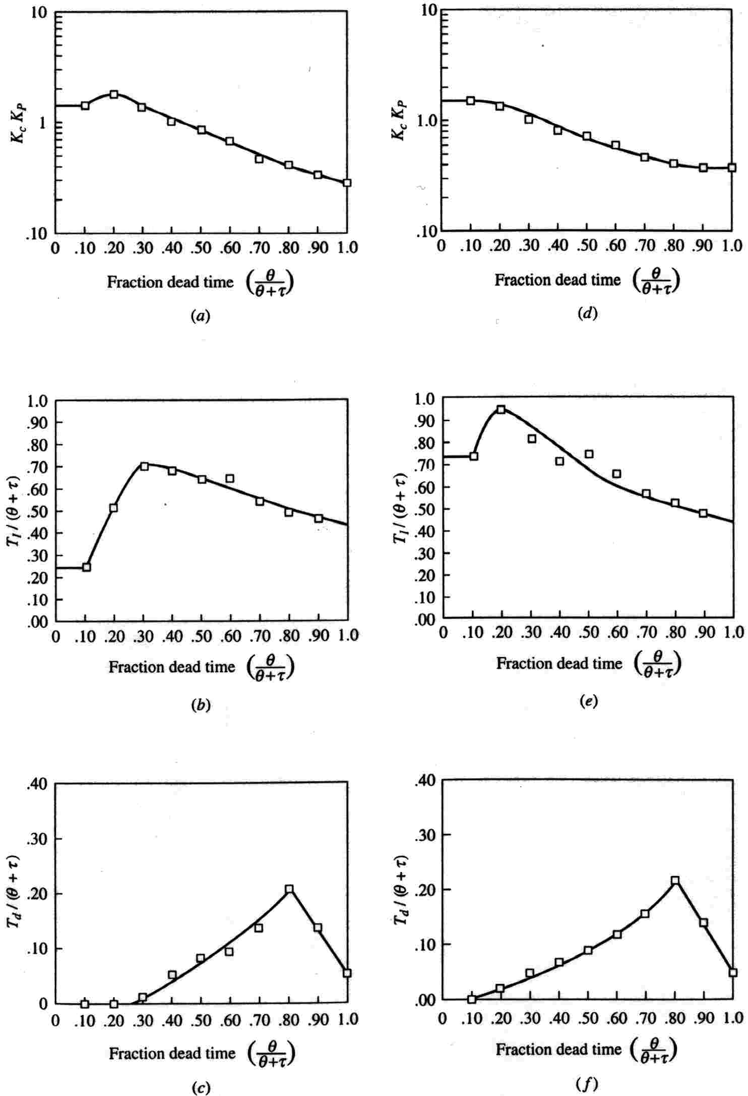
disturbance
Set point change
CHAPTER 9: PID TUNING
Tuning Charts for PID Feedback Controllers
These were developed by
summarizing a large
number of case studies
in these dimensionless
charts?
(See page 281 in the textbook for larger plot.)

Slide 24
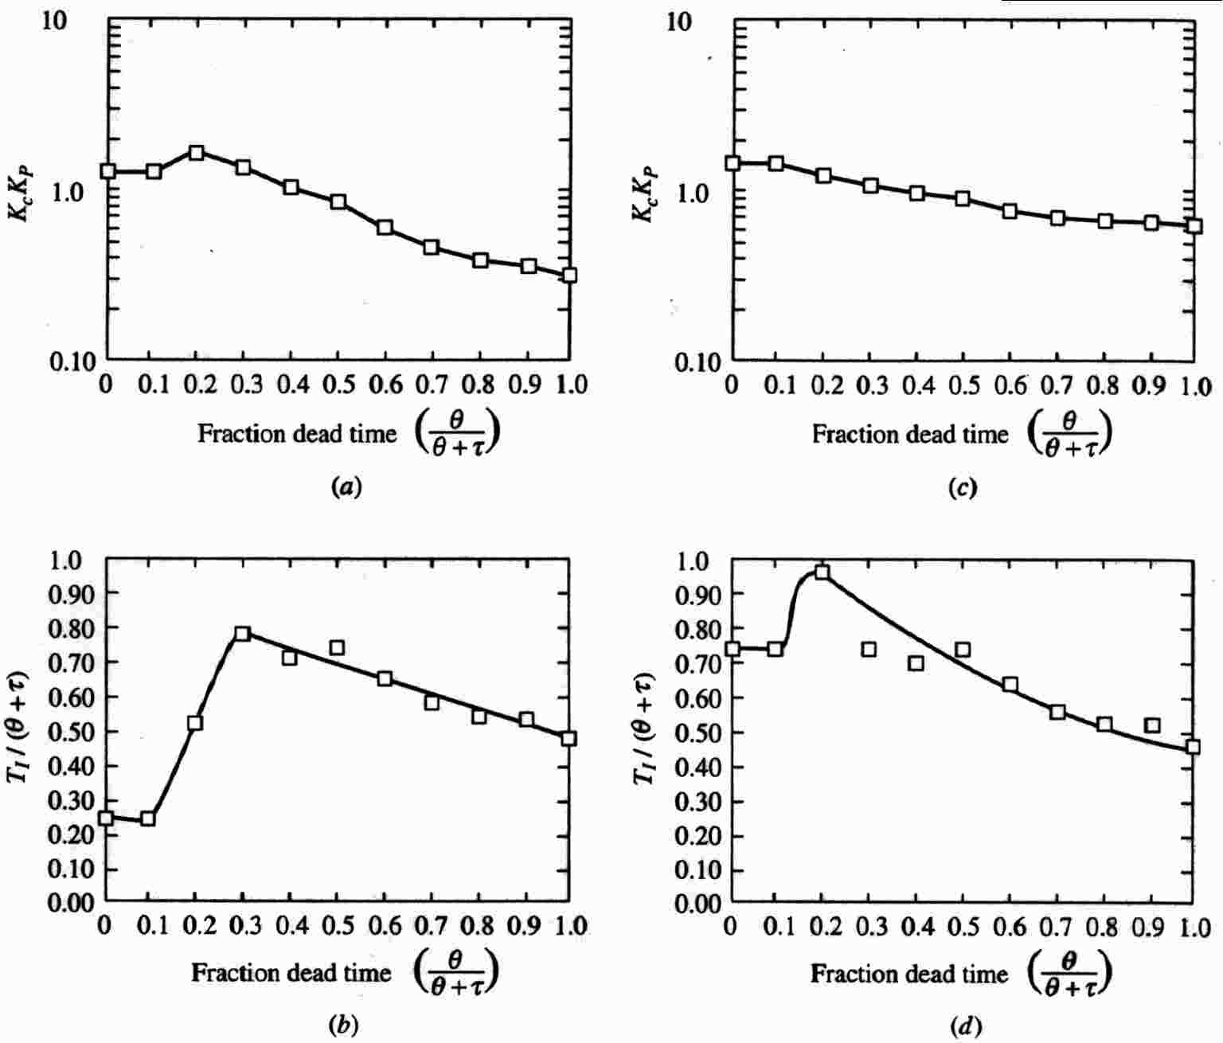
CHAPTER 9: PID TUNING
disturbance
Set point
Tuning Charts for PI Feedback Controllers
These were developed by
summarizing a large
number of case studies
in these dimensionless
charts?
(See page 286 in the textbook for larger plot.)

Slide 25
CHAPTER 9: PID TUNING
Let’s apply the tuning charts to the three-tank mixing process, which is not first order with dead time.
F_{S}
solvent
F_{A}
pure A
AC
Process reaction curve
Kp = 0.039 %A/%open
θ = 5.5 min
τ = 10.5 min
Tuning from chart
Kc = ??
TI = ??
Td = ??

Slide 26
CHAPTER 9: PID TUNING
Let’s apply the tuning charts to the three-tank mixing process, which is not first order with dead time.
F_{S}
solvent
F_{A}
pure A
AC
Process reaction curve
Kp = 0.039 %A/%open
θ = 5.5 min
τ = 10.5 min
Tuning from chart
Kc = 1.2/0.039 = 30 %open/%A
TI = 0.69(16) = 11 min
Td = 0.05(16) = 0.80 min

Slide 27
CHAPTER 9: PID TUNING
Concentration disturbance
Good
Performance
Effluent concentration
3.4
3.3
F_{S}
concentration
3.2
solvent
3.1
3
0
20
40
60
80
100
120
140
160
180
200
time
Valve % open
F_{A}
pure A
50
AC
45
40
manipulated flow
35
30
25
0
20
40
60
80
100
120
140
160
180
200
time

Slide 28
CHAPTER 9: PID TUNING
FINE TUNING: Process reaction curve and tuning charts provide a good method for tuning many (not all) PID loops. We need to learn how to fine tune loops to further improve performance based on current loop behavior -WHY?
Some loops could have different performance objectives
Some loops could have dynamics different from first order with dead time
Could have been error in the process reaction curve, perhaps a disturbance occurred during the experiment.
Plant dynamics can change due to changes in feed flow rate, reactor conversion, and so forth.

Slide 29
CHAPTER 9: PID TUNING
What is the effect of changing the controller gain on the control performance of a PID loop?
Let’s do an experiment by changing Kc and monitoring the performance.

Slide 30
CHAPTER 9: PID TUNING
60
Why does IAE
increase for
small Kc?
Why does IAE
increase for
large Kc?
Bad
v1
TC
40
control performance, IAE
?
v2
20
0
0
0.5
1
1.5
2
controller gain
1
1
1
Kc = 0.62
Kc = 1.14
Kc = 1.52
0.5
0.5
0.5
controlled variable
controlled variable
controlled variable
0
0
0
-0.5
-0.5
Is this the “best”?
-0.5
-1
0
50
100
150
200
-1
0
50
100
150
200
-1
0
50
100
150
200
time
time
time
PID controller with Kc changing, TI = 10, Td = 0.

Slide 31
CHAPTER 9: PID TUNING
What is the effect of changing the integral time on the control performance of a PID loop?
Is the answer different from Kc? What is different?

Slide 32
CHAPTER 9: PID TUNING
FINE TUNING: Let’s apply our understanding to build fine tuning guidelines.
S-LOOP plots deviation variables (IAE = 9.6759)
1.5
1
This is “good” control
performance.
Explain the shape of
the CV and MV
responses.
Controlled Variable
0.5
0
0
5
10
15
20
25
30
35
40
45
50
Time
1.5
1
Manipulated Variable
0.5
0
0
5
10
15
20
25
30
35
40
45
50
Time

Slide 33
CHAPTER 9: PID TUNING
Note: this is a step change to the set point - good for diagnosis!
CV limited set point overshoot, fast damping, and return to the set point
S-LOOP plots deviation variables (IAE = 9.6759)
1.5
1
Controlled Variable
0.5
CV does not change because of dead time
0
0
5
10
15
20
25
30
35
40
45
50
Constant slope
E(t) = constant
Time
1.5
MV overshoot moderate <= 0.5(ΔMVss)
1
Manipulated Variable
ΔMV₀ = Kc (ΔSP) should be close to the needed change at steady state.
ΔMVss
0.5
0
0
5
10
15
20
25
30
35
40
45
50
Time

Slide 34
CHAPTER 9: PID TUNING
Apply the fine tuning guidelines to the response below and suggest specific changes for improvement.
S-LOOP plots deviation variables (IAE = 19.3873)
1
0.8
0.6
Controlled Variable
0.4
0.2
0
0
5
10
15
20
25
30
35
40
45
50
Time
1
0.8
0.6
Manipulated Variable
0.4
0.2
0
0
5
10
15
20
25
30
35
40
45
50
Time

Slide 35
CHAPTER 9: PID TUNING
Apply the fine tuning guidelines to the response below and suggest specific changes for improvement.
S-LOOP plots deviation variables (IAE = 19.3873)
This is poor control
performance.
Controller not
aggressive enough.
Small ΔMV₀, increase
controller gain,
K_{c} by about x2
1
0.8
0.6
Controlled Variable
The CV response is very slow, not aggressive enough
0.4
0.2
0
0
5
10
15
20
25
30
35
40
45
50
Time
1
0.8
0.6
Manipulated Variable
0.4
The initial change in the MV is too small, less than 40% of the final, steady-state change.
0.2
0
0
5
10
15
20
25
30
35
40
45
50
Time

Slide 36
CHAPTER 9: PID TUNING
Apply the guidelines to the response below and suggest specific changes for improvement.
S-LOOP plots deviation variables (IAE = 20.1754)
2
1.5
Controlled Variable
1
0.5
0
0
10
20
30
40
50
60
70
80
90
100
Time
2.5
2
1.5
Manipulated Variable
1
0.5
0
0
10
20
30
40
50
60
70
80
90
100
Time

Slide 37
CHAPTER 9: PID TUNING
Apply the guidelines to the response below and suggest specific changes for improvement.
S-LOOP plots deviation variables (IAE = 20.1754)
This is poor control
performance.
Controller too
aggressive.
ΔMV₀ is OK. There-
fore, increase
integral time,
T_{I} by about x2
2
CV too oscillatory
1.5
Controlled Variable
1
0.5
0
0
10
20
30
40
50
60
70
80
90
100
Time
2.5
2
MV overshoot too large
1.5
Manipulated Variable
1
0.5
ΔMV₀
0
0
10
20
30
40
50
60
70
80
90
100
Time

Slide 38
CHAPTER 9: PID TUNING, WORKSHOP 1
Imagine that you are shipwrecked on an island and that you do not have your textbook or lecture notes! Naturally, you want to tune some PID controllers.
Review the tuning charts and develop some rough guidelines for tuning that you will remember for the rest of your life.
Tropical paradise but no textbook or internet connection.

Slide 39
CHAPTER 9: PID TUNING, WORKSHOP 2
The controller gain has been positive for the examples in the notes. Is K_{c} always greater than zero? In your answer, discuss the temperature control system in the picture below.
v1
TC
v2
What are the units of the controller gain?

Slide 40
CHAPTER 9: PID TUNING, WORKSHOP 3
The data below is a process reaction curve for a process, plotted in deviation variables. Determine the tuning for a PID controller.
4
3
2
Controlled Variable
1
0
v1
-1
TC
0
5
10
15
20
25
30
35
40
45
50
Time
15
v2
10
Manipulated Variable
5
0
0
5
10
15
20
25
30
35
40
45
50
Time

Slide 41
CHAPTER 9: PID TUNING, WORKSHOP 4
Diagnose the closed-loop data in the figure and suggest modifications, if necessary.
1.5
S-LOOP plots deviation variables (IAE = 6.1515)
1
Controlled Variable
0.5
v1
0
TC
-0.5
0
5
10
15
20
25
30
35
40
45
50
Time
20
v2
15
Manipulated Variable
10
5
0
-5
0
5
10
15
20
25
30
35
40
45
50
Time

Slide 42
CHAPTER 9: PID TUNING, WORKSHOP 5
Even with the most careful experiments, you are able to determine the model parameters with ± 50% uncertainty. Recommend initial tuning constant values for a PID controller.
1
1
DYNAMIC SIMULATION
0.8
0.8
0.6
0.6
Manipulated Variable
Controlled Variable
0.4
0.4
0.2
0.2
0
0
0
5
10
15
20
25
30
35
40
45
50
gain
0
5
10
15
20
25
30
35
40
45
50
Time
Time
Dead time
1.0 - 3.0
2.5 - 7.5
Time constant
5.0 -1 5.0

Slide 43
CHAPTER 9: PID TUNING
When I complete this chapter, I want to be
able to do the following.
Explain the performance goals that we seek to achieve via tuning.
Apply a tuning procedure using the process reaction curve and tuning correlations.
Further improve performance by fine tuning
Lot’s of improvement, but we need some more study!
Read the textbook
Review the notes, especially learning goals and workshop
Try out the self-study suggestions
Naturally, we’ll have an assignment!

Slide 44
CHAPTER 9: LEARNING RESOURCES
SITE PC-EDUCATION WEB
- Instrumentation Notes
- Interactive Learning Module (Chapter 9)
- Tutorials (Chapter 9)
Search the WEB and find a “automatic PID tuning” software product. Prepare a critical review of the technique.

Slide 45
CHAPTER 9: SUGGESTIONS FOR SELF-STUDY
1. Find some process reaction curve plots in Chapters 3-5 and determine the tuning for PID and PI controllers using the tuning charts.
2. Using S_LOOP, repeat the simulation results for the three-tank mixer under PID control. Then determine the sensitivity to changes in tuning by changing K_{C} and T_{I} (one at a time, % changes from the basis case tuning); -50%, -10%, +50%. Discuss your results.
3. Using S_LOOP, add noise to the measurement in submenu 1, Kn = 0.05 . Simulate with the original tuning and other values for Td. What happens to the performance?

Slide 46
CHAPTER 9: SUGGESTIONS FOR SELF-STUDY
4. Formulate questions similar to those in the Interactive Learning Modules, one each for Check Your Reading, Study Questions and Thought Questions.
5. In chapters 3-5, find examples of processes for which the tuning from the tuning charts would be (1) applicable and (2) not applicable.
6. On Monday, we tuned the three-tank mixer composition controller. On Friday, we anticipate reducing the feed flow rate by 50% (from 7 to 3.5 m³/min). When this occurs, should we change the tuning of the controller? If yes, which constants and by how much?
(Hint: Three-tank mixer model is in Example 7.2 on Page 223 of textbook.)

