Slide 1
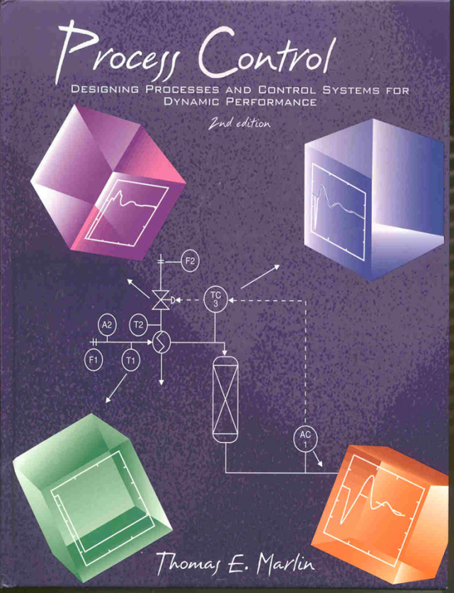
Process Control: Designing Process and Control Systems for Dynamic Performance
Chapter 7. The Feedback Loop
Copyright © Thomas Marlin 2013
The copyright holder provides a royalty-free license for use of this material at non-profit educational institutions

Slide 2
CHAPTER 7: THE FEEDBACK LOOP
When I complete this chapter, I want to be
able to do the following.
Identify the major elements in the feedback loop
Select appropriate candidate variables to be controlled and manipulated
Evaluate the control performance data using standard measures of dynamic performance

Slide 3
CHAPTER 7: THE FEEDBACK LOOP
Outline of the lesson.
Typical loop elements
Relating variables to control objectives
- Examples
Typical control performance measures
Five approaches to feedback control

Slide 4
CHAPTER 7: THE FEEDBACK LOOP
The Concept: We show limited detail in the piping and instrumentation (P&I) drawing. We see the sensor location, variable measured, connection to the final element (valve) and the location of the final element.
v1
TC
A
v2

Slide 5
CHAPTER 7: THE FEEDBACK LOOP
The Reality: Many elements in the loop affect the safety, reliability, accuracy, dynamics and cost. Engineers need to understand the details!
v1
4-20 mA
T
A
4-20 mA
v2
3-15 psi

Slide 6
CHAPTER 7: THE FEEDBACK LOOP
What affects the response to the computer?
Make a step
(without feedback control)
Sensor &
transmitter
computing
network
input and A/D
conversion
I/P
conversion
final
element
electronic
transmission
output
and D/A
electronic
transmission
pneumatic
transmission
THE PROCESS

Slide 7
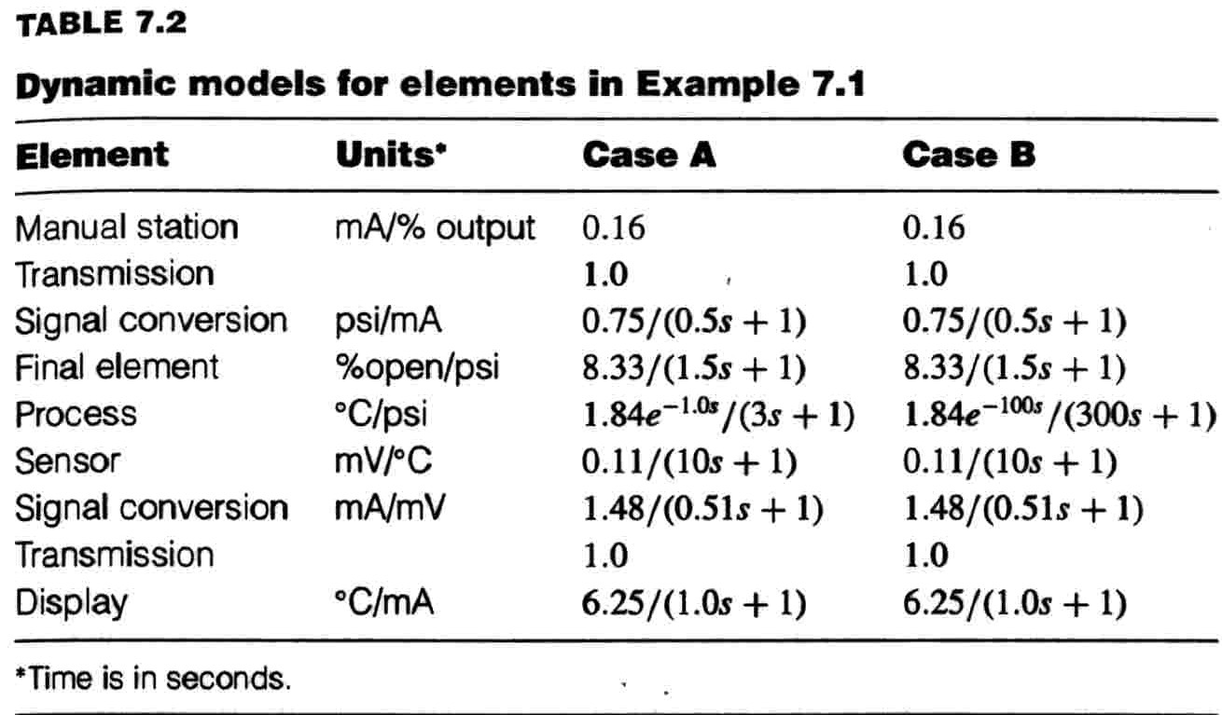
CHAPTER 7: THE FEEDBACK LOOP
Class exercise: Given the following dynamics, sketch the responses for a step in manual station to the displayed value.

Slide 8
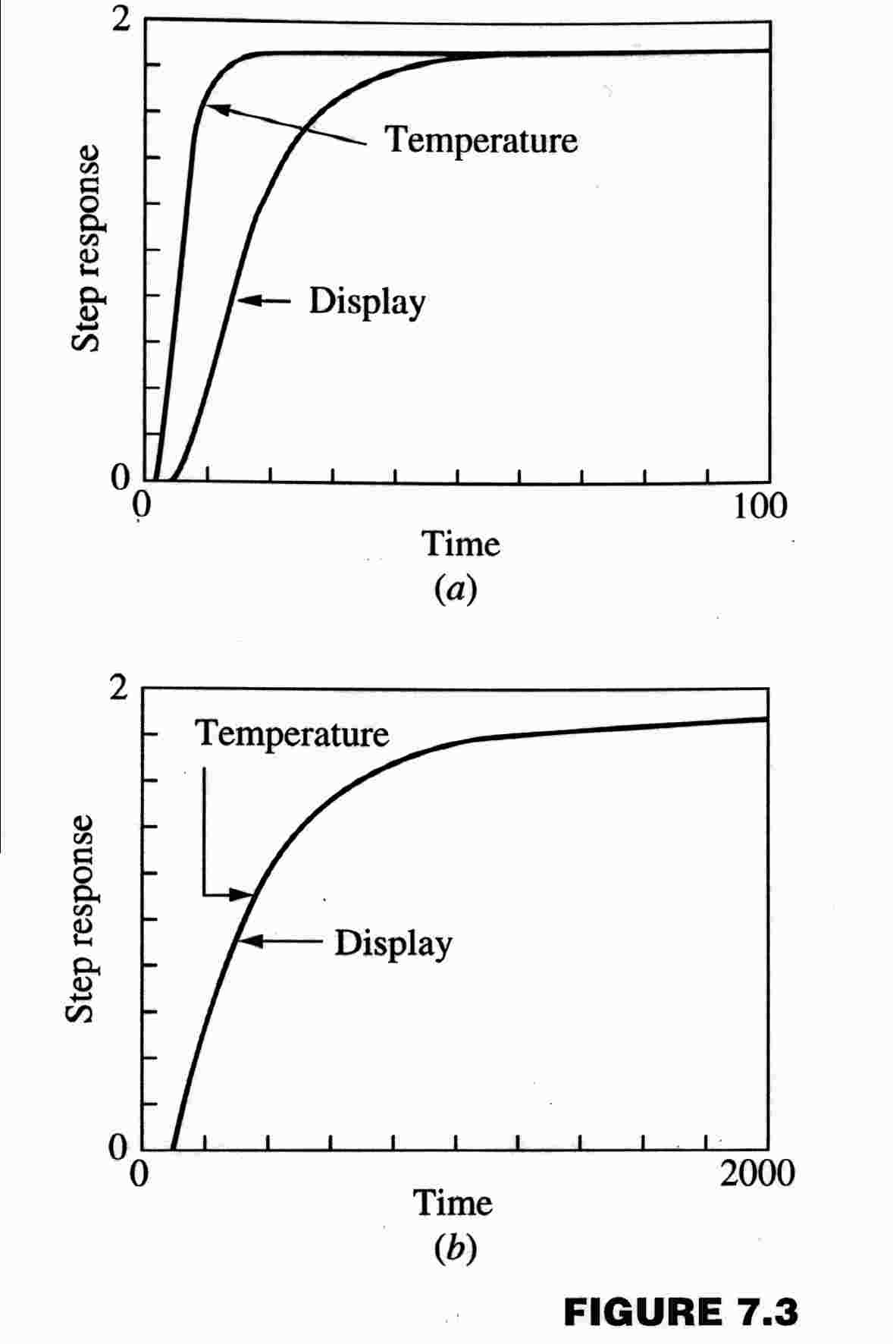
CHAPTER 7: THE FEEDBACK LOOP
Class exercise: Given the following dynamics, sketch the responses for a step in manual station to the displayed value.
What you see (from the display) is not always what is occurring!!

Slide 9
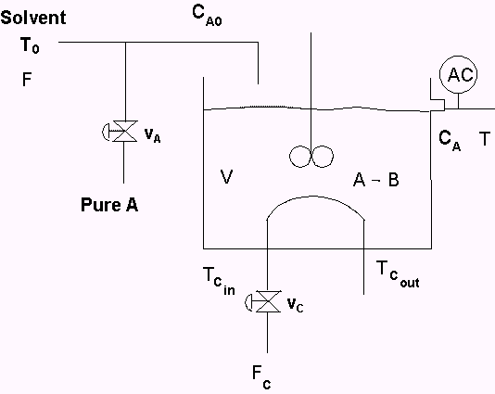
CHAPTER 7: THE FEEDBACK LOOP
The engineer must decide what measurement to control and what valve to adjust (and provide the equipment to support the decisions).

Slide 10
CHAPTER 7: THE FEEDBACK LOOP
The engineer must decide what measurement to control and what valve to adjust (and provide the equipment to support the decisions).
CV to control ? Use seven categories of control objectives!

Slide 11
CHAPTER 7: THE FEEDBACK LOOP
The engineer must decide what measurement to control and what valve to adjust (and provide the equipment to support the decisions).
MV to adjust ?
1. Causal relationship
2. Automated
3. Fast dynamics
4. Compensate for large disturbances
5. Can adjust quickly with little adverse affect on process performance

Slide 12
CHAPTER 7: THE FEEDBACK LOOP
The engineer must decide what measurement to control and what valve to adjust (and provide the equipment to support the decisions).
We could use either valve.
We will revisit this choice
later (Chapter13)

Slide 13
CHAPTER 7: THE FEEDBACK LOOP
The figure shows the feedback loop We’ll see the calculation in the next chapter.
Explain, including the
feedback concept.

Slide 14
Class exercise on the feedback loop: Using the methods just described, select ONE variable to be controlled and for that variable, ONE valve to be manipulated.
Flue gas
AT
PI
1
4
FT
TI
1
1
PI
feed
5
TI
TI
5
2
TI
PT
6
1
TI
3
TI
7
TI
TI
TI
9
10
4
burner
FT
TI
FI
2
8
3
TI
11
air
PI
PI
PI
fuel
2
3
6

Slide 15
Class exercise on the feedback loop: Using the methods just described, select ONE variable to be controlled and for that variable, ONE valve to be manipulated.
Flue gas
AT
PI
1
4
FT
TI
1
1
PI
feed
5
TI
TI
5
2
TI
TC
PT
6
1
TI
3
TI
7
TI
TI
TI
9
10
4
burner
FT
TI
FI
2
8
3
TI
11
air
PI
PI
PI
fuel
2
3
6

Slide 16
Class exercise on the feedback loop: Using the methods just described, select ONE variable to be controlled and for that variable, ONE valve to be manipulated.
Flue gas
AC
AT
PI
O₂
1
4
FT
TI
1
1
PI
feed
5
TI
TI
5
2
TI
PT
6
1
TI
3
TI
7
TI
TI
TI
9
10
4
burner
FT
TI
FI
2
8
3
TI
11
air
PI
PI
PI
fuel
2
3
6

Slide 17
CHAPTER 7: THE FEEDBACK LOOP
Music: “I cannot define good music, but I know what I like.”
Control Performance: We must be able to define what we desire, so that we can design equipment and controls to achieve our objectives.
Set point
entered by
person
1.5
1
Controlled Variable
0.5
Controlled variable, value from a sensor
0
0
5
10
15
20
25
30
35
40
45
50
Time
2
Manipulated variable, usually a valve
1.5
1
Manipulated Variable
0.5
0
0
5
10
15
20
25
30
35
40
45
50
Time

Slide 18
CHAPTER 7: THE FEEDBACK LOOP
Let’s be sure we understand the
variables in the plot. We will see this
plot over and over and over …!
1.5
1
Controlled Variable
0.5
0
0
5
10
15
20
25
30
35
40
45
50
Time
2
1.5
Manipulated Variable
1
0.5
0
0
5
10
15
20
25
30
35
40
45
50
Time

Slide 19
CHAPTER 7: THE FEEDBACK LOOP
Set point Change
∞
= IAE =
⌠
⌡
|SP(t)-CV(t)| dt
0
1.5
A
B
1
Return to set point, “zero offset
0.5
B/A = Decay ratio
0
0
5
10
15
20
25
30
35
40
45
50
Rise time
Time
2
C/D = Maximum overshoot of manipulated variable
1.5
C
1
0.5
D
0
0
5
10
15
20
25
30
35
40
45
50
Time

Slide 20
CHAPTER 7: THE FEEDBACK LOOP
Disturbance Response
∞
⌠
⌡
= IAE =
|SP(t)-CV(t)| dt
0
0.8
0.6
Maximum CV deviation from set point
0.4
0.2
0
-0.2
0
5
10
15
20
25
30
35
40
45
50
Time
0
-0.5
-1
-1.5
0
5
10
15
20
25
30
35
40
45
50
Time

Slide 21
CHAPTER 7: THE FEEDBACK LOOP
Disturbance Response
Often, the process is subject to many large and small disturbances and sensor noise. The performance measure characterizes the variability.
20
S-LOOP plots deviation variables (IAE = 5499.9786)
10
Variance or standard deviation of CV
0
Controlled Variable
-10
-20
0
100
200
300
400
500
600
700
800
900
1000
Time
20
10
Variance or standard deviation of MV
0
Manipulated Variable
-10
-20
0
100
200
300
400
500
600
700
800
900
1000
Time

Slide 22
CHAPTER 7: THE FEEDBACK LOOP
To reduce the variability in the CV,
we increase the variability in the MV.
We must design plant with MV’s
that can be adjusted at low cost.
20
10
Controlled Variable
0
-10
-20
0
100
200
300
400
500
600
700
800
900
1000
Time
20
10
Manipulated Variable
0
-10
-20
0
100
200
300
400
500
600
700
800
900
1000
Time

Slide 23
CHAPTER 7: THE FEEDBACK LOOP
Class exercise: For each of the performance measures below, determine a good value, i.e., large/small, positive/negative, etc.
Offset
IAE
Decay ratio
Rise time
Settling time
MV overshoot
Maximum CV deviation
CV variance
MV variance
Can we achieve good values for all at the same time?
What are the tradeoffs?

Slide 24
Class exercise: Comment on the quality of control for the four responses below.
1.5
S-LOOP plots deviation variables (IAE = 17.5417)
3
S-LOOP plots deviation variables (IAE = 43.9891)
1
2
0.5
A
1
B
Controlled Variable
Controlled Variable
0
0
-0.5
0
20
40
60
80
100
120
-1
0
20
40
60
80
100
120
Time
Time
2
4
1.5
3
1
2
Manipulated Variable
0.5
Manipulated Variable
0
1
-0.5
0
0
20
40
60
80
100
120
-1
0
20
40
60
80
100
120
Time
Time
1.5
S-LOOP plots deviation variables (IAE = 34.2753)
1.5
S-LOOP plots deviation variables (IAE = 24.0376)
1
1
Controlled Variable
0.5
C
0.5
D
Controlled Variable
0
0
-0.5
0
20
40
60
80
100
120
-0.5
0
20
40
60
80
100
120
Time
Time
1
1.5
0.5
1
Manipulated Variable
0.5
0
Manipulated Variable
0
-0.5
0
20
40
60
80
100
120
-0.5
0
20
40
60
80
100
120
Time
Time

Slide 25
Class exercise: Comment on the quality of control for the four responses below.
1.5
S-LOOP plots deviation variables (IAE = 17.5417)
3
S-LOOP plots deviation variables (IAE = 43.9891)
1
2
0.5
A
1
B
Controlled Variable
Controlled Variable
0
0
-0.5
0
Generally acceptable
-1
20
40
60
80
100
120
0
Too oscillatory
Time
20
40
60
80
100
120
Time
2
4
1.5
3
1
2
Manipulated Variable
0.5
Manipulated Variable
0
1
-0.5
0
0
20
40
60
80
100
120
-1
0
20
40
60
80
100
120
Time
Time
1.5
S-LOOP plots deviation variables (IAE = 34.2753)
1.5
S-LOOP plots deviation variables (IAE = 24.0376)
1
1
Controlled Variable
0.5
C
0.5
D
Controlled Variable
0
0
-0.5
-0.5
Gets close quickly;
Gets to set point slowly
0
Too slow
20
40
60
80
100
120
0
20
40
60
80
100
120
Time
Time
1
1.5
0.5
1
Manipulated Variable
0.5
0
Manipulated Variable
0
-0.5
0
20
40
60
80
100
120
-0.5
0
20
40
60
80
100
120
Time
Time

Slide 26
CHAPTER 7: THE FEEDBACK LOOP
We can apply feedback via many approaches
1, No control - The variable responds to all inputs, it “drifts”.
2. Manual - A person observes measurements and introduces changes to compensate, adjustment depends upon the person.
3. On-Off - The manipulated variable has only two states, this results in oscillations in the system.
4. Continuous, automated - This is a modulating control that has corrections related to the error from desired.
5. Emergency - This approach takes extreme action (shutdown) when a dangerous situation occurs.

Slide 27
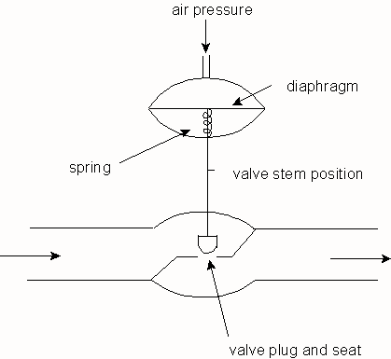
CHAPTER 7: THE FEEDBACK LOOP, WORKSHOP 1
The control valve is used to introduce a variable resistance to flow.
What is the body of the valve?
Describe three bodies and what factors are important in selecting.
What is the actuator?
What power source is used? What happens when the power source fails?

Slide 28
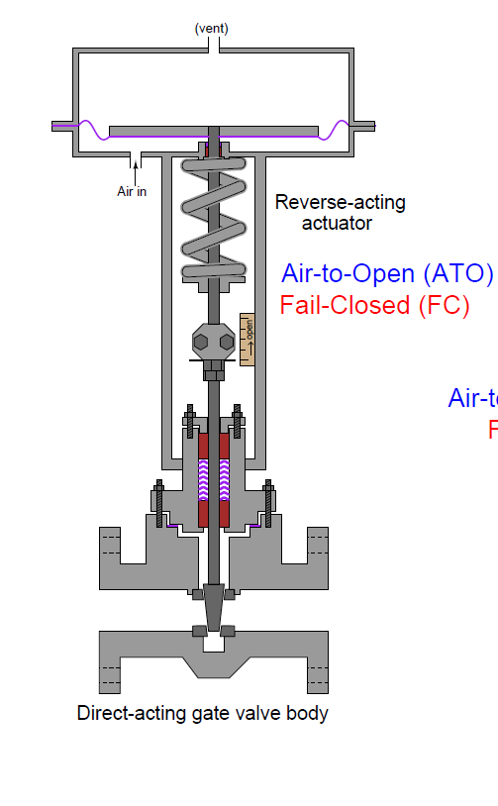
CHAPTER 7: THE FEEDBACK LOOP, WORKSHOP 1
Power source is compressed air
Valve actuator that includes the spring and flexible diaphragm
Valve body that includes the stem and the elements in contact with the fluid
Kuphalt, T. (2012) Lessons in Industrial Instrumentation, http://www.openbookproject.net/books/socratic/sinst/

Slide 29
CHAPTER 7: THE FEEDBACK LOOP, WORKSHOP 2
Recommend the correct failure position (open or closed) for each of the circled control valves.
feed
product
air
fuel

Slide 30
CHAPTER 7: THE FEEDBACK LOOP, WORKSHOP 3
Find at least one variable that could be handled by each of the five approaches; no control, manual, on/off, continuous, and emergency.
feed
product
air
fuel

Slide 31
CHAPTER 7: THE FEEDBACK LOOP, WORKSHOP 4
Select several pairs of controlled and manipulated variables for the following process.
v_{S}
F
C_{A0}
Solvent
Pure A
C_{A}
v_{A}
A → B
T
V
T_{Cout}
vc
F_{C}
T_{Cin}

Slide 32
CHAPTER 7: THE FEEDBACK LOOP
When I complete this chapter, I want to be
able to do the following.
Identify the major elements in the feedback loop
Select appropriate candidate variables to be controlled and manipulated
Evaluate the control performance data using standard measures of dynamic performance
Lot’s of improvement, but we need some more study!
Read the textbook
Review the notes, especially learning goals and workshop
Try out the self-study suggestions
Naturally, we’ll have an assignment!

Slide 33
CHAPTER 7: LEARNING RESOURCES
SITE PC-EDUCATION WEB
- Instrumentation Notes
- Interactive Learning Module (Chapter 7)
- Tutorials (Chapter 7)

Slide 34
CHAPTER 7: SUGGESTIONS FOR SELF-STUDY
1. Find a sample process in each of your previous courses and select a pair of controlled and manipulated variables
- Heat Transfer (heat exchanger)
- Fluid Mechanics (flow in a pipe
- Mass Transfer (stripper, distillation)
- Reaction Engr. (packed bed reactor)
2. Compare the measures of control performance in this chapter with the seven control objectives given in Chapter 2.
3. Describe the actions you would take if you measured a disturbance and did not want to wait for feedback corrections.

