Slide 1
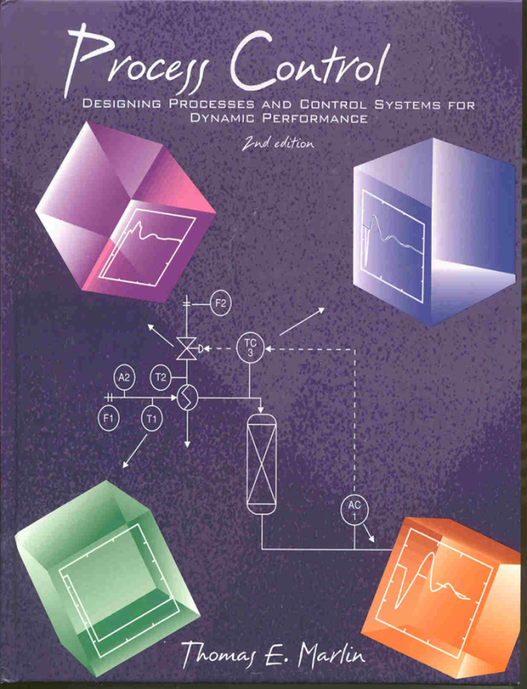
Process Control: Designing Process and Control Systems for Dynamic Performance
Chapter 6. Empirical Model Identification
Copyright © Thomas Marlin 2013
The copyright holder provides a royalty-free license for use of this material at non-profit educational institutions

Slide 2
CHAPTER 6: EMPIRICAL MODEL IDENTIFICATION
When I complete this chapter, I want to be
able to do the following.
Design and implement a good experiment
Perform the graphical calculations
Perform the statistical calculations
Combine fundamental and empirical modelling for chemical process systems

Slide 3
CHAPTER 6: EMPIRICAL MODEL IDENTIFICATION
Outline of the lesson.
Experimental design for model building
Process reaction curve (graphical)
Statistical parameter estimation
Workshop

Slide 4
CHAPTER 6: EMPIRICAL MODELLING
We have invested a lot of effort to learn fundamental
modelling. Why are we now learning
about an empirical approach?
TRUE/FALSE QUESTIONS
We have all data needed to develop a fundamental model of a complex process
We have the time to develop a fundamental model of a complex process
Experiments are easy to perform in a chemical process
We need very accurate models for control engineering
false
false
false
false

Slide 5
EMPIRICAL MODEL BUILDING PROCEDURE
A priori knowledge
Start
Not just
process
control
Experimental Design
Plant Experimentation
Determine Model Structure
Parameter Estimation
Diagnostic Evaluation
Alternative
data
Model Verification
Complete

Slide 6
EMPIRICAL MODEL BUILDING PROCEDURE
Looks very general; it is!
However, we still need to
understand the process!
Start
Experimental Design
Plant Experimentation
Determine Model Structure
Parameter Estimation
Diagnostic Evaluation
T
Model Verification
A
Complete
Changing the temperature 10 K in a ethane pyrolysis reactor is allowed.
Changing the temperature in a bio-reactor could kill micro-organisms

Slide 7
EMPIRICAL MODEL BUILDING PROCEDURE
Base case operating conditions
Definition of perturbation
Measures
Duration
Start
Experimental Design
Plant Experimentation
Determine Model Structure
Safely
Small effect on product quality
Small effect of profit
Parameter Estimation
Diagnostic Evaluation
We will stick with linear.
What order, dead time, etc?
Model Verification
Complete

Slide 8
EMPIRICAL MODEL BUILDING PROCEDURE
Start
Experimental Design
Plant Experimentation
Determine Model Structure
Gain, time constant, dead time ...
Parameter Estimation
Does the model fit the data used to evaluate the parameters?
Diagnostic Evaluation
Model Verification
Does the model fit a new set of data not used in parameter estimation.
Complete

Slide 9
EMPIRICAL MODEL BUILDING PROCEDURE
Start
Experimental Design
What is our goal?
We seek models good enough for control design, controller tuning, and process design.
How do we know?
We’ll have to trust the book and instructor for now. But, we will check often in the future!
Plant Experimentation
Determine Model Structure
Parameter Estimation
Diagnostic Evaluation
Model Verification
Complete

Slide 10
EMPIRICAL MODEL BUILDING PROCEDURE
Process reaction curve - The simplest and most often used method. Gives nice visual interpretation as well.
1. Start at steady state
2. Single step to input
3. Collect data until steady state
4. Perform calculations
T

Slide 11
EMPIRICAL MODEL BUILDING PROCEDURE
Process reaction curve - Method I
S = maximum slope
Δ
θ
δ
Data is plotted in deviation variables

Slide 12
EMPIRICAL MODEL BUILDING PROCEDURE
Process reaction curve - Method II
0.63Δ
Δ
0.28Δ
δ
t_{28%}
t_{63%}
Data is plotted in deviation variables

Slide 13
Let’s get get out the calculator
and practice with this
experimental data.
55
51
47
input variable, % open
output variable, degrees C
43
55
39
45
0
10
20
30
40
time

Slide 14
EMPIRICAL MODEL BUILDING PROCEDURE
Process reaction curve - Methods I and II
The same experiment in either method!
Method I
Developed first
Prone to errors because of evaluation of maximum slope
Method II
Developed in 1960’s
Simple calculations
Recommended

Slide 15
EMPIRICAL MODEL BUILDING PROCEDURE
Process reaction curve
Start
Experimental Design
Plant Experimentation
Determine Model Structure
Parameter Estimation
Diagnostic Evaluation
Model Verification
Is this a well designed
experiment?
Complete

Slide 16
EMPIRICAL MODEL BUILDING PROCEDURE
Process reaction curve
Start
Experimental Design
Plant Experimentation
Determine Model Structure
Parameter Estimation
Diagnostic Evaluation
Input should be close to a perfect step; this was basis of equations. If not, cannot use data for process reaction curve.
Model Verification
Complete

Slide 17
EMPIRICAL MODEL BUILDING PROCEDURE
Process reaction curve
Start
Experimental Design
Plant Experimentation
Determine Model Structure
Parameter Estimation
Diagnostic Evaluation
Model Verification
Should we use this data?
Complete

Slide 18
EMPIRICAL MODEL BUILDING PROCEDURE
Process reaction curve
Start
Experimental Design
Plant Experimentation
Determine Model Structure
Parameter Estimation
Diagnostic Evaluation
The output must be “moved” enough. Rule of thumb:
Signal/noise > 5
Model Verification
Complete

Slide 19
EMPIRICAL MODEL BUILDING PROCEDURE
Process reaction curve
Start
Experimental Design
Plant Experimentation
Determine Model Structure
Parameter Estimation
Diagnostic Evaluation
Model Verification
Should we use this data?
Complete

Slide 20
EMPIRICAL MODEL BUILDING PROCEDURE
Process reaction curve
Output did not return close to the initial value, although input returned to initial value
Start
Experimental Design
Plant Experimentation
Determine Model Structure
Parameter Estimation
Diagnostic Evaluation
Model Verification
Complete
This is a good experimental design; it checks for disturbances

Slide 21
EMPIRICAL MODEL BUILDING PROCEDURE
Process reaction curve
Start
Experimental Design
Plot measured vs predicted
Plant Experimentation
measured
Determine Model Structure
Parameter Estimation
Diagnostic Evaluation
predicted
Model Verification
Complete

Slide 22
EMPIRICAL MODEL BUILDING PROCEDURE
Statistical method
Provides much more general approach that
is not restricted to
step input
first order with dead time model
single experiment
“large” perturbation
attaining steady-state at end of experiment
Requires
more complex calculations

Slide 23
EMPIRICAL MODEL BUILDING PROCEDURE
Statistical method
The basic idea is to formulate the model so that regression can be used to evaluate the parameters.
We will do this for a first order plus dead time model, although the method is much more general.
How do we do this for the model below?

Slide 24
EMPIRICAL MODEL BUILDING PROCEDURE
Statistical method
We have discrete measurements, so let’s express the model as a difference equation, with the next prediction based on current and past measurements.

Slide 25
EMPIRICAL MODEL BUILDING PROCEDURE
Now, we can solve a standard regression problem to minimize the sum of squares of deviation between prediction and measurements. For a first-order model with dead time:
We evaluate the minimum by setting the partial derivatives w.r.t. parameters a and b to zero..

Slide 26
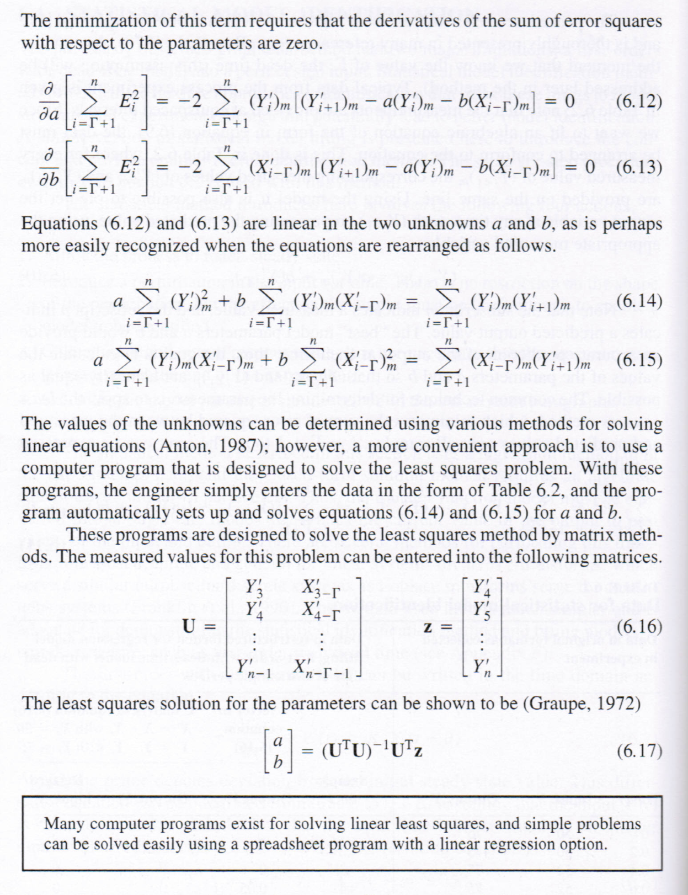
EMPIRICAL MODEL BUILDING PROCEDURE
The model parameters are evaluated at numerous values of the dead time, Γ = θ/Δt, and the result giving the lowest sum of error squared is taken as the best estimate of all parameters.
Always compare with data.

Slide 27
EMPIRICAL MODEL BUILDING PROCEDURE
Predicted vs. Measured using the statistical method
Start
Experimental Design
Plant Experimentation
Determine Model Structure
Parameter Estimation
Diagnostic Evaluation
Model Verification
Complete

Slide 28
EMPIRICAL MODEL BUILDING PROCEDURE
Statistical method
Start
Random?
Experimental Design
Plant Experimentation
Determine Model Structure
Parameter Estimation
Diagnostic Evaluation
Model Verification
Complete
Plotted for every measurement (sample)

Slide 29
EMPIRICAL MODEL BUILDING PROCEDURE
We performed a process reaction curve for the isothermal CSTR with first order reaction. The dynamic parameters are
F
C_{A0}
C_{A}
V
Recently, we changed the feed flow rate by -40% and reached a new steady-state. What are the C_{A0}→C_{A} dynamics now?

Slide 30
EMPIRICAL MODEL BUILDING PROCEDURE
Match the method to the application.

Slide 31
EMPIRICAL MODEL BUILDING
How accurate are empirical models?
Linear approximations of non-linear processes
Noise and unmeasured disturbances influence data
Lack of consistency in graphical method
lack of perfect implementation of valve change
sensor errors
Let’s say that each parameter has an error
± 20%. Is that good enough for
future applications?

Slide 32
CHAPTER 6: EMPIRCAL MODELLING WORKSHOP 1
We introduced an impulse to the process at t=0. Develop and apply a graphical method to determine a dynamic model of the process.
3
2
output
1
0
0
5
10
15
20
25
30

Slide 33
CHAPTER 6: EMPIRCAL MODELLING WORKSHOP 2
State whether we can use a first order with dead time model for the following process. Explain your answer.
T
(Time in seconds)

Slide 34
CHAPTER 6: EMPIRCAL MODELLING WORKSHOP 3
We are familiar with analyzers from courses on analytical chemistry. In an industrial application, we can extract samples and transport them to a laboratory for measurement.
What equipment is required so that could we can achieve faster measurements for use in feedback control?
A

Slide 35
CHAPTER 6: EMPIRCAL MODELLING WORKSHOP 4
We are performing an experiment, changing the reflux flow and measuring the purity of the distillate. Discuss the processes that will affect the empirical dynamic model.
Pure product
Fresh feed flow is constant
Reactor
Mostly unreacted feed

Slide 36
CHAPTER 6: EMPIRICAL MODEL IDENTIFICATION
When I complete this chapter, I want to be
able to do the following.
Design and implement a good experiment
Perform the graphical calculations
Perform the statistical calculations
Combine fundamental and empirical modelling for chemical process systems
Lot’s of improvement, but we need some more study!
Read the textbook
Review the notes, especially learning goals and workshop
Try out the self-study suggestions
Naturally, we’ll have an assignment!

Slide 37
CHAPTER 6: LEARNING RESOURCES
SITE PC-EDUCATION WEB
- Instrumentation Notes
- Interactive Learning Module (Chapter 6)
- Tutorials (Chapter 6)
Software Laboratory
- S_LOOP program to simulate experimental step data, with noise if desired
Intermediate reference on statistical method
- Brosilow, C. and B. Joseph, Techniques of Model-Based Control, Prentice-Hall, Upper Saddle River, 2002 (Chapters 15 & 16).

Slide 38
CHAPTER 6: SUGGESTIONS FOR SELF-STUDY
1. Find a process reaction curve plotted in Chapters 1-5 in the textbook. Fit using a graphical method.
Discuss how the parameters would change if the experiment were repeated at a flow 1/2 the original value.
2. Estimate the range of dynamics that we expect from
a. flow in a pipe
b. heat exchangers
c. levels in reflux drums
d. distillation composition
e. distillation pressure
3. Develop an Excel spreadsheet to estimate the parameters in a first order dynamic model.

