Slide 1
Chemical Engineering 460
The Physical Side of Process Control
By T. Marlin
Learning goals
Sensor selection
+ Selection factors
+ Location
+ Physics for 4 important measured variables
Control valves, bodies and actuators
Signal transmission and digital control

Slide 2
The Mathematical side of Process Control
D(s)
G_{d}(s)
SP(s)
E(s)
MV(s)
CV(s)
+
G_{C}(s)
G_{v}(s)
G_{P}(s)
+
-
+
CV_{m}(s)
G_{S}(s)
Variables
CV(s) = controlled variable
CV_{m}(s) = measured value of CV(s)
D(s) = disturbance
E(s) = error
MV(s) = manipulated variable
SP(s) = set point
Transfer functions
G_{C}(s) = controller
G_{v}(s) = valve
G_{P}(s) = feedback process
G_{S}(s) = sensor
G_{d}(s) = disturbance process

Slide 3
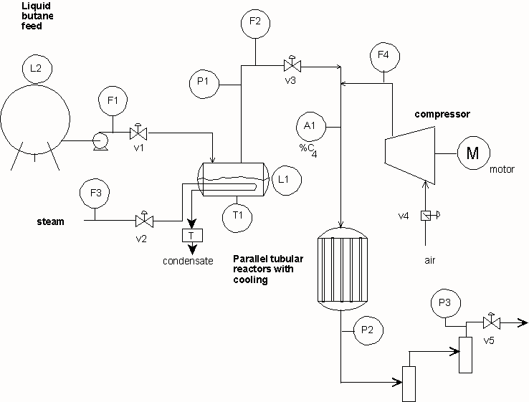
What kind of equipment decisions does an engineer make when designing a process (or experiment)?
Where should this variable be displayed?
What is the best flow sensor?
What is the best valve?
Maleic Anhydride Process

Slide 4
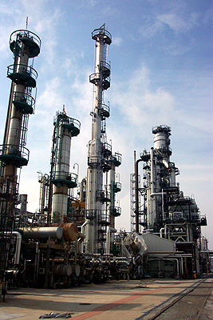
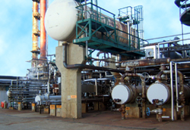
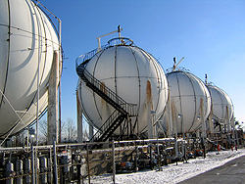
Sensors: Do you believe in automation?
Do we run around the plant to determine the measurements values?
Process pictures courtesy of Petro-Canada Products

Slide 5
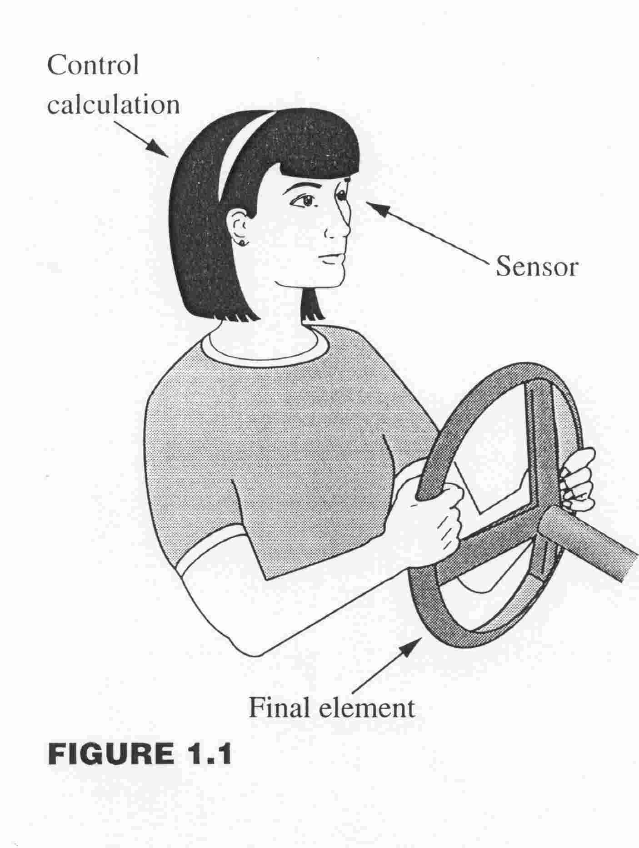
Sensors: We need them to know the process conditions
(for safety, product quality, ….)
Where are the sensors?
- Located at the process equipment
- Some displays near the equipment for use by people working on the equipment
- Some values transmitted to a centralized location for use by computers and people for display, control, and storage in history

Slide 6
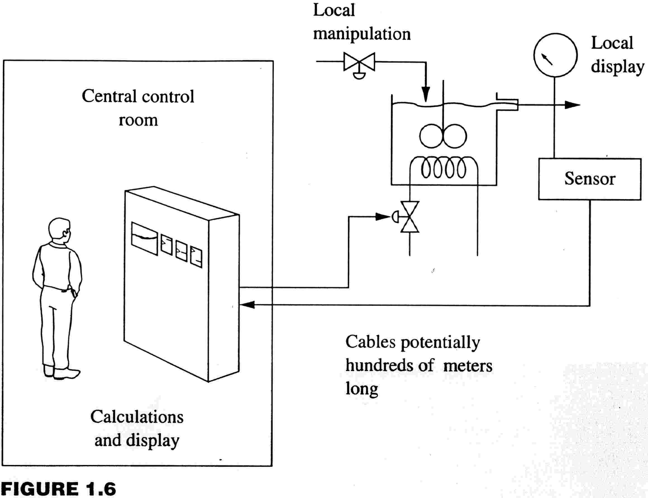
Measurements are displayed either locally or in a central control room (or both)
Sensors with local indication for technicians working on process equipment
Central control room
Transmission to central computer for displays, plot, history, and calculations used for control.

Slide 7
Sensors: What are important features for process control?
Accuracy
Repeatability
Reproducibility
Span (Range)
Reliability
Linearity
Maintenance
Consistency with process
environment
Dynamics
Safety
Cost
These are explained in the “pc-education” site.
Most engineers select sensors, do not design them.

Slide 8
Sensors: What are important features for process control?
Sensors - We must “see” key variables to apply control
Please define the following terms
Accuracy =
Reproducibility =

Slide 9
Sensors: What are important features for process control?
Sensors - We must “see” key variables to apply control
Please define the following terms
Accuracy = Degree of conformity to a standard (or true) value when a sensor is operated under specified conditions.
Reproducibility = Closeness of agreement among repeated sensor outputs for the same process variable under the same conditions, when approaching from various directions.

Slide 10
Sensors: What are important features for process control?
Discuss the accuracy and reproducibility in these cases
A
B
C
D

Slide 11
Sensors: What are important features for process control?
Every sensor has a “zero” and “span” that defines the range over which the sensor measures the process variable. Generally, the larger the span, the lower the accuracy.
What is the correct span for
T9 (for control)
T10 (for start up monitoring)
F2

Slide 12
Some variables that are measured in nearly all processes. What are they?
The four basic sensors
level
flow
temperature
pressure
BARTEK
Maleic Anhydride Process

Slide 13
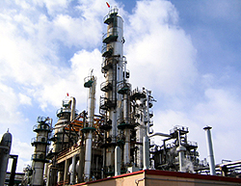
Sensors: Is accuracy in flow measurement important?
Petro-Canada Refinery
Petroleum refinery processing 100,000 barrels/day of crude oil: A +0.50% error in flow measurement represents about*
~19 million $/year extra cost to purchaser!
Add a strong base to neutralize (pH=7) a strong acid: a +0.50% error in the base flow represents
A pH of about 10-11 !
* Based on $100/Bl crude price

Slide 14
Sensors: How do we measure fluid flow?
This control system requires a flow measurement. Let’s consider a situation in which the liquid is a “clean fluid” with turbulent flow through the pipe.
FC
liquid
cooling

Slide 15
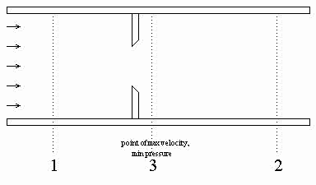
Sensors: How do we measure fluid flow?
The most frequently used flow sensor is the orifice meter. What is the basic principle for this sensor?
FC
liquid
How can we use this behavior to measure flow?
cooling
Velocity increases; Bernoulli says that pressure decreases

Slide 16
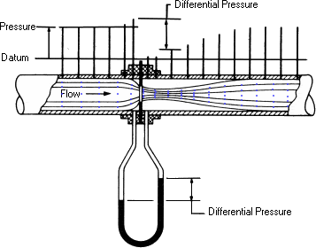
Sensors: Principles of the orifice meter
Nice visual display of concept.
In practice, pressure difference is measured by a reliable and electronic sensor
= ΔP_{orifice}
From: Superior Products, Inc. http://www.orificeplates.com/

Slide 17



Relate the pressure drop to the flow rate
v = velocity
F = volumetric flow rate
f = frictional losses
= density
A = cross sectional area
Bernoulli’s eqn.
General meter eqn.
Installed orifice meter
(requires density measurement)
ρ₀ = aver. density
C₀ = constant for specific meter
Installed orifice meter
(assuming constant density)
Most common flow calculation, does not require density measurement

Slide 18
Sensors: Principles of the orifice meter
When an orifice meter is used, the calculations in yellow are performed.
Typically, they are not shown on a process drawing.
“Measured value” to flow controller
Multiply signal by meter constant K
K
FC
Take square root of measurement
√
Measure pressure difference
ΔP
liquid
cooling

Slide 19
Sensors: Are there limitations to orifices?
Typical accuracy is 2-4% of span. Is this true for all values of the flow rate?
v = velocity
F = volumetric flow rate
f = frictional losses
= density
A = cross sectional area
General meter eqn.
C_{meter}
We assume that the meter coefficient is constant. This assumption is acceptable only for higher values of flow, typically 25-100% of the maximum for an orifice
Reynolds number

Slide 20
Sensors: Is there a downside to orifices?
What is a key disadvantage of the orifice meter?
ΔP_{loss} = P₁ – P₂
Pressure loss!
When cost of pressure increase (P₁) by pumping or compression is high, we want to avoid the “non-recoverable” pressure loss.
pressure
ΔP_{orifice}= P₁ – P₃
Non-recoverable pressure drop
Distance →

Slide 21
Sensors: Is there a downside to orifices?
What can occur after the orifice plate that can make the measurement useless?
Cavitation!
The liquid could be near its bubble point, so that a decrease in pressure could lead to partial vaporization. This results in extreme noise in the pressure difference.
pressure
ΔP_{orifice}= P₁ – P₃
Distance →

Slide 22
Sensors: Factors in selecting an orifice meter
Accuracy | Typically, 2-4% inaccuracy Strongly affected by density changes from base case
Repeatability | Much better than accuracy
Reproducibility | Much better than accuracy
Span | Accuracy limited to 25-100% of span Span achieved by selecting diameter of orifice and ΔP_{orifice}
Reliability | Very reliable, no moving parts
Linearity | Must take square root to achieve linear relationship between measured signal and flow rate
Maintenance | Very low
Process Environment | Turbulent, Single liquid phase, no slurries (plugging) Straight run of pipe needed (D= pipe diameter), 10-20D upstream, 5-8D downstream
Dynamics | Nearly instantaneous
Safety | Very safe
Cost | Low equipment (capital) cost, large number of suppliers High operating cost (non-recoverable pressure loss)

Slide 23
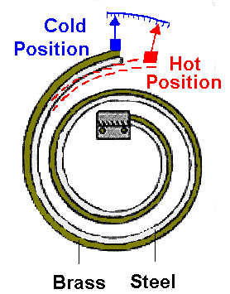
Temperature: Local display is possible using thermometers and bimetallic sensors
http://www.cyberphysics.co.uk/topics/heat/thermometer.htm
Citation: Omega WWW site
No external power required and low cost.
Not generally used for transmission to a controller or remote display.

Slide 24
Thermocouples: Specific metal pairs are used in practice for selected accuracies and ranges of temperature
T2
T1
“Seebeck effect: When two wires composed of dissimilar metals are joined at both ends and the ends are at different temperatures, there is a continuous current which flows in the thermoelectric circuit. Thomas Seebeck made this discovery in 1821.
If this circuit is broken at the center, the net open circuit voltage (the Seebeck voltage) is a function of the junction temperatures and the composition of the two metals.”
Citation: Omega WWW site

Slide 25
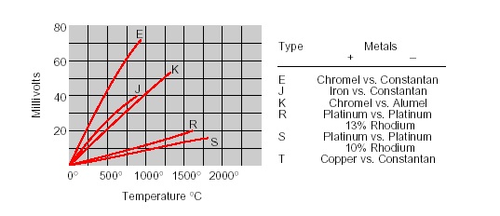
Thermocouples: Specific metal pairs are used in practice for selected accuracies and ranges of temperature
We seek a nearly linear relationship between voltage and temperature, and we correct the mild non-linearity. Accuracy is not good, ± 2 °C.
Voltage vs Temperature
One junction assumed to be at 0 °C
Citation: Omega WWW site

Slide 26
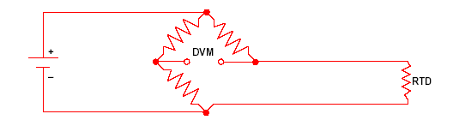
RTDs: Electrical resistance depends on temperature, with higher temperature having higher resistance
T1
Generally higher accuracy (± 0.1 C), less physically robust and more expensive than thermocouples.
The relationship is nearly linear but still requires a correction for high accuracy.
Citation: Omega WWW site

Slide 27
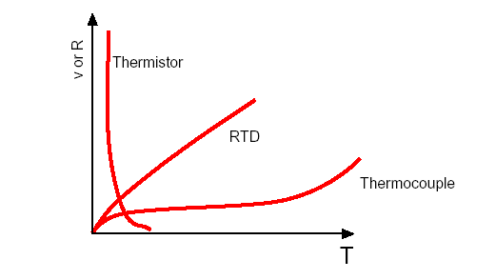
Thermisters: Electrical resistance depends on temperature, with lower temperature having higher resistance
Provides higher accuracy than other two devices, much less physically robust, and can lose accuracy if operated outside of recommended range.
Generally used in temperature range from below 0 C to a few hundred C.
Citation: Omega WWW site

Slide 28
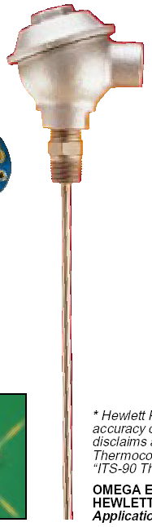
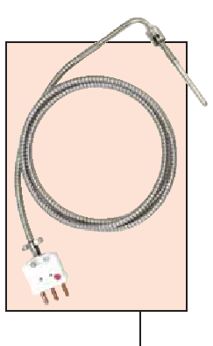
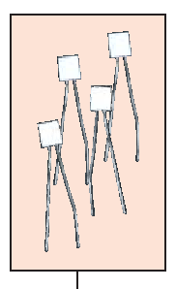
Thermocouples, RTDs, and Thermisters: Generally in shield to protect sensor from the process environment and to protect the process materials from the sensor.
Thermowell
Citation: Omega WWW site

Slide 29
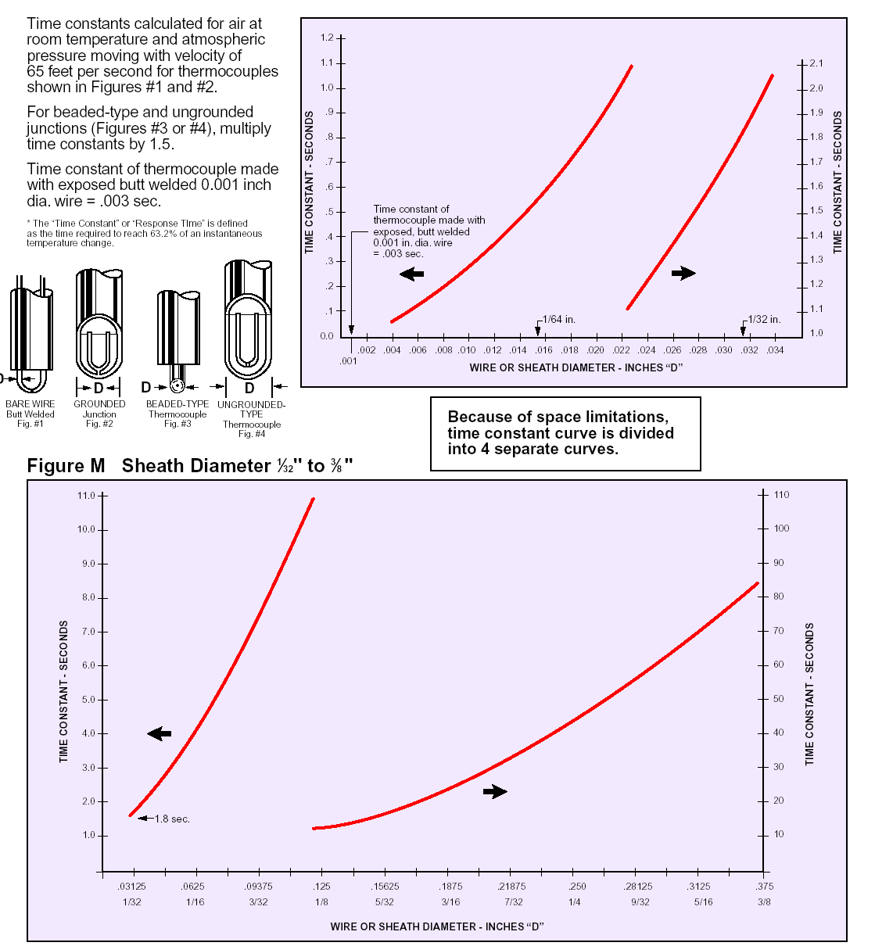
Thermocouples, RTDs, and Thermisters
I know the meaning of “time constant”!
Careful, shields slow the temperature measuring device!
But, we definitely need shielding to protect sensor from process and/or process fluid from the sensor.
Time constant (sec.)
Sheath diameter
Citation: Omega WWW site

Slide 30
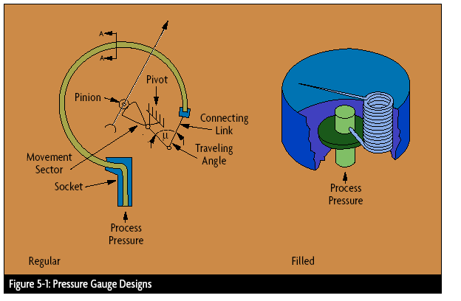
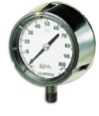
Pressure affects chemical reactions, separations, and many other key process performance indicators. It should not exceed the strength of the vessel!
Bourdon Tube for local display of pressure
No external power and low cost
Citation: Omega WWW site

Slide 31
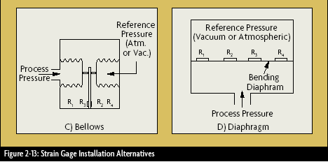
Pressure using Strain Gauge: A change in strain affects the electrical resistance of a metal.
Appropriate for a range of pressures from 3” water to rather high (200,000 psi, 1400 MPa)
Citation: Omega WWW site

Slide 32
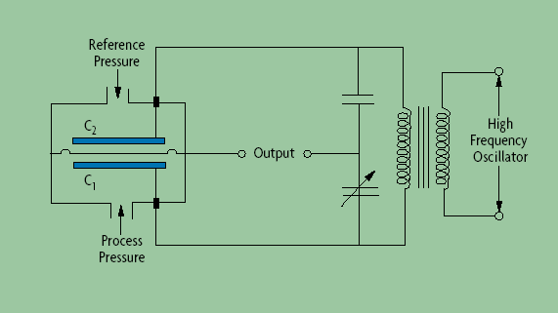
Pressure using Capacitance: A change in pressure deflects the separating diaphragm, which affects the capacitance.
Appropriate for a wide range of pressures from very low (vacuum, 0.001 in H₂0!) to moderately high (10,000 psi, 70 MPa)
Citation: Omega WWW site

Slide 33
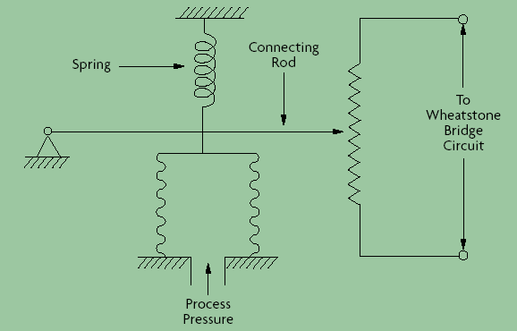
Pressure using Potentiametric: Converts the deflection of the arm to a change in resistance.
Appropriate for a range of pressures from 5 to 10,000 psi. They are not as accurate as other sensors but are less expensive.
Citation: Omega WWW site

Slide 34
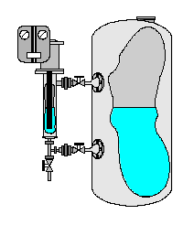
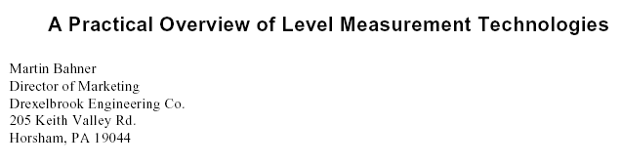
Level : Local display is useful.
A sight glass gives a local indication of the level.
No power is required and cost is very low.
Any disadvantages for a sight glass indication?

Slide 35
Level using displacement: Sensors measure the weight of an object suspended in the liquid.
Measure the force to hold up the object.
How?
A stilling chamber reduces the effects of flows and agitation on the measurement.

Slide 36
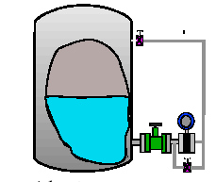
Level using head: Sensors measure the pressure difference to infer level.
Measure the pressure difference between the to “taps”, i.e., openings in the vessel.
How?
Why isn’t the lower tap at the bottom of the vessel?

Slide 37
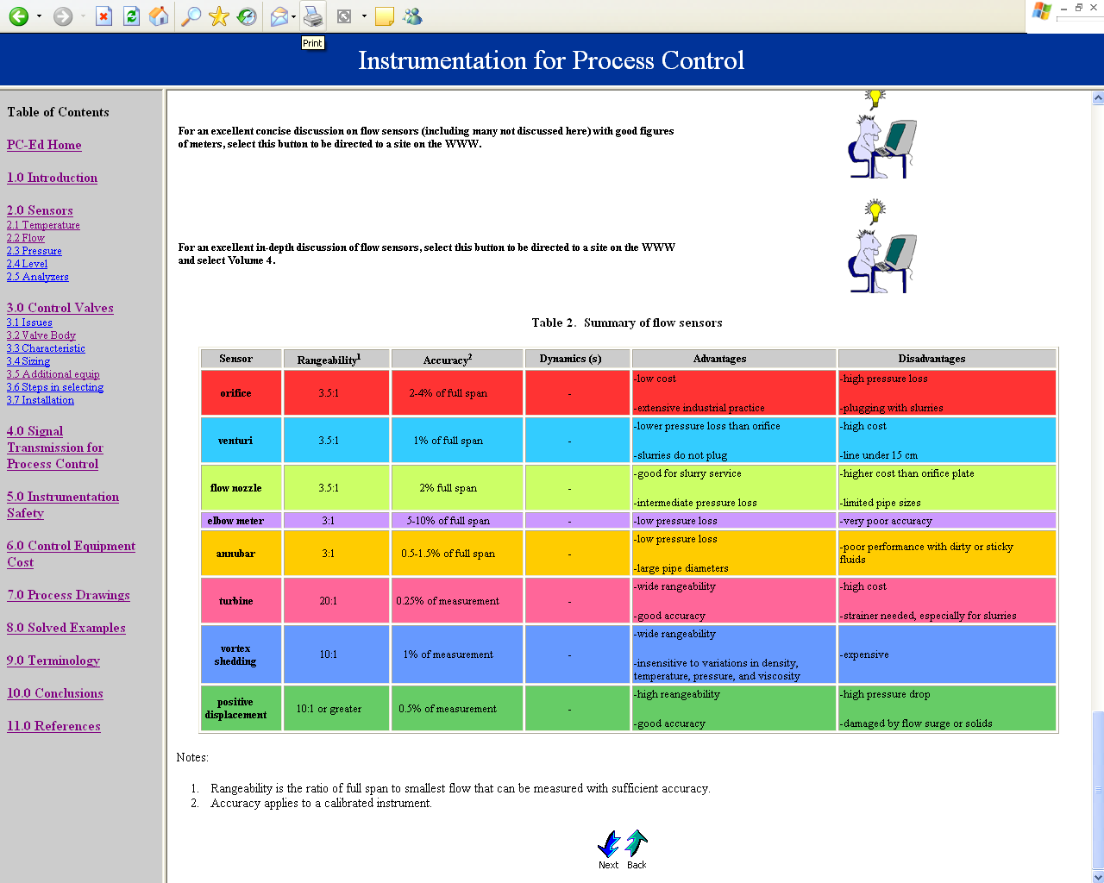
For details on many sensors, including principles and
advantages and disadvantages, we can
access the pc-education WEB site!
http://www.pc-education.mcmaster.ca/Instrumentation/go_inst.htm

Slide 38
Adjusting flow rates: Do you believe in automation?
Do we run around the plant to adjust the flows when required?
Process pictures courtesy of Petro-Canada Products

Slide 39
Adjusting flows: Do you believe in automation?
Central control room
Overview of entire process
Make immediate adjustment anywhere
Safe location
History of past operation
Process pictures courtesy of Petro-Canada Products

Slide 40
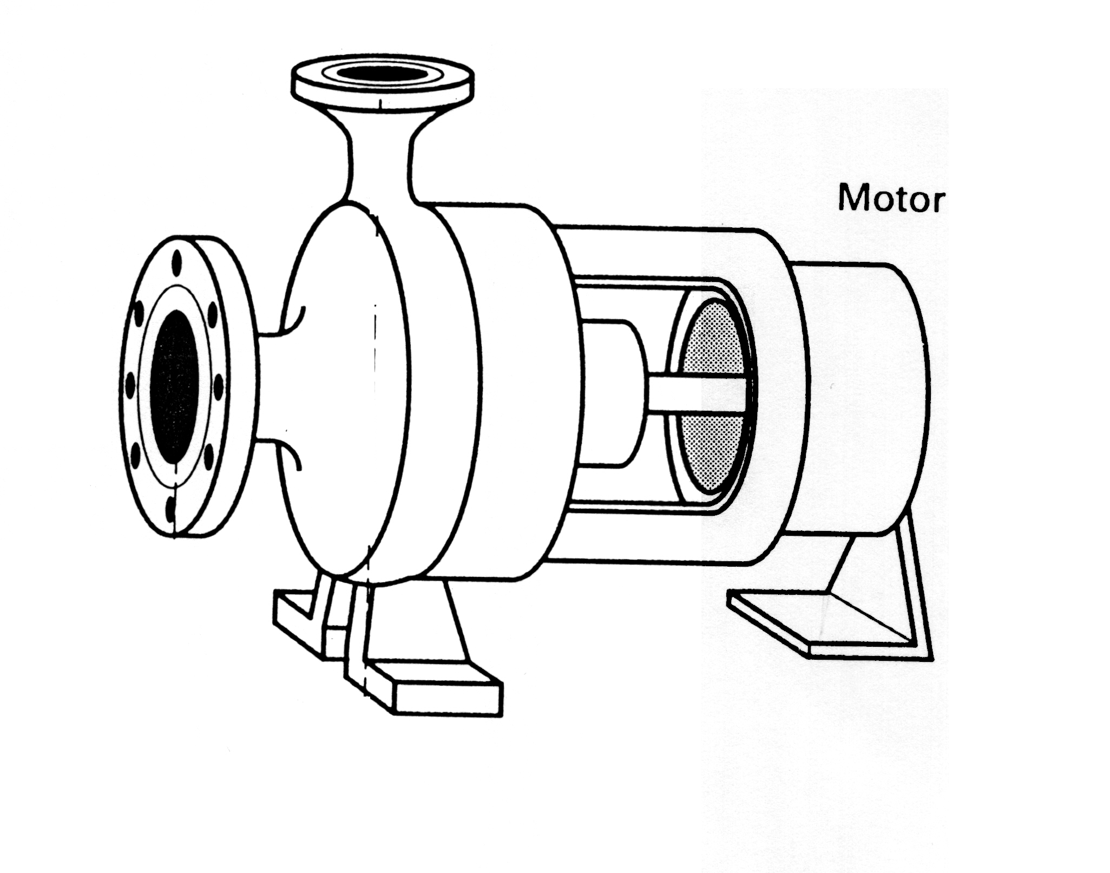
Flow principles: Let’s look at a typical centrifugal pump
For an animation and description of the basics of a centrifugal pump, follow the hyperlink below.
Flow = F2 (m³/min)
Pressure = P2 (kPa)
Outlet
http://www.pumpworld.com/centrif1.htm
Inlet (suction)
Flow = F1 (m³/min)
Pressure = P1 (kPa)
Motor (work)
Pump

Slide 41
Flow principles: Let’s look at a typical centrifugal pump
What goes here?
=
>
<
F1 F2
P1 P2
Flow = F2 (m³/min)
Pressure = P2 (kPa)
Outlet
Inlet (suction)
Flow = F1 (m³/min)
Pressure = P1 (kPa)
Motor (work)
Pump

Slide 42
Flow principles: Let’s look at a typical centrifugal pump
What goes here?
=
>
<
F1 = F2
P1 < P2
Flow = F2 (m³/min)
Pressure = P2 (kPa)
Outlet
Inlet (suction)
Flow = F1 (m³/min)
Pressure = P1 (kPa)
Motor (work)
Pump

Slide 43
Principles of flow through a closed conduit
Constant speed centrifugal pump
P₀ = constant
liquid
We turn on the pump motor and let the system reach steady state. How do we calculate the flow rate that would occur?
Hint: Use the plot at the left.
Head at pump outlet
Flow rate

Slide 44
Principles of flow through a closed conduit
Constant speed centrifugal pump
P₀ = constant
liquid
Pump head curve
Steady-state flow rate at given conditions
Head at pump outlet
“system” curve, pressure drop vs flow rate
Flow rate
What if we want a different flow rate in the system?

Slide 45
Principles of flow through a closed conduit
Constant speed centrifugal pump
liquid
To achieve the desired flow, we vary the system resistance by changing the pressure drop across a valve .
We adjust the
valve opening
to achieve
the desired
flow rate!
Head at outlet of pump
Flow rate

Slide 46
Valves: How to we “actuate” or open and close valves?
(fully open or closed)
We will concentrate on control valves used to “modulate” the flow, i.e., achieve value of flow between maximum (fully opened) and minimum (fully closed)

Slide 47
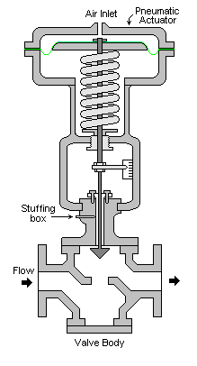
Valves: What are the two main features?
The actuator provides the ability to change the flow resistance, i.e., the size of the opening for flow.
The most common actuator is a pneumatic diaphragm.
The body of the valve defines the flow path and is selected to achieve the desired fluid flow behavior.
Beychok (2012) released through creative commons, http://en.citizendium.org/wiki/File:Control_Valve.png

Slide 48
Valves: What are important features for process control?
Capacity
Range
Failure position
Gain
Pressure drop
Precision
Linearity
Consistency with process
environment
Dynamics
Cost
These are explained in the “pc-education” site.
Most engineers select valves, do not design them.

Slide 49
Valves: What are important features for process control?
Capacity =
Range =
Pressure drop =

Slide 50
Valves: What are important features for process control?
Capacity = The maximum flow rate through the flow system (pipes, valves, and process equipment) must meet operating requirements.
Range = The range indicates the extent of flow values that the valve can reliably regulate; very small and large flows cannot be maintained at desired values. Range is reported as ratio of largest to smallest.
Pressure drop = The purpose of the valve is to create a variable pressure drop in the flow system. However, a large (non-recoverable) pressure drop wastes energy.

Slide 51
Valves: All valves have a defined position when air pressure equals zero; how do we chose?
Air pressure applies a force to depress the diaphragm; therefore, the failure position is the highest diaphragm position. This moves the stem up; given the valve body design, the failure position is fail open (air-to-close).
Process safety!
Process safety!
What is the failure position for this valve?
How can we change the failure position (to fail closed) for this valve?
Fail open
Beychok (2012) released through creative commons, http://en.citizendium.org/wiki/File:Control_Valve.png

Slide 52
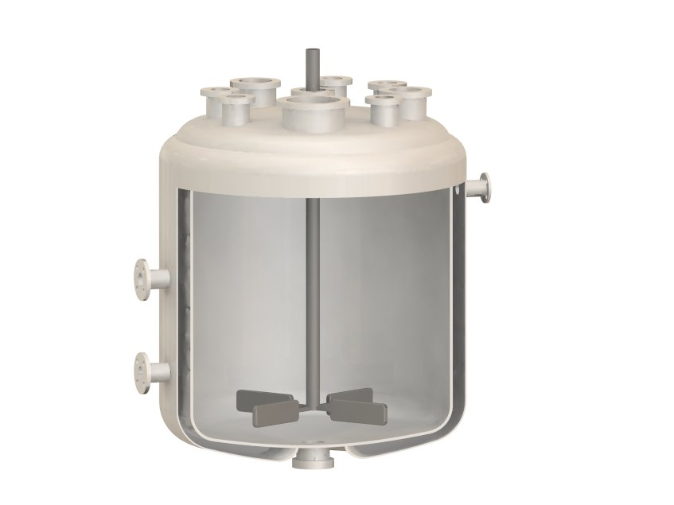

Chemical reactor with cooling jacket
What is the correct failure position for the cooling fluid flow valve?
Cooling fluid out
Fail open to maximize cooling
Cooling fluid in
Wikiwand http://www.wikiwand.com/en/Chemical_reactor

Slide 53
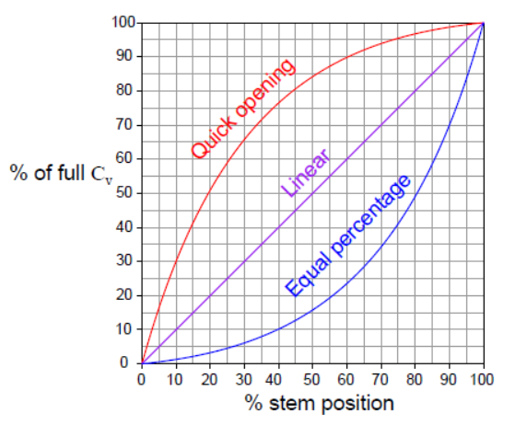
The engineer selects the relationship between the percent opening and the flow through the valve
Choice is based on the process, with the goal of a “linear closed-loop system.
If the process gain is non-linear, we can select the “opposite” non-linearity for the valve C_{v}

Slide 54
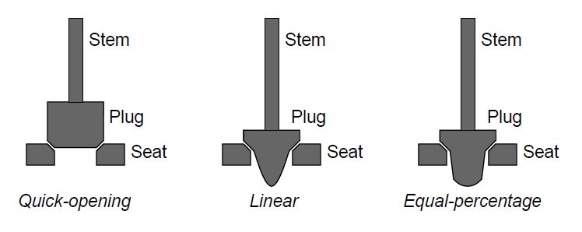
The desired valve characteristic is achieved through the design of the valve seat and plug.
These examples are for a globe valve body

Slide 55
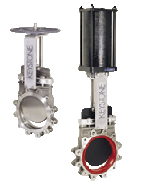
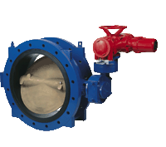
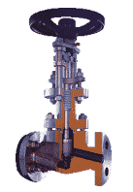
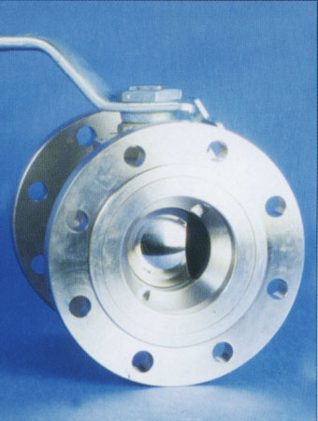
Valve Body: We match the valve body to the fluid type and process needs?
Butterfly
Gate
Globe
http://www.tycoflowcontrol-pc.com/products_results.asp?Selection=Double+Flanged+Butterfly+Valve&m=1
Ball
Fluids: water, nitrogen, tree pulp and water, blood, sewage, food products (yogurt), highly pure pharma products, hazards (isocyanates), polymer melts, and just about anything else that flows!
http://images.google.ca/imgres?imgurl=http://www.ckit.co.za/Secure/Catalogues/mac%2520steel/fluid%2520control/MS%2520image%252024%2520-2520thumb.jpg&imgrefurl=http://www.ckit.co.za/Secure/Catalogues/Mac%2520steel/Fluid%2520control/MS%2520fluid%2520control.htm&h=150&w=113&sz=5&hl=en&start=83&tbnid=3ZKYixrpLJ5wTM:&tbnh=96&tbnw=72&prev=/images%3Fq%3Dball%2Bvalves,%2Bprocess%2Bcontrol%26start%3D80%26ndsp%3D20%26svnum%3D10%26hl%3Den%26sa%3DN

Slide 56
Valve Body: We match the valve body to the fluid type and process needs?
Butterfly
Gate
Globe
http://www.tycoflowcontrol-pc.com/products_results.asp?Selection=Double+Flanged+Butterfly+Valve&m=1
Question: Would a globe valve be a good choice for affecting yogurt flow?
Ball
Answer: No! The globe valve has many small “dead ends” where food could collect and not be removed by cleaning fluid.
http://images.google.ca/imgres?imgurl=http://www.ckit.co.za/Secure/Catalogues/mac%2520steel/fluid%2520control/MS%2520image%252024%2520-2520thumb.jpg&imgrefurl=http://www.ckit.co.za/Secure/Catalogues/Mac%2520steel/Fluid%2520control/MS%2520fluid%2520control.htm&h=150&w=113&sz=5&hl=en&start=83&tbnid=3ZKYixrpLJ5wTM:&tbnh=96&tbnw=72&prev=/images%3Fq%3Dball%2Bvalves,%2Bprocess%2Bcontrol%26start%3D80%26ndsp%3D20%26svnum%3D10%26hl%3Den%26sa%3DN

Slide 57
Valve Body: We match the valve body to the fluid type and process needs?
Butterfly
Gate
Globe
http://www.tycoflowcontrol-pc.com/products_results.asp?Selection=Double+Flanged+Butterfly+Valve&m=1
Question: Would a butterfly valve be a good choice when tight closing is required?
Ball
Answer: No! The manufacturing would almost never provide a perfect fit.
http://images.google.ca/imgres?imgurl=http://www.ckit.co.za/Secure/Catalogues/mac%2520steel/fluid%2520control/MS%2520image%252024%2520-2520thumb.jpg&imgrefurl=http://www.ckit.co.za/Secure/Catalogues/Mac%2520steel/Fluid%2520control/MS%2520fluid%2520control.htm&h=150&w=113&sz=5&hl=en&start=83&tbnid=3ZKYixrpLJ5wTM:&tbnh=96&tbnw=72&prev=/images%3Fq%3Dball%2Bvalves,%2Bprocess%2Bcontrol%26start%3D80%26ndsp%3D20%26svnum%3D10%26hl%3Den%26sa%3DN

Slide 58
Valve Body: We match the valve body to the fluid type and process needs?
Butterfly
Gate
Globe
http://www.tycoflowcontrol-pc.com/products_results.asp?Selection=Double+Flanged+Butterfly+Valve&m=1
Question: Would a ball valve be a good choice for low non-recoverable pressure drop?
Ball
Answer: No! The flow follows a tortuous path and experiences extreme turbulence.
http://images.google.ca/imgres?imgurl=http://www.ckit.co.za/Secure/Catalogues/mac%2520steel/fluid%2520control/MS%2520image%252024%2520-2520thumb.jpg&imgrefurl=http://www.ckit.co.za/Secure/Catalogues/Mac%2520steel/Fluid%2520control/MS%2520fluid%2520control.htm&h=150&w=113&sz=5&hl=en&start=83&tbnid=3ZKYixrpLJ5wTM:&tbnh=96&tbnw=72&prev=/images%3Fq%3Dball%2Bvalves,%2Bprocess%2Bcontrol%26start%3D80%26ndsp%3D20%26svnum%3D10%26hl%3Den%26sa%3DN

Slide 59
Valve Body: We match the valve body to the fluid type and process needs?
Butterfly
Gate
Globe
http://www.tycoflowcontrol-pc.com/products_results.asp?Selection=Double+Flanged+Butterfly+Valve&m=1
Ball
Typical purchase cost ~ $2000-3000 for a 4”pipe globe or ball valve with actuator (installation extra)
http://images.google.ca/imgres?imgurl=http://www.ckit.co.za/Secure/Catalogues/mac%2520steel/fluid%2520control/MS%2520image%252024%2520-2520thumb.jpg&imgrefurl=http://www.ckit.co.za/Secure/Catalogues/Mac%2520steel/Fluid%2520control/MS%2520fluid%2520control.htm&h=150&w=113&sz=5&hl=en&start=83&tbnid=3ZKYixrpLJ5wTM:&tbnh=96&tbnw=72&prev=/images%3Fq%3Dball%2Bvalves,%2Bprocess%2Bcontrol%26start%3D80%26ndsp%3D20%26svnum%3D10%26hl%3Den%26sa%3DN

Slide 60
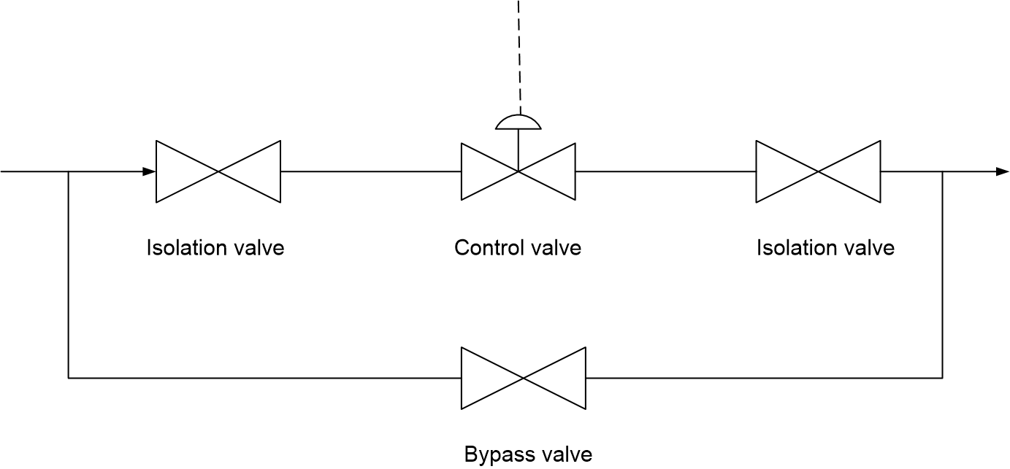
Valve Maintenance: How do engineers provide for maintenance without plant shutdown?

Slide 61
What kind of equipment decisions does an engineer make when designing a process (or experiment)?
Where should this variable be displayed?
What is the best flow sensor?
What is the best valve?
Maleic Anhydride Process

Slide 62
What kind of equipment decisions does an engineer make when designing a process (or experiment)?
What is the best flow sensor?
The cost of compression is high. Therefore, a sensor with low non-recoverable pressure drop is best. An orifice sensor is a poor choice. What is a good choice?
A pitot tube has a very low non-recoverable pressure drop.
Maleic Anhydride Process

Slide 63
What kind of equipment decisions does an engineer make when designing a process (or experiment)?
What is the best valve?
The cost of compression is high. Therefore, a valve with low non-recoverable pressure drop is best.
A butterfly valve would be an acceptable choice.
Maleic Anhydride Process

Slide 64
What kind of equipment decisions does an engineer make when designing a process (or experiment)?
Where should this variable be displayed?
What materials are being mixed? Is there an issue with the process environment after the mixing point? Should the concentration of butane be closerly monitored? Controlled?
Maleic Anhydride Process

Slide 65
Loop Elements: Sensor → Computer → Valve
What is wrong with this picture?
Central control room
controller
No communication!

Slide 66
Loop Elements: Sensor → Computer → Valve
Why must we transmit these signals?
Transmitted to/from
Central control room
Displayed locally
Manual valves

Slide 67
Loop Elements: Sensor → Computer → Valve
Why must we transmit these signals?
Transmitted to/from
Central control room
Safety related or time critical
Used for control
Important for quality, reliability, performance
Trouble shoot and monitor longer-term behavior
Displayed locally
Manual valves

Slide 68
Loop Elements: Sensor → Computer → Valve
Why must we transmit these signals?
Transmitted to/from
Central control room
Safety related or time critical
Used for control
Important for quality, reliability, performance
Trouble shoot and monitor longer-term behavior
Displayed locally
Used for local maintenance/ operation
Not safety or time critical
Manual valves
Infrequently adjusted
Not safety or time critical

Slide 69
Loop Transmission: Why learn about it?
We need to understand the “closed-loop”
We select equipment to achieve required performance
We “trouble-shoot” problems
These are our “senses” and our “handles”
Central control room
?

Slide 70
Loop Transmission: Why learn about it?
Class workshop: What are general features that we seek for the transmission of signals from the
sensor → computer and from the computer → valve?
Central control room
Hint: We have lists of features for sensors and for valves already

Slide 71
Loop Transmission: What features do we seek?
Typically much better than sensors and valves
Accuracy and reproducibility
Noise sensitivity
Reliability
Dynamics
Distance
Interoperability
Safety
Diagnostics
Cost
Class Workshop: Explain these features

Slide 72
Loop Transmission: What features do we seek?
Dynamics: Transmission delays are “in the feedback loop”. Delays in transmission are as bad as delays in the process.
Good news: Electronic transmission is very fast compared with other elements in the loop.
Caution: Old transmission systems using air pressure (pneumatic signals) can be slow for distance over 50 meters.

Slide 73
Loop Transmission: What features do we seek?
Distance: Process plants can extend over 1000’s of meters. The transmission must be capable of these distances.
Good news: Electronic transmission via “hard wire” has a large enough range.
Caution: Pneumatic signals have limited range.
Note: Telemetry is not now widely used for process control. It is used for monitoring remote equipment (wells)

Slide 74
Loop Transmission: What features do we seek?
Interoperability
When you purchase one loop element from a company, do you want to buy all other elements from the same company for the life of the plant?
NO!
Standards are recognized so that equipment from various manufacturers can be used interchangeably. This was easy for older, analog technology.
Standards are available for digital technology.

Slide 75
Loop Transmission: Two typical designs.
Life is exciting during a revolution!
Analog transmission
Continuous electronic signal
Digital transmission
Digital numeric representation
Older technology, but widely employed and will be in use for decades
Newer technology, generally used in new facilities and when replacing analog technology

Slide 76
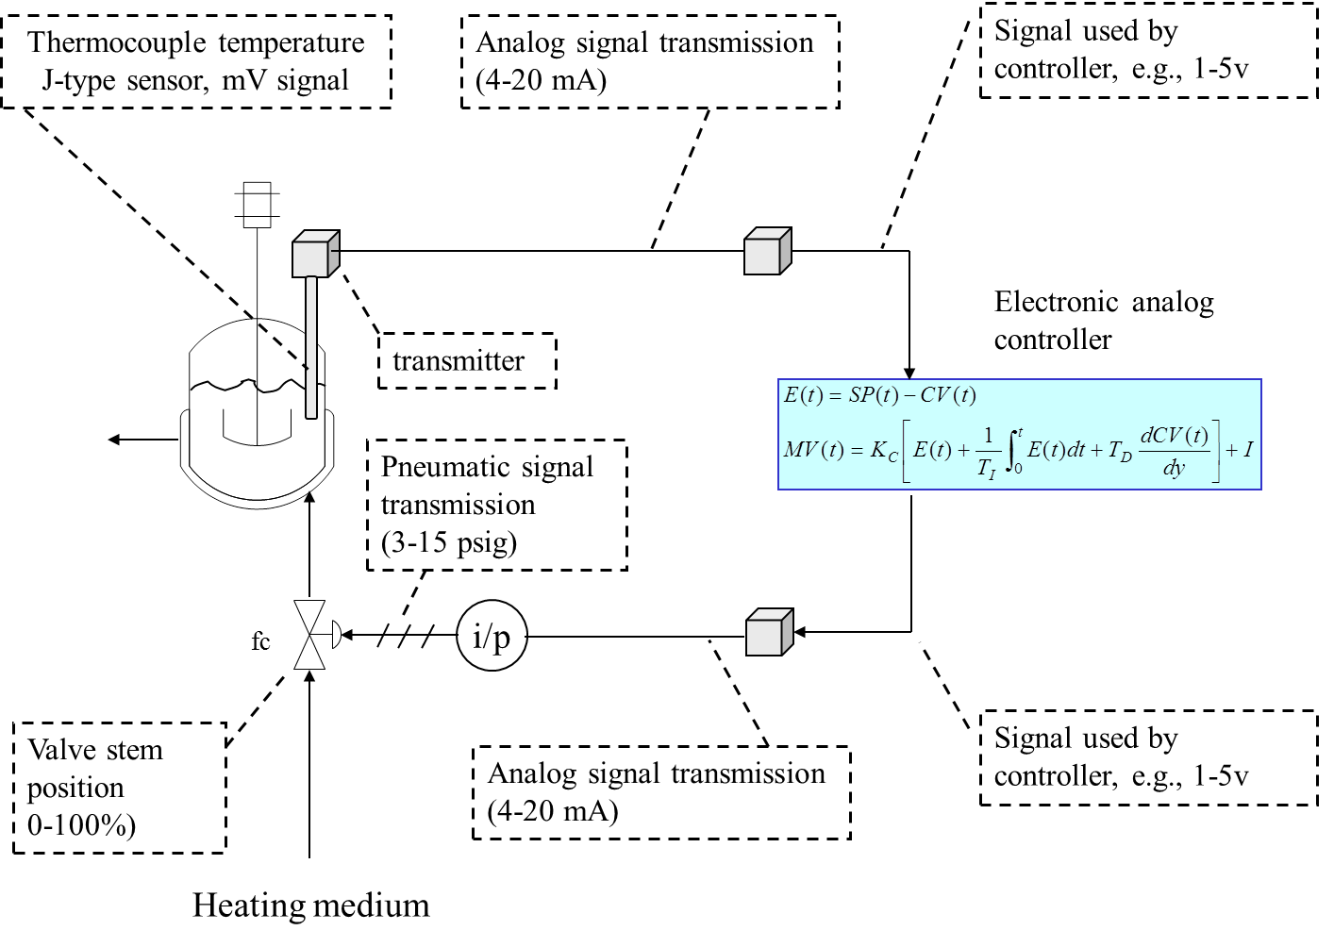
Loop Elements: A Typical Analog Loop

Slide 77
Loop Elements: A Typical Digital Loop
Thermocouple temperature sensor, mV signal
Analog signal transmission
(4-20 mA)
Analog to digital conversion
Digital number
A/D
Digital controller
transmitter
Pneumatic signal transmission
(3-15 psig)
i/p
D/A
Digital number
fc
Valve stem position
0-100%)
Analog signal transmission
(4-20 mA)
Digital to analog conversion
Heating medium

Slide 78
Loop Elements: All digital transmission
μ-Processor at every sensor and valve

Slide 79
Loop Elements: Life is exciting during a revolution!
Why have a micro-processor at every sensor and valve?
Flow Sensor
Valve

Slide 80
Loop Elements: Life is exciting during a revolution!
Why have a micro-processor at every sensor and valve?
Flow Sensor
Improve accuracy
Correct for density changes
Diagnose performance and warn when degradation begins
Calibrate quickly
Power supply error
Valve

Slide 81
Loop Elements: Life is exciting during a revolution!
Why have a micro-processor at every sensor and valve?
Flow Sensor
Improve accuracy
Correct for density changes
Diagnose performance and warn when degradation begins
Calibrate quickly
Power supply error
Valve
Diagnose performance and warn when degradation begins
Valve sticking
Air pressure low
Signal not received

Slide 82
Loop Elements: Life is exciting during a revolution!
Note that both have two-way communication for digital equipment

Slide 83
Chemical Engineering 460
The Physical Side of Process Control
By T. Marlin
Learning goals
Sensor selection
+ Selection factors
+ Location
+ Physics for 4 important measured variables
Control valves, bodies and actuators
Signal transmission and digital control

Slide 84
CHAPTER 1: INTRODUCTION - WORKSHOP 3
You are selling a gas to a customer based on the volumetric flow at standard conditions. You decide to use an orifice meter to measure the flow rate.
You have learned that the gas flow density may change by
-10% from its design (expected) value. What do you do?
Orifice meter
Our
plant
Customer
compressor
valve

